Slide 1
sPHENIX status
Kin Yip
sPHENIX Director of Operations
Time Meeting
Apr. 1, 2025

Slide 2
sPHENIX Status (~cooling)
Earlier than planned, the sPHENIX Magnet was ramped (after I presented in last week’s time meeting) to its nominal operating current @16:22 ~Mar. 25;
tripped (fast-discharge) ~04:22 ~Mar. 26 due to Cryo Interlock (phase-separator pressure). It was ramped back to operating current @14:54.
We’ve had problems with the chillers next to 1008C (for electronic-cooling-water [ECW] and sPHENIX Magnet). We’ve swapped between #3 and #4 and our electronics needed to be turned off a few times.
With all the parts arriving, AC shop should be able to fix #4 for good.
Sunday ~15:50, the Magnet water temperature started to rise. C-AD water group was consulted, and one tech came to 1008C. But they couldn’t figure out the problem ⇒ I had to ramp down the Magnet ~18:26 pm.
Mon. (Mar. 31): The water group said that temperature rose was because we had used too little ECW cooling (which shares the same chiller).
We turned on the power for all racks, and the Magnet was ramped up and reached to the operating current ~16:50 pm on Mon. (Mar. 31).

Slide 3
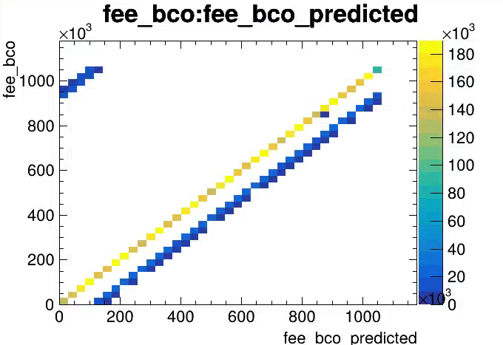
sPHENIX Status
MBD calibrations were done after a DAQ problem specifically for MBD was resolved.
TPC firmware upgrade for clock synchronization (between RHIC and sPHENIX) was implemented.
MVTX power supply had an issue which was found to be due to the AVT (Absence of Voltage Tester) in the rack. It was replaced and the issue seems resolved.
Otherwise, we’ve been taking cosmic data.

