Slide 1
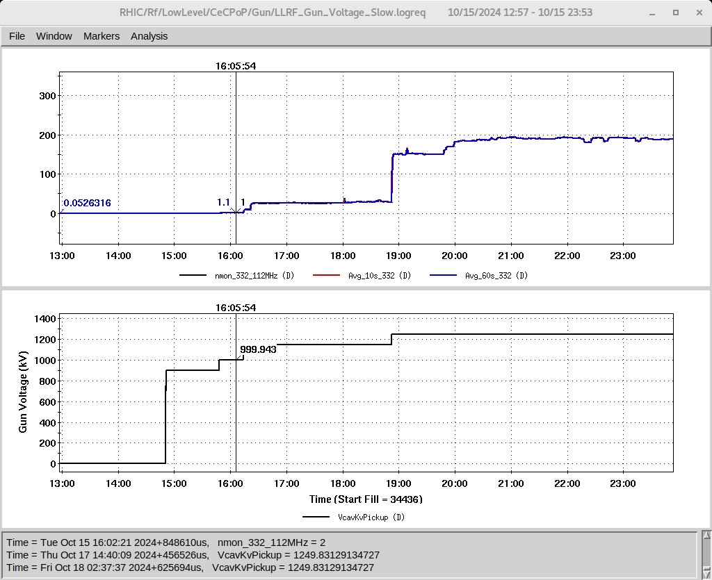
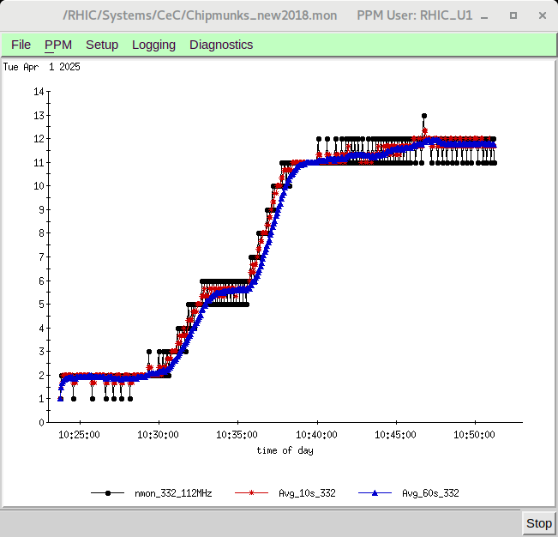
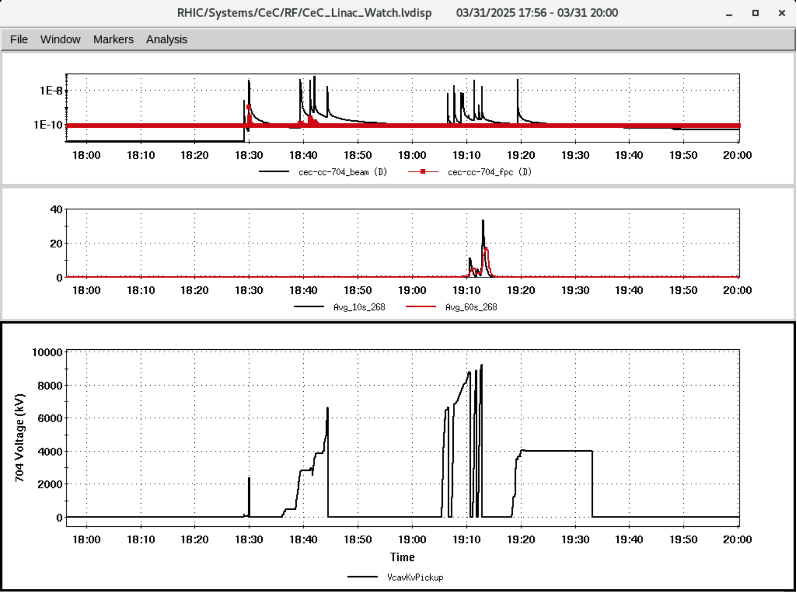
CeC status, 4/1/25
Old
New
SRFs
CeC gun was brought up and radiation level was found higher than before (at lower voltages). Might need conditioning.
5 cell cavity has vacuum bursts at lower voltages, will need conditioning.
Laser & Cathode
Will need access to IP2 to insert blank cathode for Laser alignment prior to RHIC warm up.
Na cathode development and production (with better QE uniformity) is on-going. New garage of Na cathode will be installed during warm up.
@ S. Mai and F. Severino
@ V. Litvinenko

