Slide 1
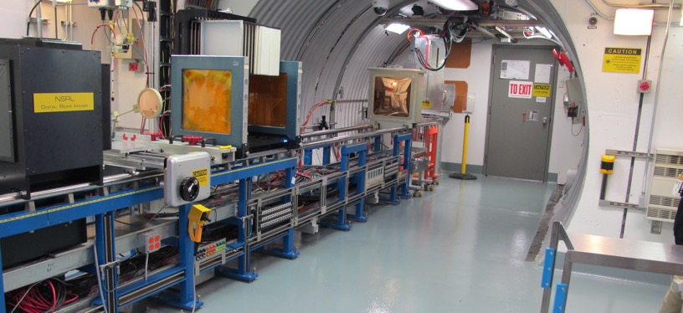
NSRL Time Meeting Report
1 April 2025
Michael Sivertz

Slide 2
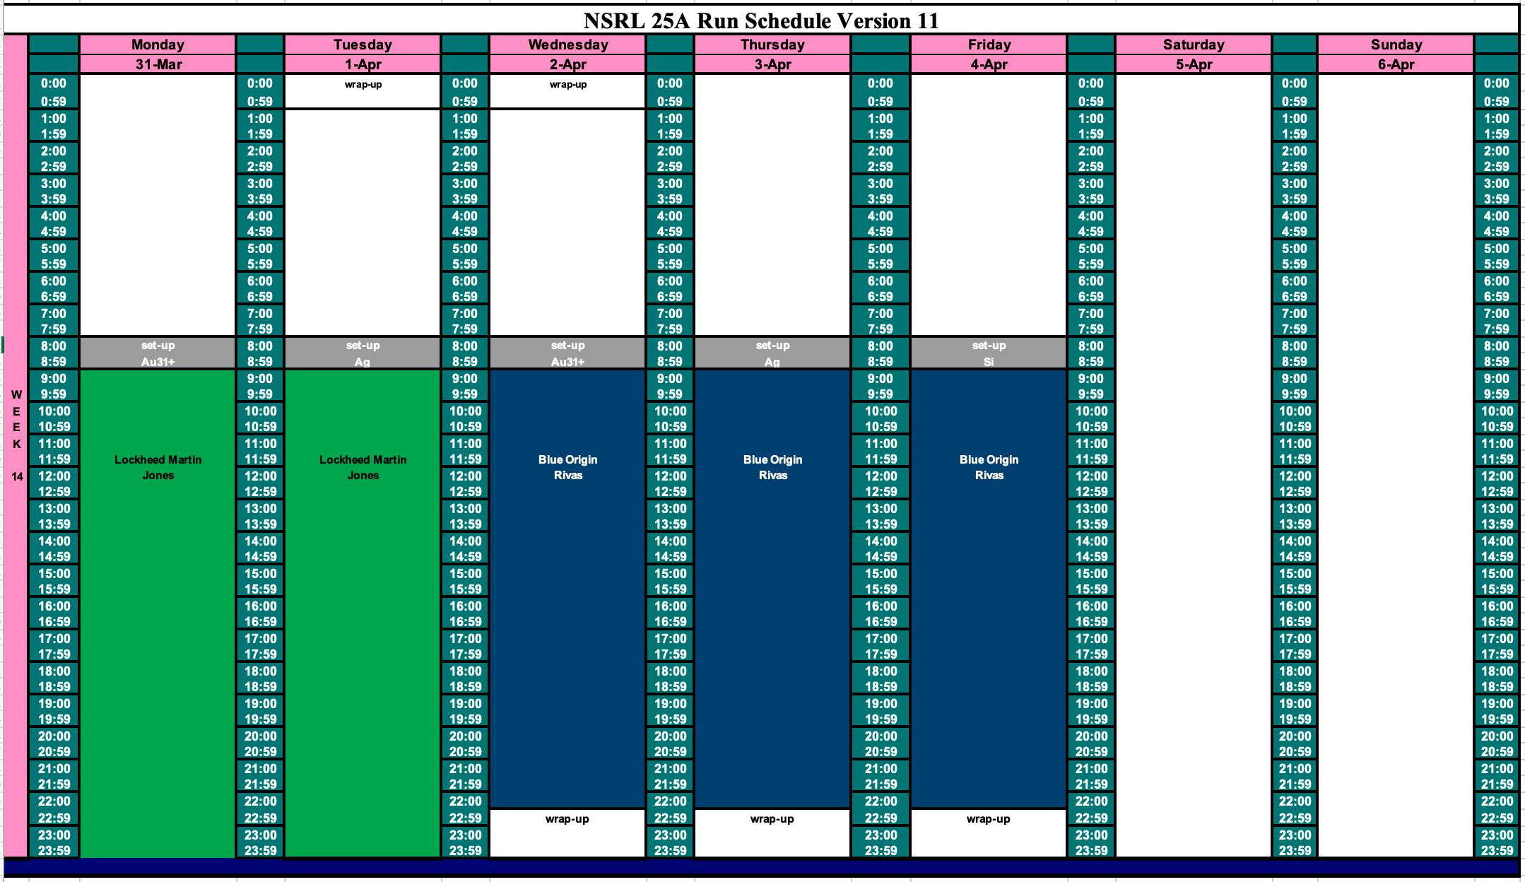
Schedule for this week

Slide 3
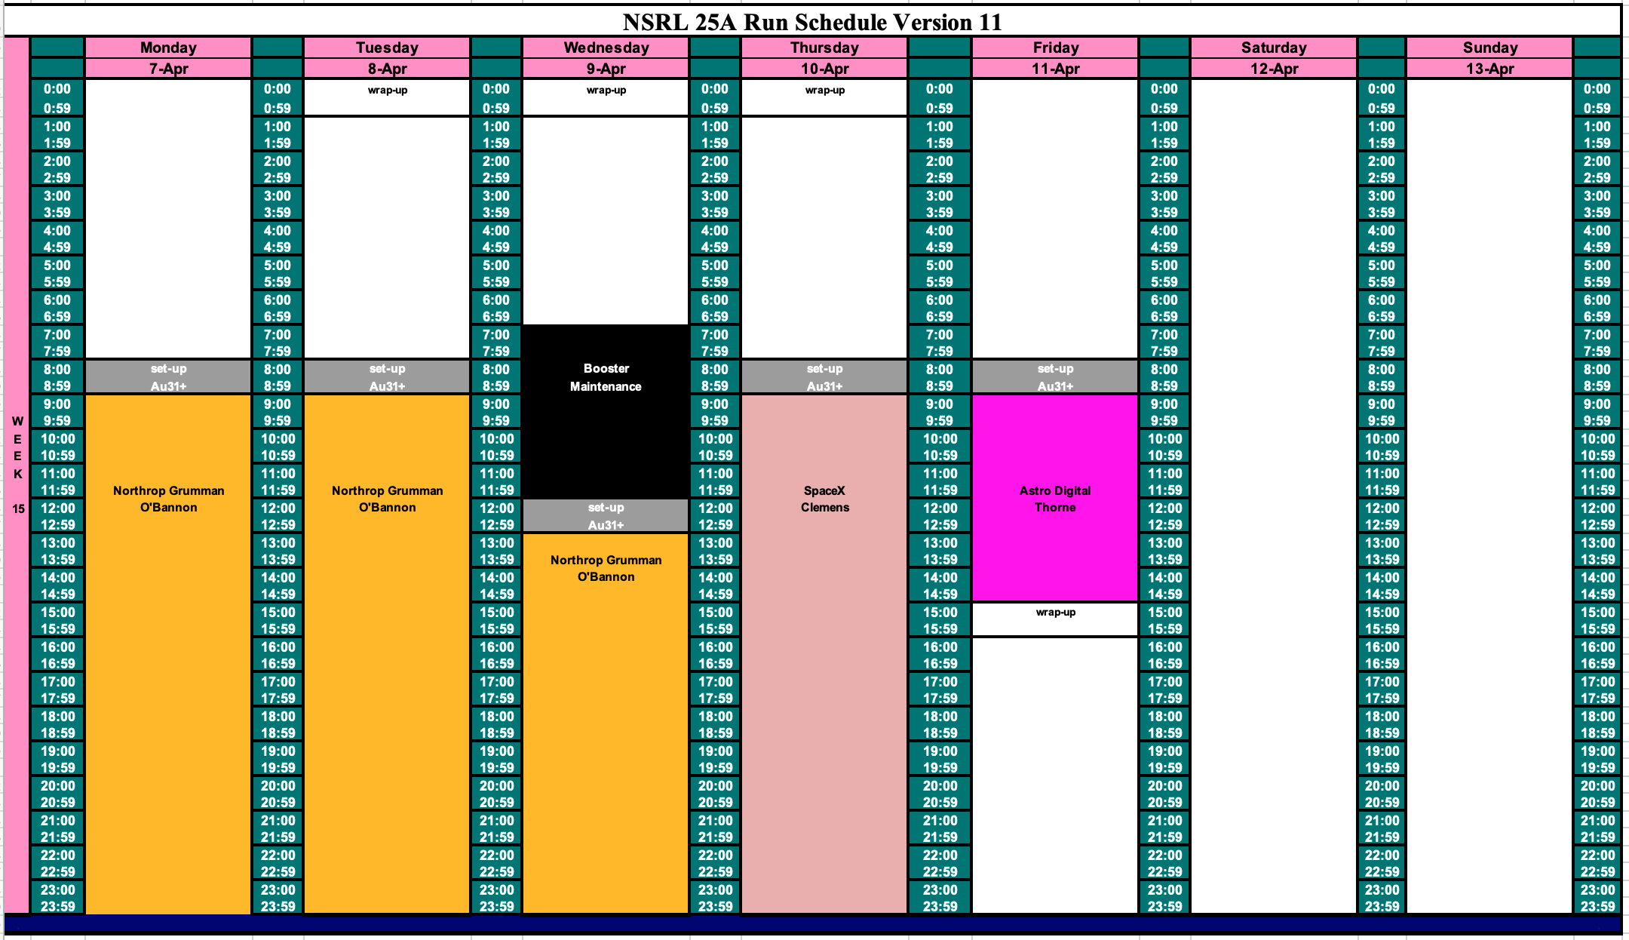
Schedule for next week

Slide 4
Future Schedule
Au31+ beam intensity from Tandem has been very good.
The RHIC delayed start-up, ion species other than Au31+ have been offered to groups testing in April. Ion species selection has not been finalized yet.
In the process of rescheduling many of the research groups testing in March/April/May because of need for EBIS.
In preparation for classified running in May 1 – 3.

