Slide 2
Data courtesy C. Naylor

Slide 3
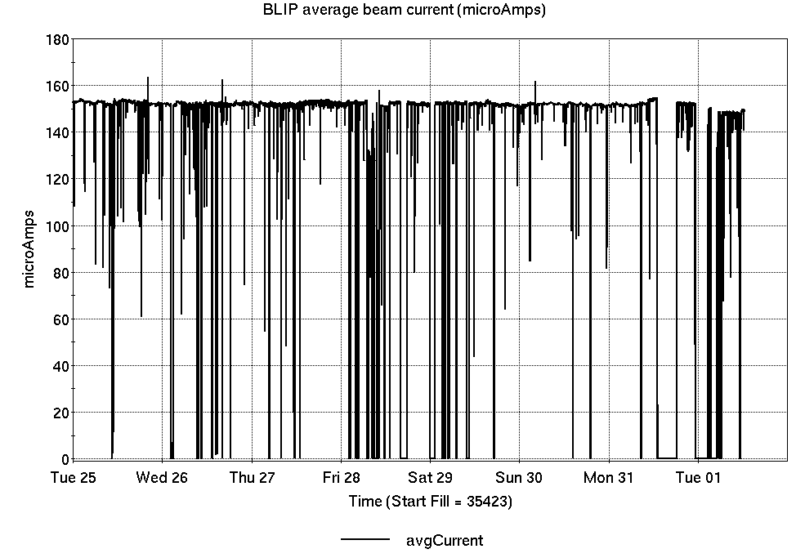
Operations for BLIP
3/25-4/1/2025:
200 MeV production continued all week and is ongoing.
147 hr production
21 hr failures
Availability: 87.5%
No BLIP
this past week

Slide 4
NSRL activity past week: 3/25-4/1/2025 (as of 0800)
NSRL running continues, with various users running
Tandem produced Fe, Au for single ion modes; Protons in use from Linac.
Running 25-A schedule since 3 February. Schedule posted, updates to 28 June for beams & users.
Availability: 45.4%

Slide 5
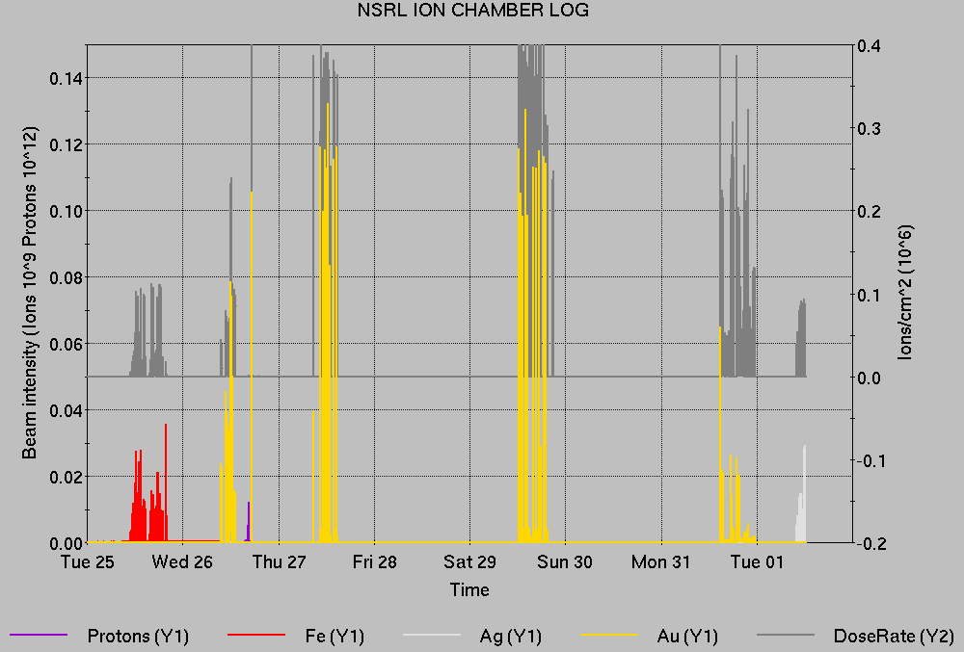
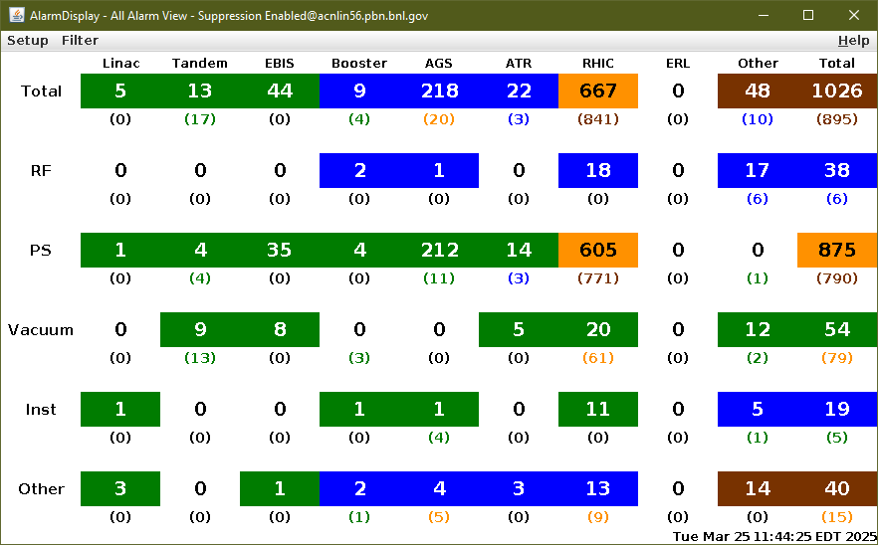
Notes from Operations
Notable failures (>1 hr)
RHIC Blue main dipole system failure, ongoing
Booster RF failure, Fire/Rescue emergency response, 914 building power and programmatic interruption
AGS ag09-blw.c-ps failure, ongoing
Booster bf6-sptm-ps interlock, filter replaced
Tandem source failure, ionizer PS replaced
Linac Mod 7, 5, 2 failures
Linac Tank 1 quad PS failures, stop charge card issues
Weather stand-down, lightning proximate to BNL
BLIP BM1&2 trip, Rad interlock NM068
Other notes
Linac air handler failure interlock tanks quad PS
cfe-wh-ps1 HW failure, replaced
AGS E17 gamma-tr PS failure, ongoing
Various Tandem foil changes, spark, trips/resets, tuning
Various Linac trips, resets, retuning

Slide 6
Reminder from Operations
MCR beam operations continue
Operator/OC shifts continue for NSRL users, 2 shifts/5 days this week and next.
NSRL limited to Au, protons during Booster/AGS setup, or pending EBIS restart.
BLIP production continues through 4 April; resumes 7 April
RHIC beam setup suspended; AGS, AtR beam anticipated this week.
Note: MCR will not be occupied continuously.
No OC on duty overnight. No MCR this weekend.
Contact CAS in off hours (x2024) for urgent issues when MCR is not staffed.
Work continues with Teams phone setup. No more Cisco (remove Cisco phones) Identify anomalies outstanding. Contact ITD, Maintenance Coordinator
Changes? Time to update is now. Expect calls at all hours.
http://directory.pbn.bnl.gov/
CHECK AND EDIT YOUR OWN CONTACT INFO
https://www.cadops.bnl.gov/Operations/personnel/call_in_lists/
CHECK YOUR CALLIN LIST: expect contact off-hours
Alarm response instructions: Groups prompted for updates

Slide 7
Keytree notes
Remote keytree systems require a database lookup to validate and authorize distribution of keytokens. The Keytrak system’s database is available for lookup functionality, but can no longer be modified in any way to add or edit qualified personnel.
Personnel affected:
New employees, experimenters arriving after 12/1/2024 could not be enrolled in database
Existing employees & experimenters, not already enrolled, cannot be added or modified in database
Remote keytrees affected:
Iris scan @NSRL
BNLID scan @AGS South gate, North Conjunction Gate
Iris scan @RHIC STAR, sPHENIX, IP12, IP4
Keytrees NOT affected:
BNLID scan @Linac, Booster
BNLID scan @RHIC IP2
MCR keytrees

Slide 8
Keytree notes, continued
Mitigation:
Choose entrants that are currently enrolled to perform the work in the enclosure under Controlled Access (CA).
Obtain CA keys from MCR for remote gate watch
Arrange for local gate watch using other tokens for entrants.
Arrange for Restricted Access, and allow for delays incurred to sweep areas.
CAUTION
Follow procedures. Gate Watch staff will remain vigilant.
No “piggy-backing” – one key/token per entrant.
Access keys are not candy! Authenticated entrant retains possession.
Radiological Controls and the Access Controls System are not to be circumvented. This is (has been) enforced with disciplinary action (dismissal).

Slide 10
Notes:
Reliability comparisons to previous runs

Slide 11
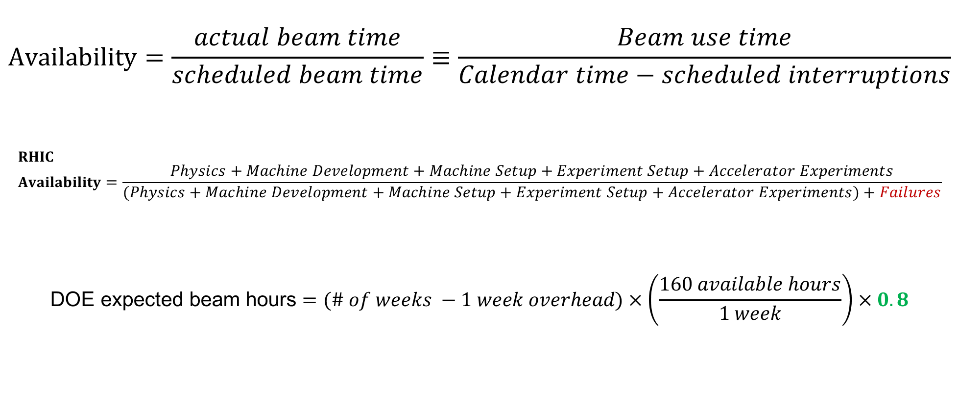
Availability, expected beam hours
$$Availability=\frac{actual beam time}{scheduled beam time}≡\frac{Beam use time}{Calendar time−scheduled interruptions}$$
$$RHIC \\ Availability=\frac{Physics+Machine Development+Machine Setup+Experiment Setup+Accelerator Experiments}{(Physics+Machine Development+Machine Setup+Experiment Setup+Accelerator Experiments)+Failures}$$
$$\text{DOE} \text{expected} \text{beam} \text{hours}=(\# of weeks −1 week overhead)×\left(\frac{160 available hours}{1 week}\right)×0.8$$
Notes:
Normally hidden. Explains how the 85% from DOE comes in to play, & general availability metrics

