Slide 1
C-AD Work Planning and Troubleshooting Awareness Refresher
Michael Dany, C-AD Work Control Manager
OPM 2.28, OPM 2.29
(For Non-Work Control Coordinators)
Notes:
Introduction to Work Planning and Control

Slide 2

Work (Defined)
In general, all physical “hands-on” job activities, other than typical office tasks, are considered work, according to the Subject Area.
According (SBMS), work is defined as all physical activities that involve the design, set-up, operation, maintenance, servicing, troubleshooting, …
Notes:
The SBMS subject area defines work as: “All physical activities that involve the design, set-up, operation, maintenance, servicing, troubleshooting, material handling, remediation, installation, repair, modification, testing, construction, demolition, decommissioning of facilities, systems, or experiments by BNL or non-BNL staff.”
In general, all physical “hands-on” activities, other than typical office tasks, is considered work according to the subject area, and therefore requires work planning.
Please remember a key takeaway in this training is that “All Work is Planned”.

Slide 3
Personnel involved in Work Planning & Control (WP&C)
Work Control Manager (WCM)
  Implements WP&C SA, qualify WCCs, etc.
  Maintains the log of work permits.
Work Control Coordinators (WCC)
  Screen work for appropriate level of work control
  Identify task specific hazards
  Select Procedures, Prepare Work Permits
Sys Experts, Engineers, GL, SMEs, Workers, et al
  Assist in the preparation of a complete work plan package
Notes:
The C-A Department has a Work Control Manager and many Work Control Coordinators, each group has some.
The Work Control Manager is responsible for implementing the Work Planning & Control process to align with SBMS requirements across the Department, and qualifying Work Control Coordinators.
Individual Work Control Coordinators are qualified and knowledgeable about their systems, equipment, processes, hazards and limitations in their area of technical expertise.
Each functional work group has at least one WCC to screen and plan their work.
They are the ones best suited to screen and plan work in their jurisdiction. An authorized WCC is the only one allowed to classify the work as Construction or Operations, identify the appropriate level of work planning and prepare a Work Permit Document. Their JTA requires additional training to maintain their qualifications as a Work Control Coordinator.

Slide 4

Three Levels of Work Planning
There are three levels of planning for Operations
and Construction:
Worker Planned Work – low hazard work with minimal hazard controls, typically “skill of the craft” activities.
Prescribed Work – work that utilizes a valid procedure (OPM).
Permit Planned Work – work that utilizes a work permit (Green Sheet) which details the known hazards, necessary controls and the work steps to be performed. USI checklist is required.
Prescribed work is best for complex or hazardous work that may be routine and will be performed numerous times. The level of planning is the same as for a permit, but the planning is done once.
Notes:
There are three levels of work planning for Operations and Construction. Work Control Coordinators have been trained to screen the work and identify the appropriate level of work planning needed for each job.
1.) Worker Planned Work: acknowledges the skill of the worker and allows the worker to identify the hazards associated with the work and requires the worker to implement appropriate hazard mitigation measures. The worker must select the appropriate PPE, control hazardous energy sources using LOTO procedures, and pause the job if the scope of work changes or additional unexpected hazards arise.
2.) Prescribed Work: is performed using an approved procedure. The procedure provides the required work steps, precautions and hazard mitigation measures. The worker is still required to pause the job if the scope of work changes or additional hazards are identified.
3.) Permit Planned Work: is a more detailed work planning process that requires support from an ES&H representative and other experts as appropriate to develop a safe work plan. The job planning and review team may consult with SMEs, F&O FPM, Research Space Manager, the Service Provider (workers, supervisors, system experts, etc.) or others as needed. The planning team identifies hazards and controls then completes the Work Permit form, provided in the Subject Area. (This is referred to as the Green Sheet in C-AD).

Slide 5
Work Permits
Green Sheet
  WCC forms a review team to review the task and job hazards.
    Includes a visit to the job site.
  USI Screening checklist is required for all permits.
  Work permit is authorized by Line Manager
  WCC, Responsible Person, Supervisor, or Group Leader provides a pre-job brief to workers. Workers acknowledge and sign.
  Workers perform the work within the hazard controls on the permit.
  Post-job feedback documented.
Notes:
5) If the Work Control Coordinator has screened the job as Permit Planned, or the Worker Planned Work job has been elevated to Permit required, due to specific job concerns; a review team is established to review the job tasks and associated hazards. A job walk-down is performed so all team members can observe site conditions and specific hazards.
The WCC and review teams fills out the Work Permit form, and review team members sign the final original Green copy, know as the Green Sheet.
The signed Work Permit is presented to the Independent Reviewer who checks the form to ensure due diligence, proper review and all signatures are appropriate.
Prior to starting work, a pre-job brief is delivered to all workers by the Responsible Person (or the WCC, GL, Supervisor). The hazards and controls identified on the work permit are reviewed and acknowledged by the workers. A qualified line manager authorizes the work to proceed.
The job is then performed using the identified hazards controls, and post-job feedback documented on the permit form.
It should be noted that all Contractor / Vendor work on-site ALWAYS requires a Work Permit, in addition to any job specific training requirements for the task.

Slide 6

Some Troubleshooting Myths
Is this Work?
“I’m not Working, just Troubleshooting, Diagnosing.”
“LOTO doesn’t apply to Troubleshooting!”
“Its OK to bypass safety devices when troubleshooting.”
“Troubleshooting needs to be performed with the power On.”
“We need to fix the problem quickly to reduce downtime.”

Slide 7
Common Pitfalls when Troubleshooting
Scope Creep
Tunnel Vision
Substituting Parts
Oversizing Fuses
Increase Pressure / Flow
Using “Jumpers”
Removing / Using Wrong PPE
Blind Reaching
HPI Issues: Time Pressure, Off-Hours Call-In, Poor Communication, Ergonomics,
Override / Bypass Safety Devices
“Need a Bigger Hammer”
Using the Wrong Tool
Change the Sequence of Operations
Using Chemicals / Spays / Lube
Assuming the “Fix” is Good
Documents Not Updated
Communication Breakdown
Other Potential Hazards

Slide 8
So, What CAN We Do?
Talk to your Work Control Coordinator
Use your senses, observe conditions, sights, sounds, etc.,
Review data logs, performance history, operator feedback,
Review schematics, equipment manuals, identify points of weakness,
Try to identify the point of failure,
Consult with Engineers, System Experts, SMEs
Prepare a LIMITED diagnostic plan,
Don’t exceed the diagnostic plan, Pause to evaluate the repair,
Modify the plan and re-evaluate the hazards

Slide 9
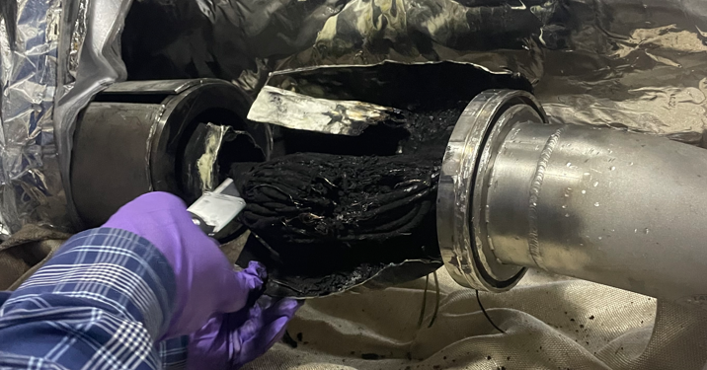
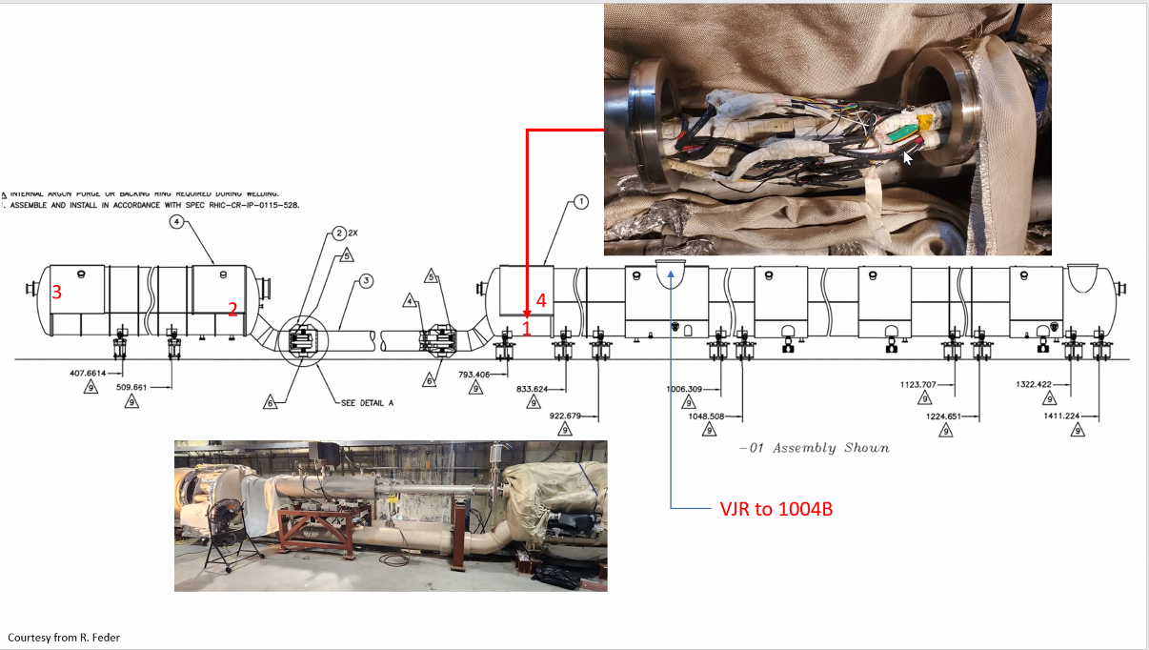
Troubleshooting RHIC Blue Dipole Bus
Avoid Pitfalls, Incorporate Lessons Learned,
Pause for New Conditions, Re-evaluate New Hazards

Slide 10
Summary
WCC screens and plans the work.
WCC selects appropriate level of work planning.
Avoid common troubleshooting pitfalls.
Diagnostics (Troubleshooting) is WORK and requires Work Planning.
The scope of the Diagnostic phase is limited, and the Repair phase may require additional work planning.

