Slide 1
RHIC Schedule Meeting
Medani P. Sangroula
Scheduling Physicist
04/07/2025

Slide 2
RHIC Operations FY25
Revised: 04/07/2025
2024
Dec | Jan | Feb | Mar | Apr | May | Jun | Jul | Aug | Sep | Oct | Nov | Dec
2026
Today
Scrub:
Jan 24
45 K:
Feb 24
4 K:
Mar 24
4 K:
Jun 30
Planning basis: 4K cooldown on 3/24/25 for Au + Au and 7 weeks break on 06/30 (cryo remains on). Resume operation on 08/18 to 12/22 dependent on approved budget.
RHIC Cryo
Break
...
NSRL (Feb 3 - )
BLIP (Jan 24 - Jun 6)
Planning basis may change!
AGS operations (Mar 3 - Jun 30)
Break
...
Booster (Feb 3 - )
Linac (Jan 19 - Jun 6)
Assuming no polarized proton required after Jun 6
...
EBIS (May 12 – )
Upgrade
EBIS got delayed for another week
...
Tandem (Jan 23 - )
May 12 instead of May 07

Slide 3
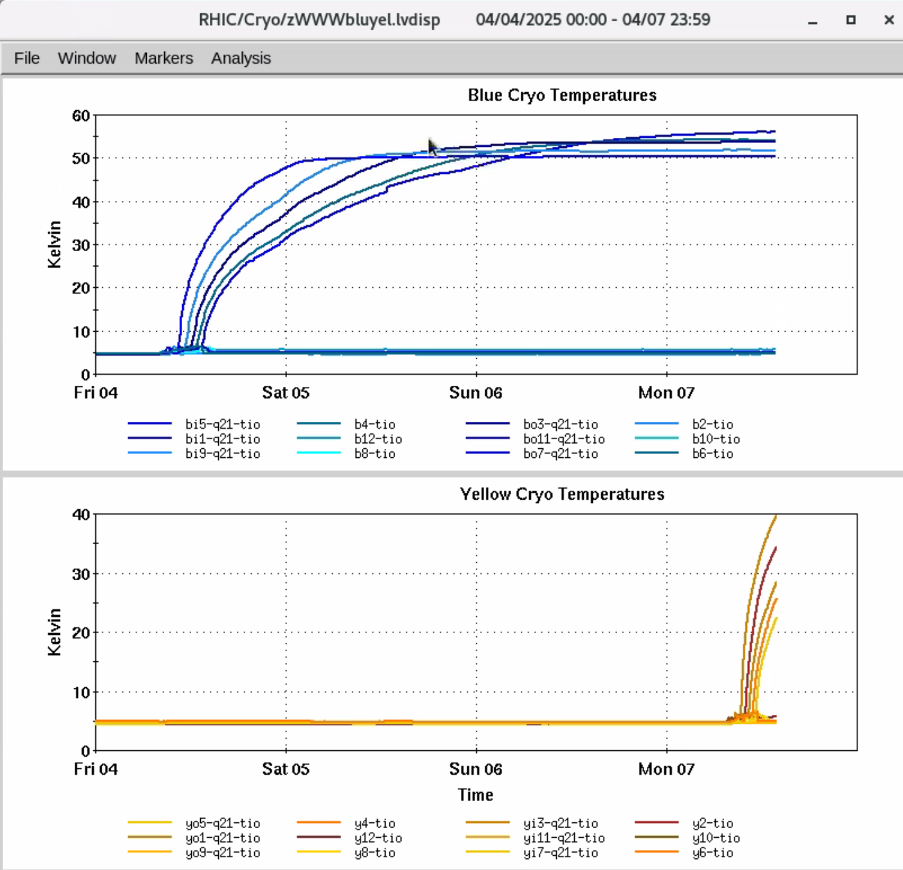
Ongoing Work
RHIC is warming up!
We are narrowing down the location (Blue main dipole return bus at sector 4) for repair.
NSRL is running Au and Iodine beams.
BLIP intend to run this week (Wed/Thu) for 24 hour with 117 MeV.
Planning to use the Booster and AGS for AI/ML related beam study and polarized proton development with skew quads.

