Slide 1
Preinjector Status
D. Raparia
Time Meeting
April 08, 2025

Slide 2
Tandem
Tandem delivering Au+34 beam RHIC setup.
MP6: repair work over weekend charging system did not resolve the issue, diagnosis work continues
Tandem Control Room staffed 6:00 – 24:00 for NSRL.
Will go back to 24/7 operation when needed for RHIC setup

Slide 3
EBIS
LION2: system debugging continue
Collector Power Supply Issue (MCM350, 30kV):
• On Friday, a breakdown found in the 30kV cable for the MCM350 Collector Power Supply.
• Yesterday morning, the breakdown location was identified at the isolation transformer end of the cable.
• The semiconducting layer of the cable needs to be stripped back to resolve the issue.
• An estimated three-week schedule delay.

Slide 4
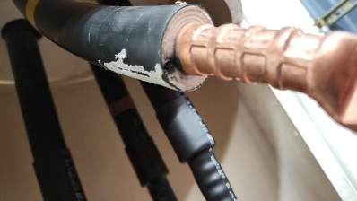
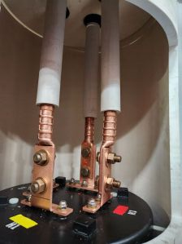
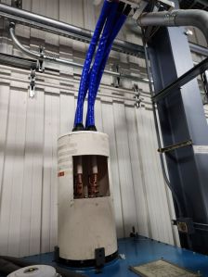
Breakdown at semiconductor layer
Semiconducting layer of cable stripped

Slide 5
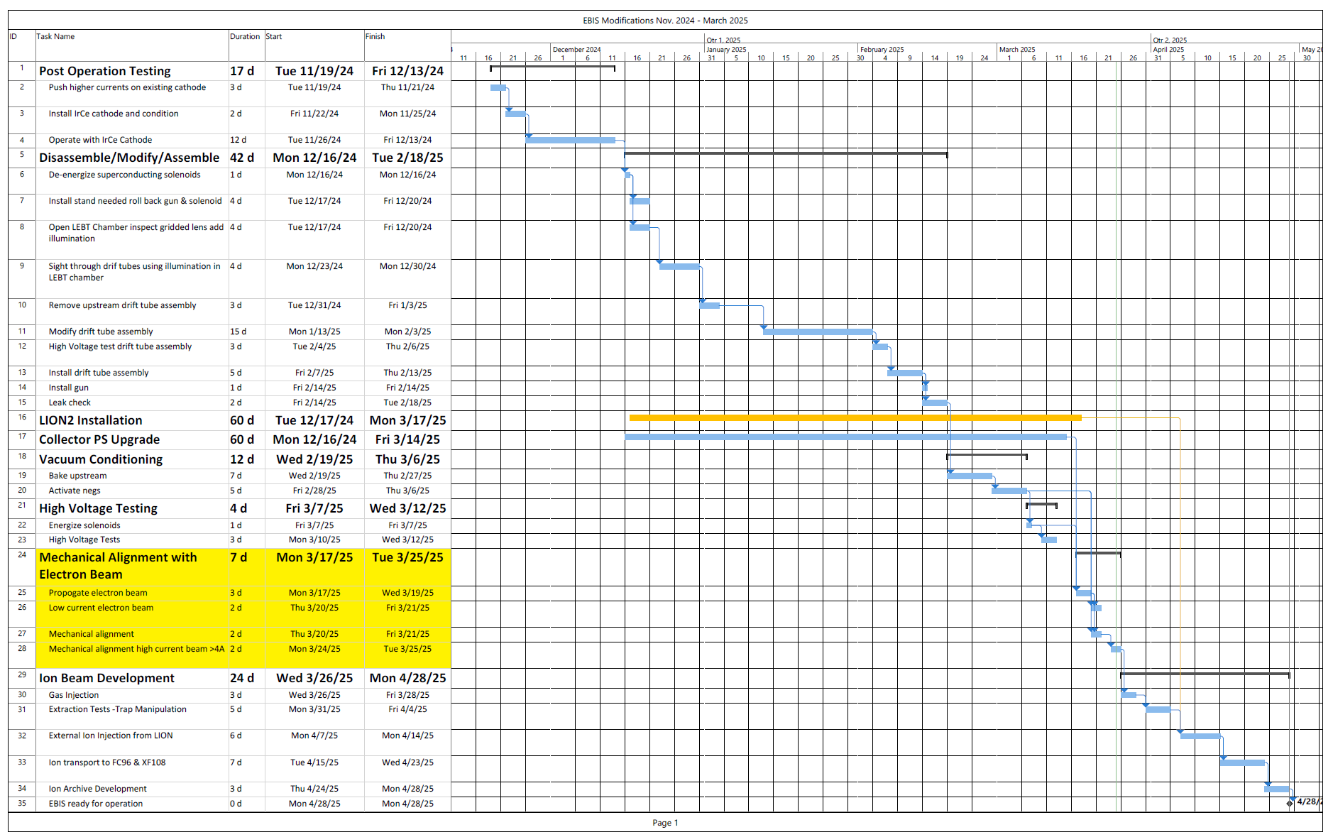
EBIS Schedule

Slide 6
Linac
The 200 MeV, 150 µA run was successfully completed on Friday.
• OPPIS is providing PP to 200 MeV Polarimeter and Booster
• Dy foil irradiation has been postponed to 4/9, pending approval.

