Slide 1
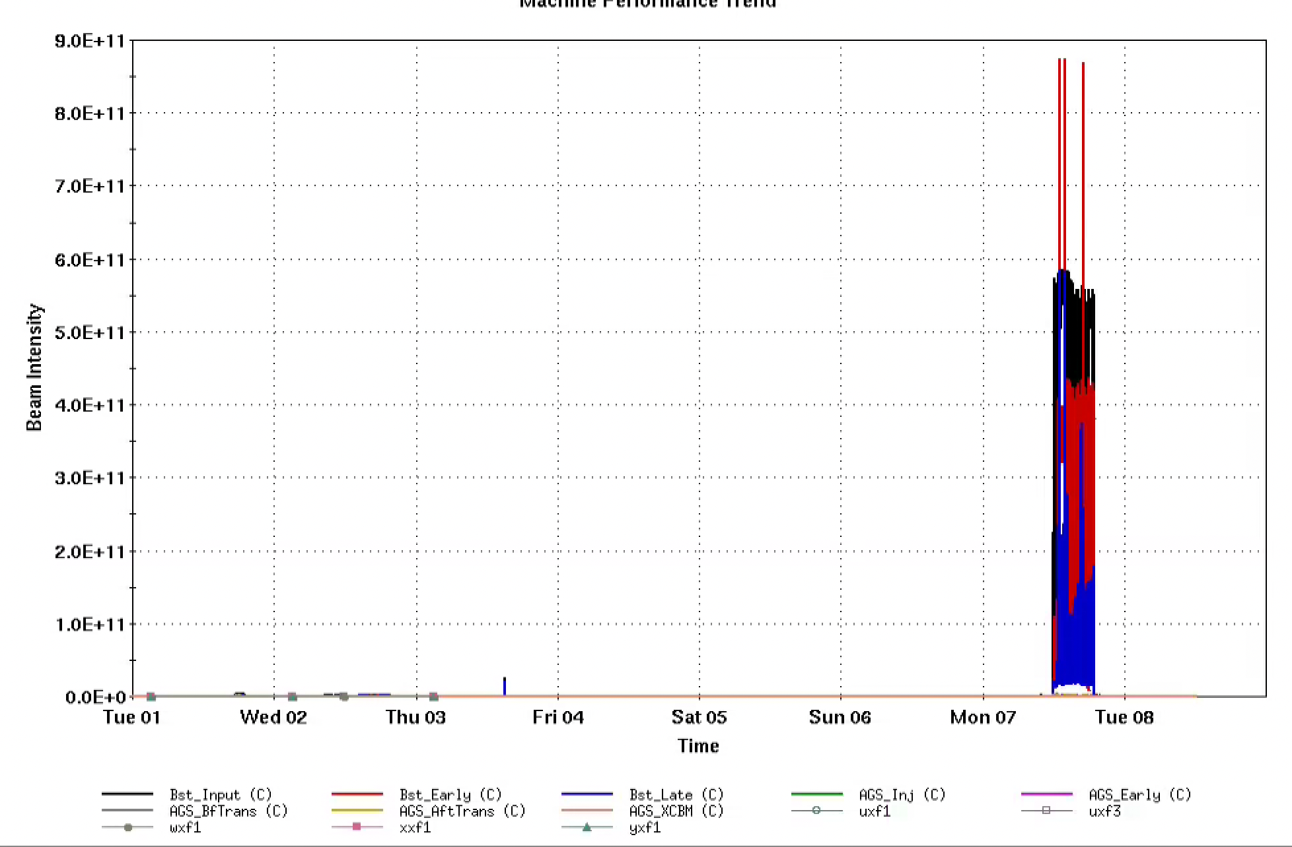
AGS Status: Time meeting 4/8/25
AGS ramp of Au 3.85 GeV/n ramp established (for APEX)
Not extracted due to extraction bump problem
Polarized protons to Booster extraction (for development)
Cold snake not ready until Thur/Fri
Could use ‘no snake’ AGS for instrumentation setup
AI/ML work to proceed in Booster
Injector intensities

Slide 2
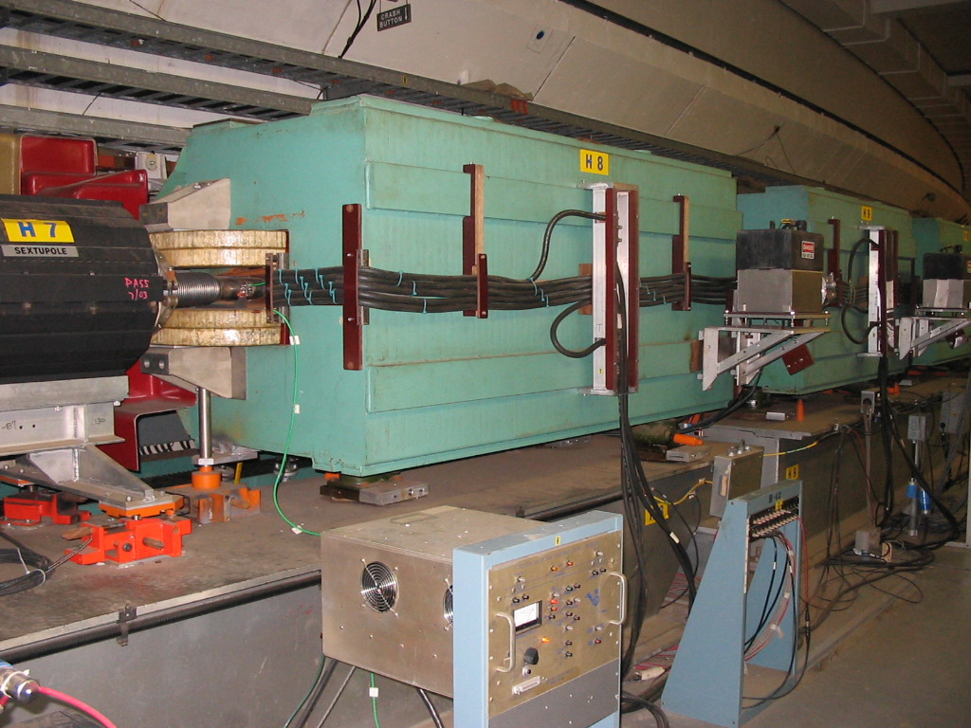
Ballad of the backlegs
AGS main magnet (”C” shaped)
G09 and H11 supplies power coils around the backlegs of two separate sets of AGS main magnets
Larger (5 cm) horizontal excursions required to locate beam correctly at kicker and septum
Long history—specialized to handle the back emf of the main magnet up and down ramp
Bank of 50 MOSFETs controls the pulse shape
3 failures (two in G09, one in H11)
All 50 MOSFETs damaged in each incident
Consistent with overvoltage condition on the input (from rectifiers) which would put the MOSFETs out of operating range
At least one failure coincident with failure of H11 to respond to ‘ramp down’ trigger
Backleg windings
Main ‘pancake’ coil around pole tips

Slide 3
Ballad of the backlegs
AGS main magnet (”C” shaped)
Remediating measures
Temperature monitoring and interlock (for diagnostic and some (slow) protection)
PLC being added to enforce pulse length constraint
Re-design of control board
New control board has hard limit on rectifier voltage
Even if root cause not totally solved (yet), should prevent ‘total transistor damage’ events
Design,fabrication,installation: 2-2.5 weeks
Backleg windings
Main ‘pancake’ coil around pole tips

