Slide 1
Preinjector Status
D. Raparia
Time Meeting
April 15, 2025

Slide 2
Tandem
Tandem delivering Au⁺³¹ for NSRL , Au⁺³⁴ was unstable this morning
MP6: repair work over weekend charging system did fix one issue but other issues persist, diagnosis work continues
Tandem Control Room staffed 6:00 – 24:00 for NSRL.
Will go back to 24/7 operation when needed for RHIC setup

Slide 3
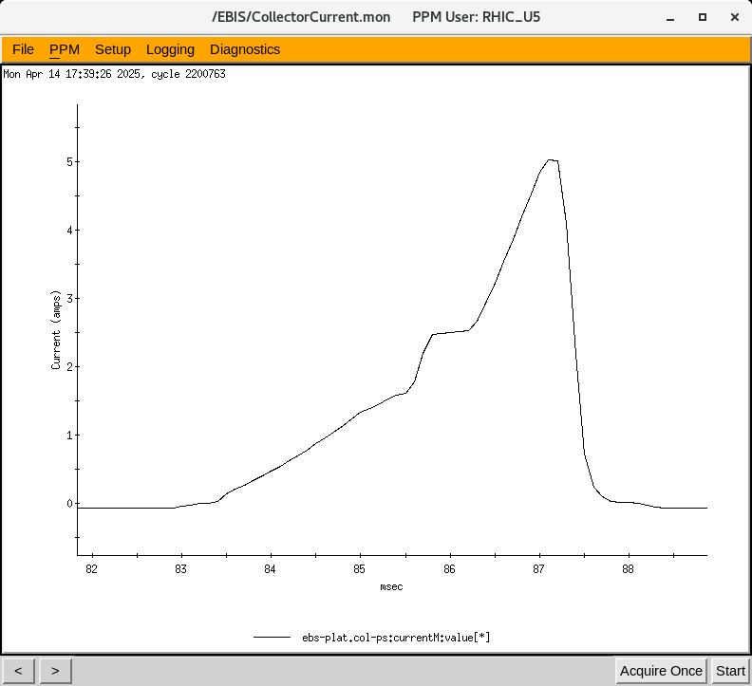
EBIS
LION2: working on other ions than Au
Collector Power Supply Issue (MCM350, 30kV) fixed
Electron beam being commission
4/10 : 0.45 A
4/11: 2.95 A
4/14 : 5.10 A
Some work was needed on the XEBIS control software, as the timing is changing with voltage increments.
• An estimated four-week schedule delay.

Slide 4
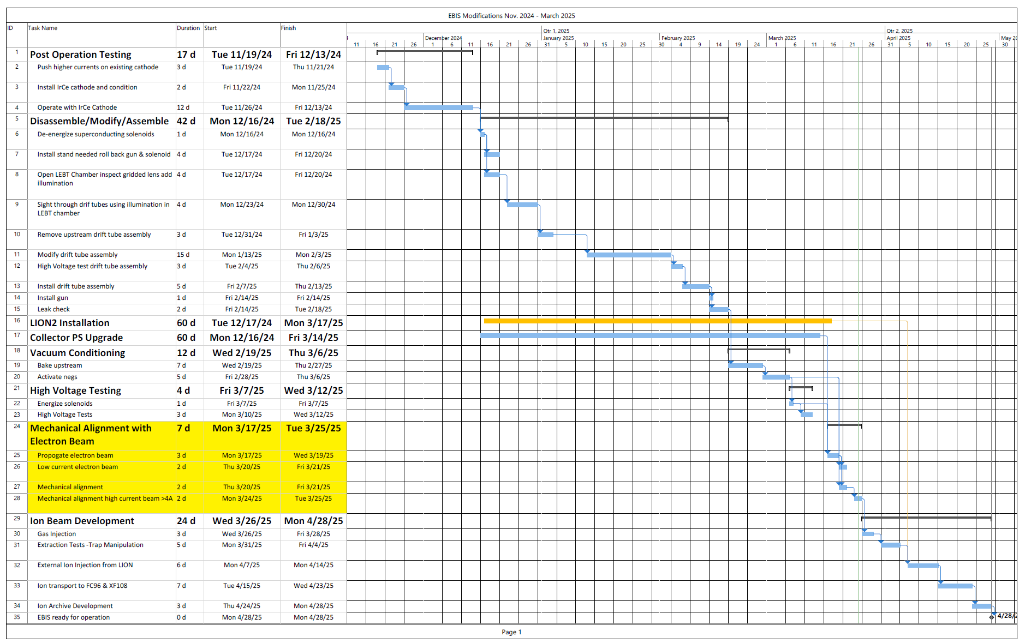
EBIS Schedule

Slide 5
Linac
4/9: There were some issues with mod 2 FEC reset , not understood
4:9: There were linac chiller issues , down time about 6 HRs
4/10: BLIP Fy foil irradiation at 117 MeV 1.5 uA was completed
4/10: booster used unpolarized beam due OPPIS was down because of chiller issue
4/13: Added 10 g Rb in the OPPIS
4/15: BLIP run , 200 MeV 0.15 uA , 2 Hrs
- OPPIS is providing PP to 200 MeV Polarimeter and Booster

