Slide 1
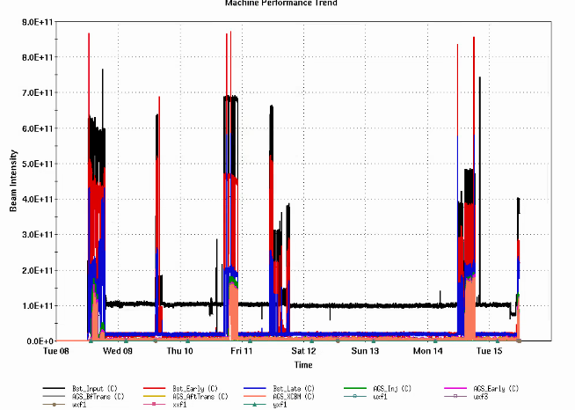
AGS Status: Time meeting 4/15/25
Extraction BLW supply work continues
Modifications expected to be finished by ~Apr 23
Designed to protect against overvoltage conditions on the transistor bank
Polarized proton development
Proton beam accelerated to flattop with snakes
Several power supply issues resolved over last week
Polarimeter signal cable problem
No measurements until resolved
AI/ML optimization tools development ongoing in LtB,BtA
Injector intensities

