Slide 1
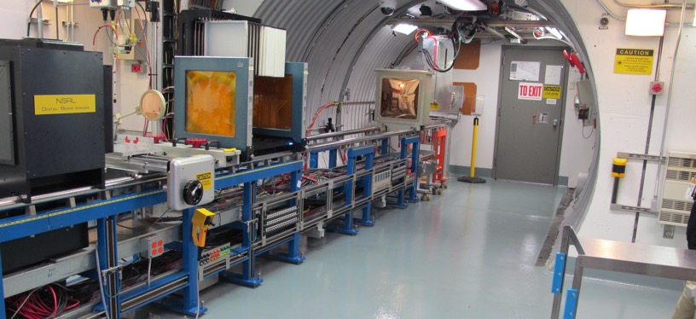
NSRL Time Meeting Report
15 April 2025
Michael Sivertz

Slide 2
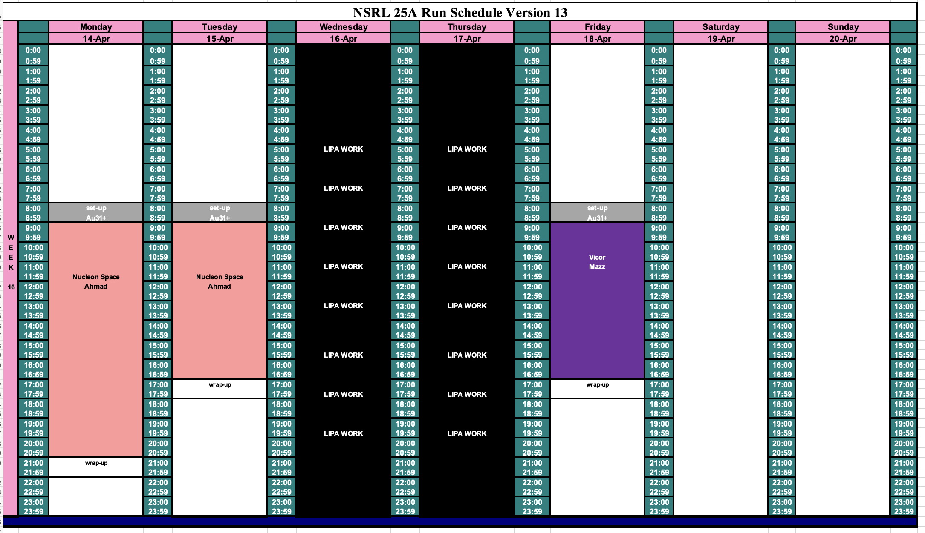
Schedule for this week

Slide 3
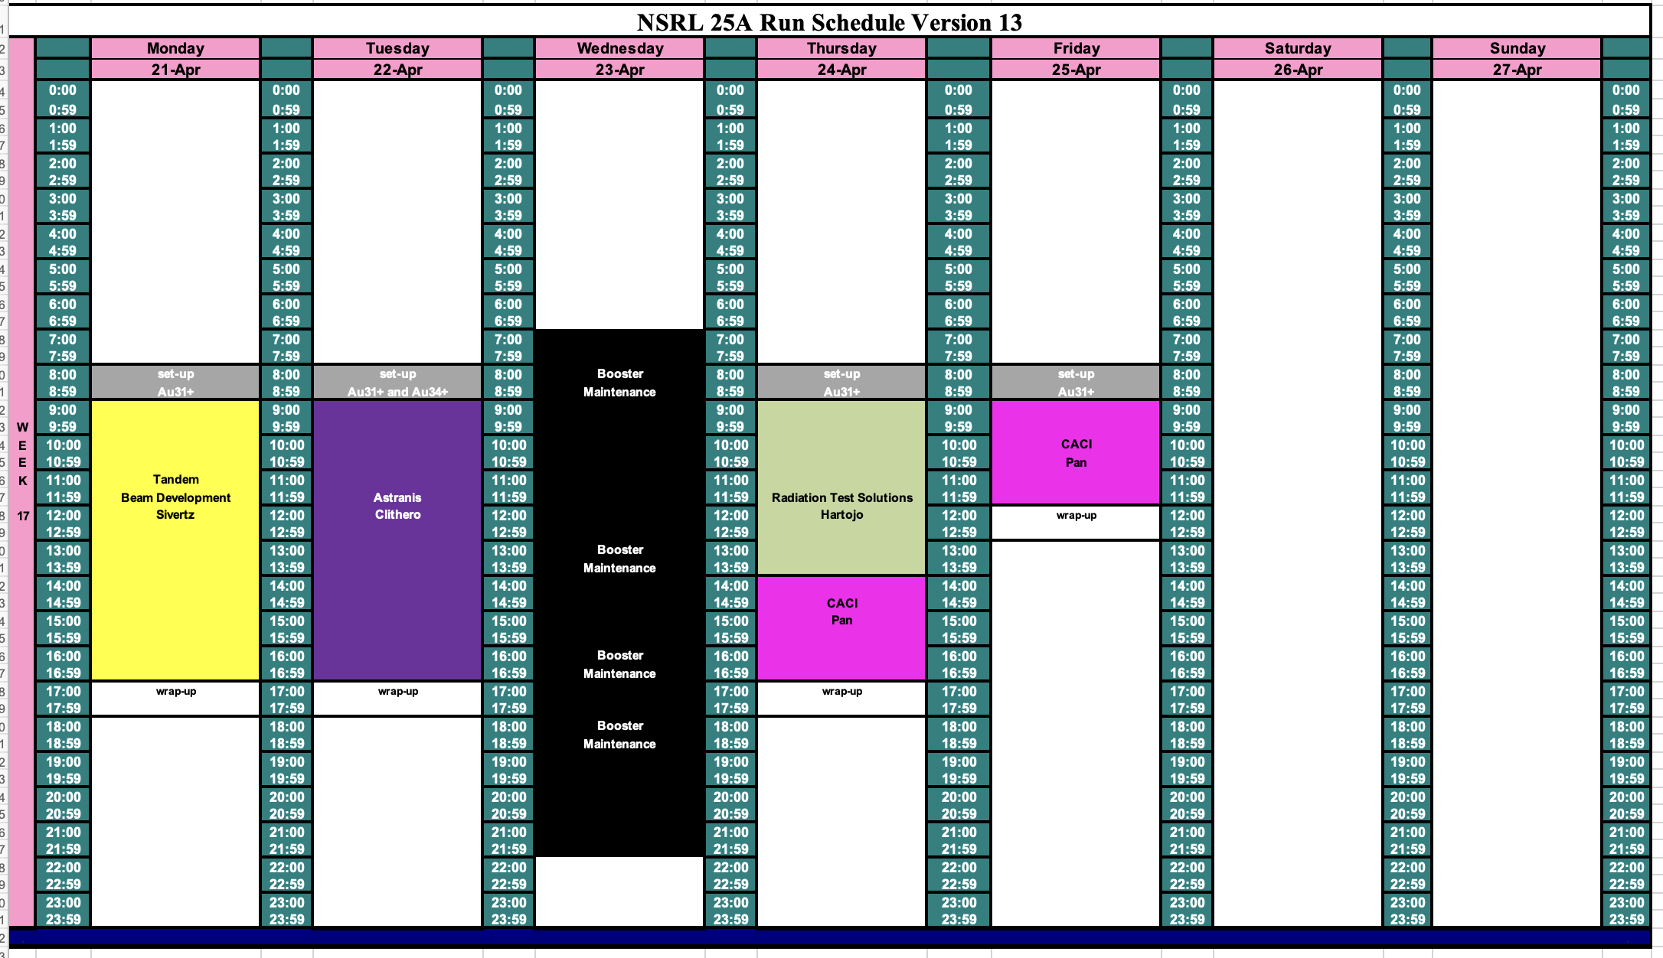
Schedule for next week

Slide 4
Future Schedule
Au31+ beam intensity from Tandem has been very good.
Au34+ beam intensity from Tandem is also very good (except for this morning)!
Relinquished two days of beam development (4/16 – 17) to LIPA for substation work.
Looking for both Au31+ and Au34+ again on 4/22/25.
Booster Maintenance occupying all day on 4/23/25.
May request Ag on 4/25/25.
In preparation for classified running in May 1 – 3.
This work will probably have to be delayed.

