Slide 2
Data courtesy C. Naylor

Slide 3
Data courtesy C. Naylor

Slide 4
Data courtesy C. Naylor

Slide 5
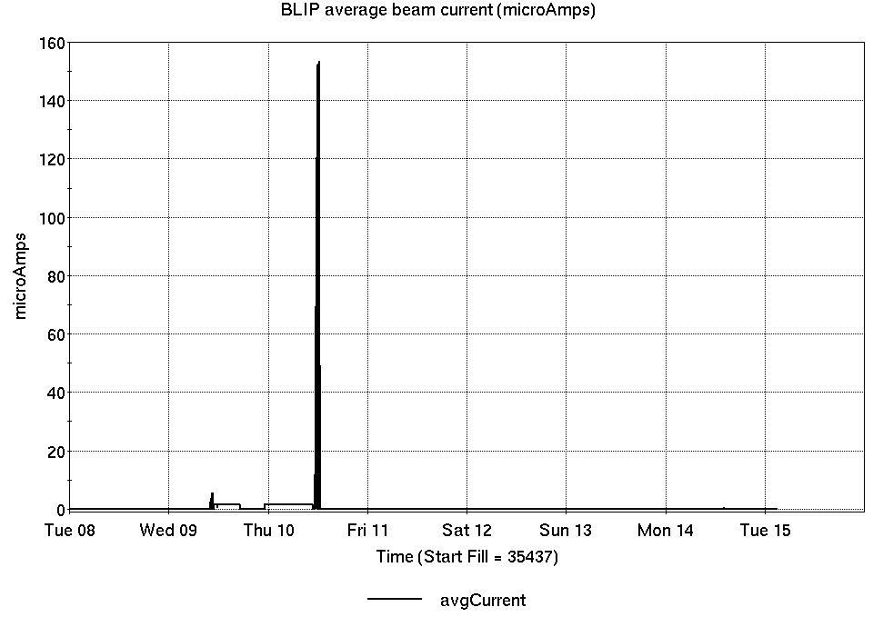
Operations for BLIP
4/8-15/2025:
117 MeV exposure was the only scheduled irradiation.
17.9 hr production
4.07 hr setup
6.13 hr failures
Availability: 78.2%
No BLIP
this past week

Slide 6
NSRL activity past week: 4/8-15/2025 (as of 0800)
NSRL running continues, with various users running
Tandem Au only, for single ion modes.
Running 25-A schedule since 3 February. Schedule posted, updates to 28 June for beams & users.
Availability: 96.1%

Slide 7
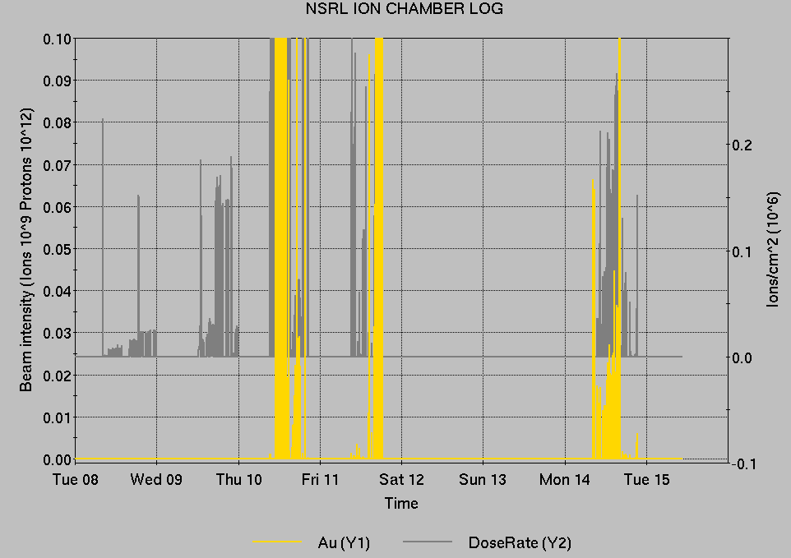
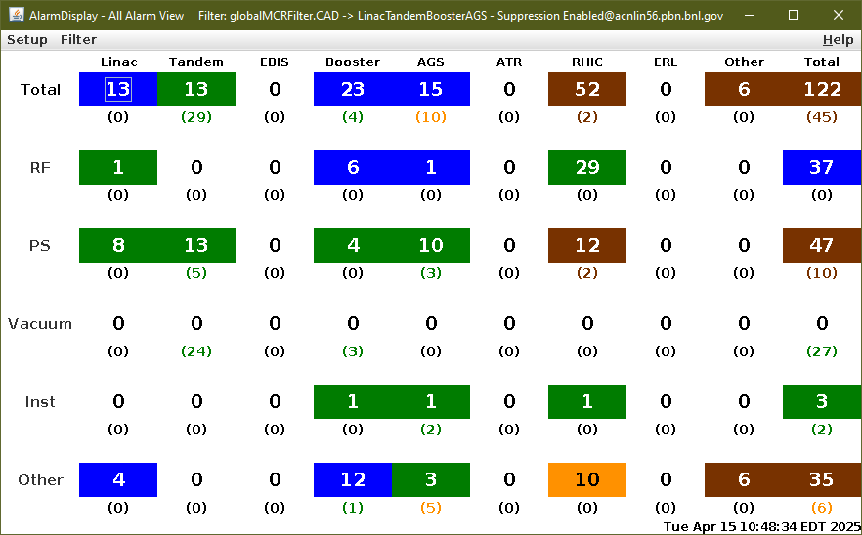
Notes from Operations
Notable failures (>1 hr)
RHIC Blue main dipole system failure, ongoing
AGS extraction bump failures, ongoing
AGS polarimeter failure, ongoing issue with RF sweep signal
Linac chiller trip, affecting various systems
Power dip, affecting some AGS systems
OPPIS source interlock, cooling resistivity
LtB d2-5 PS failure, flow switch leak repair
AGS e17 snake quad PS failure, missing connector repaired
Other notes
Various Tandem accelerator room access, tuning, foil changes
Over 37 hours injector pp setup, other studies
Filtered to present running state.
Not zero...

Slide 8
Reminder from Operations
MCR beam operations continue
Operator/OC shifts continue for NSRL users, 2 shifts/5 days this week and next.
NSRL ions from Tandem, Linac protons as required (pending resumption of AGS Au)
GCR pending EBIS restart.
BLIP production 17-18 April; longer run starts Monday.
RHIC beam setup suspended pending warmup/repair
AtR beam pending extraction PS failures.
AGS Polarized proton setup, other studies continue 2 shifts/5 days pending Booster availability
Booster interruption Wed PM, beam restoration TBD
Note: MCR will not be occupied continuously.
No OC on duty overnight. Operator overnight BLIP, intermittently. No MCR this weekend.
Contact CAS in off hours (x2024) for urgent issues when MCR is not staffed.
Teams phone setup: awaiting ITD. Contact ITD help desk x5522, Maintenance Coordinator
Changes? Time to update is now. Expect calls at all hours.
http://directory.pbn.bnl.gov/
CHECK AND EDIT YOUR OWN CONTACT INFO
https://www.cadops.bnl.gov/Operations/personnel/call_in_lists/
CHECK YOUR CALLIN LIST: expect contact off-hours
Alarm response instructions: Groups prompted for updates

Slide 9
Keytree notes
Remote keytree systems require a database lookup to validate and authorize distribution of keytokens. The Keytrak system’s database is available for lookup functionality, but can no longer be modified in any way to add or edit qualified personnel.
Personnel affected:
New employees, experimenters arriving after 12/1/2024 could not be enrolled in database
Existing employees & experimenters, not already enrolled, cannot be added or modified in database
Remote keytrees affected:
Iris scan @NSRL
BNLID scan @AGS South gate, North Conjunction Gate
Iris scan @RHIC STAR, sPHENIX, IP12, IP4
Keytrees NOT affected:
BNLID scan @Linac, Booster
BNLID scan @RHIC IP2
MCR keytrees

Slide 10
Keytree notes, continued
Mitigation:
Choose entrants that are currently enrolled to perform the work in the enclosure under Controlled Access (CA).
Obtain CA keys from MCR for remote gate watch
Arrange for local gate watch using other tokens for entrants.
Arrange for Restricted Access, and allow for delays incurred to sweep areas.
CAUTION
Follow procedures. Gate Watch staff will remain vigilant.
No “piggy-backing” – one key/token per entrant.
Access keys are not candy! Authenticated entrant retains possession.
Radiological Controls and the Access Controls System are not to be circumvented. This is (has been) enforced with disciplinary action (dismissal).

Slide 12
Notes:
Reliability comparisons to previous runs

Slide 13
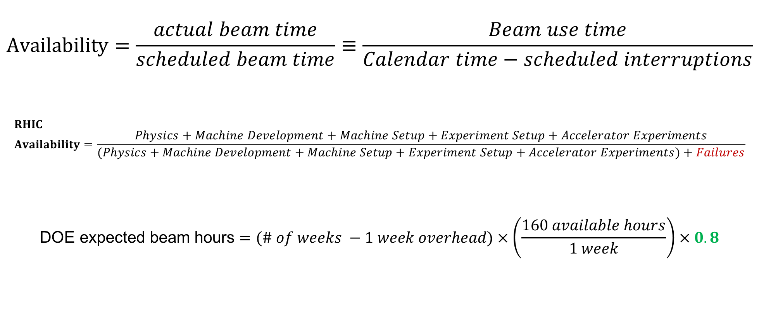
Availability, expected beam hours
$$Availability=\frac{actual beam time}{scheduled beam time}≡\frac{Beam use time}{Calendar time−scheduled interruptions}$$
$$RHIC \\ Availability=\frac{Physics+Machine Development+Machine Setup+Experiment Setup+Accelerator Experiments}{(Physics+Machine Development+Machine Setup+Experiment Setup+Accelerator Experiments)+Failures}$$
$$\text{DOE} \text{expected} \text{beam} \text{hours}=(\# of weeks −1 week overhead)×\left(\frac{160 available hours}{1 week}\right)×0.8$$
Notes:
Normally hidden. Explains how the 85% from DOE comes in to play, & general availability metrics

