Slide 1
Preinjector Status
D. Raparia
Time Meeting
April 22, 2025

Slide 2
Tandem
Tandem delivering Au⁺³¹ for NSRL
MP6: Repair work was completed last week and twas closed as of yesterday. Testing today. it will be reopened for chain replacement
Tandem Control Room staffed 6:00 – 24:00 for NSRL.
Will go back to 24/7 operation when needed for RHIC setup

Slide 3
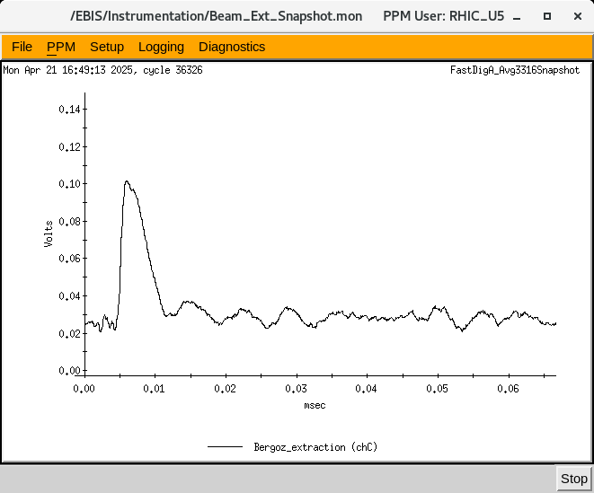
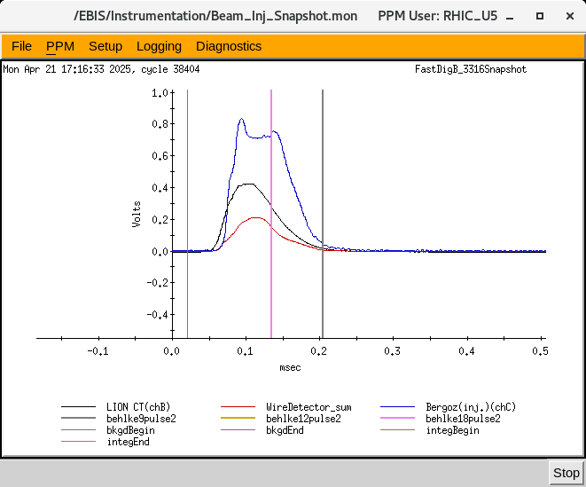
EBIS
LION2: working on other ions than Au
Ion extraction from EBIS using
-4/16: residual gas, e-beam 3.1 A, 70 ms ,
-4/17: He gas injection, e-beam 4.3 A, New DT Voltage distribution
- 4/18: Si capture from LION2 , could not extract due to HV Platform issues. e-baem 4.3 A
- 4/21: Si+ fast injection from LION2 , and extraction form EBIS,
Extracted Si
Si injection into EBIS

Slide 4
New EBIS schedule

Slide 5
Linac
^{BLIP}
4/15: 1 Hr , 200 MeV 0.15 uA
4/17: 24 Hrs , 117 MeV, 50 uA
4/21: 11days, 200 MeV , 150 uA
OPPIS
- 4/19-20: replaced plasmatron and its PS, acr driver board, other maintenance
OPPIS is providing PP to 200 MeV Polarimeter and Booster and NSRL
Several RFQ, Mod 1, 2 ,3,4 and 7 tripes

