Slide 1
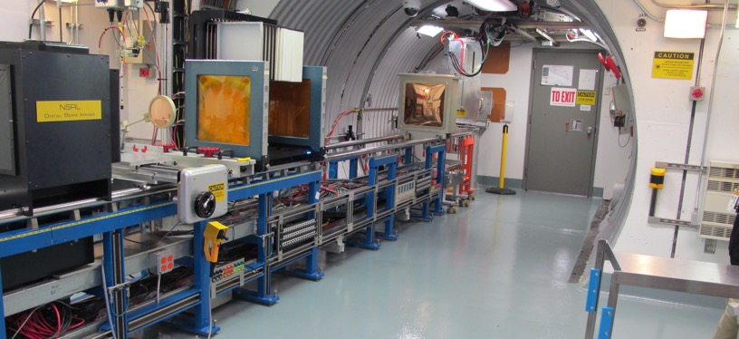
NSRL Time Meeting Report
22 April 2025
Michael Sivertz

Slide 2
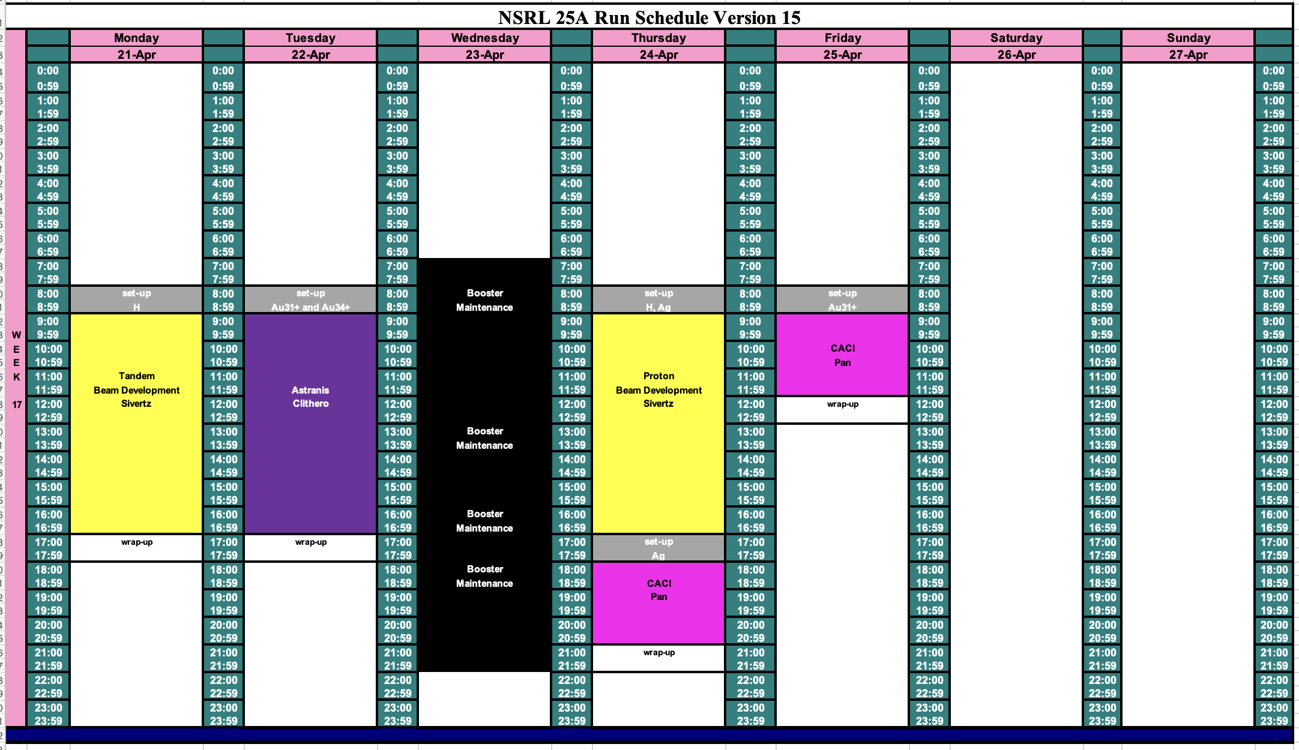
Schedule for this week

Slide 3
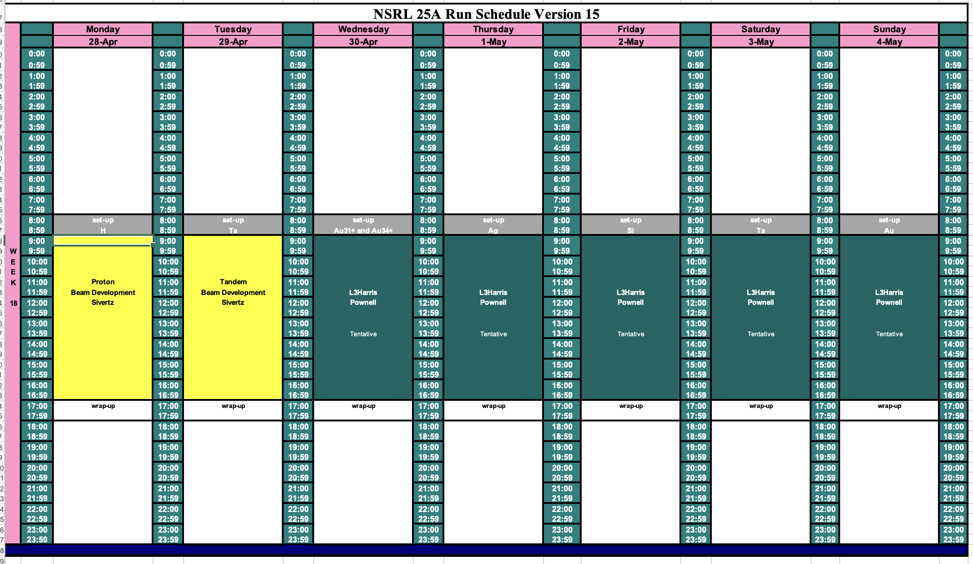
Schedule for next week

Slide 4
Future Schedule
Looking for both Au31+ and Au34+ on 4/22/25.
Booster Maintenance occupying all day on 4/23/25.
Ag on 4/24/25, with protons in the morning.
Au31+ on 4/25/25.
Classified running from 30 April through May 4.
Spread the work out over 5 days with one ion species per day.
Added two days, but made each day shorter.
Running now includes Saturday and Sunday.
Planning to spend the week of 19 May doing beam development for the NASA radiobiology program starting 2 June 2025.

