Slide 1
Time meeting
Accelerator Operations Support

Slide 2
RHIC:
Blue repairs
Continue, DX Splice assessment today
Access to most areas until repairs complete
IR4 posted work zone
POD meetings Daily
Streaming and here
See timeline HERE

Slide 3
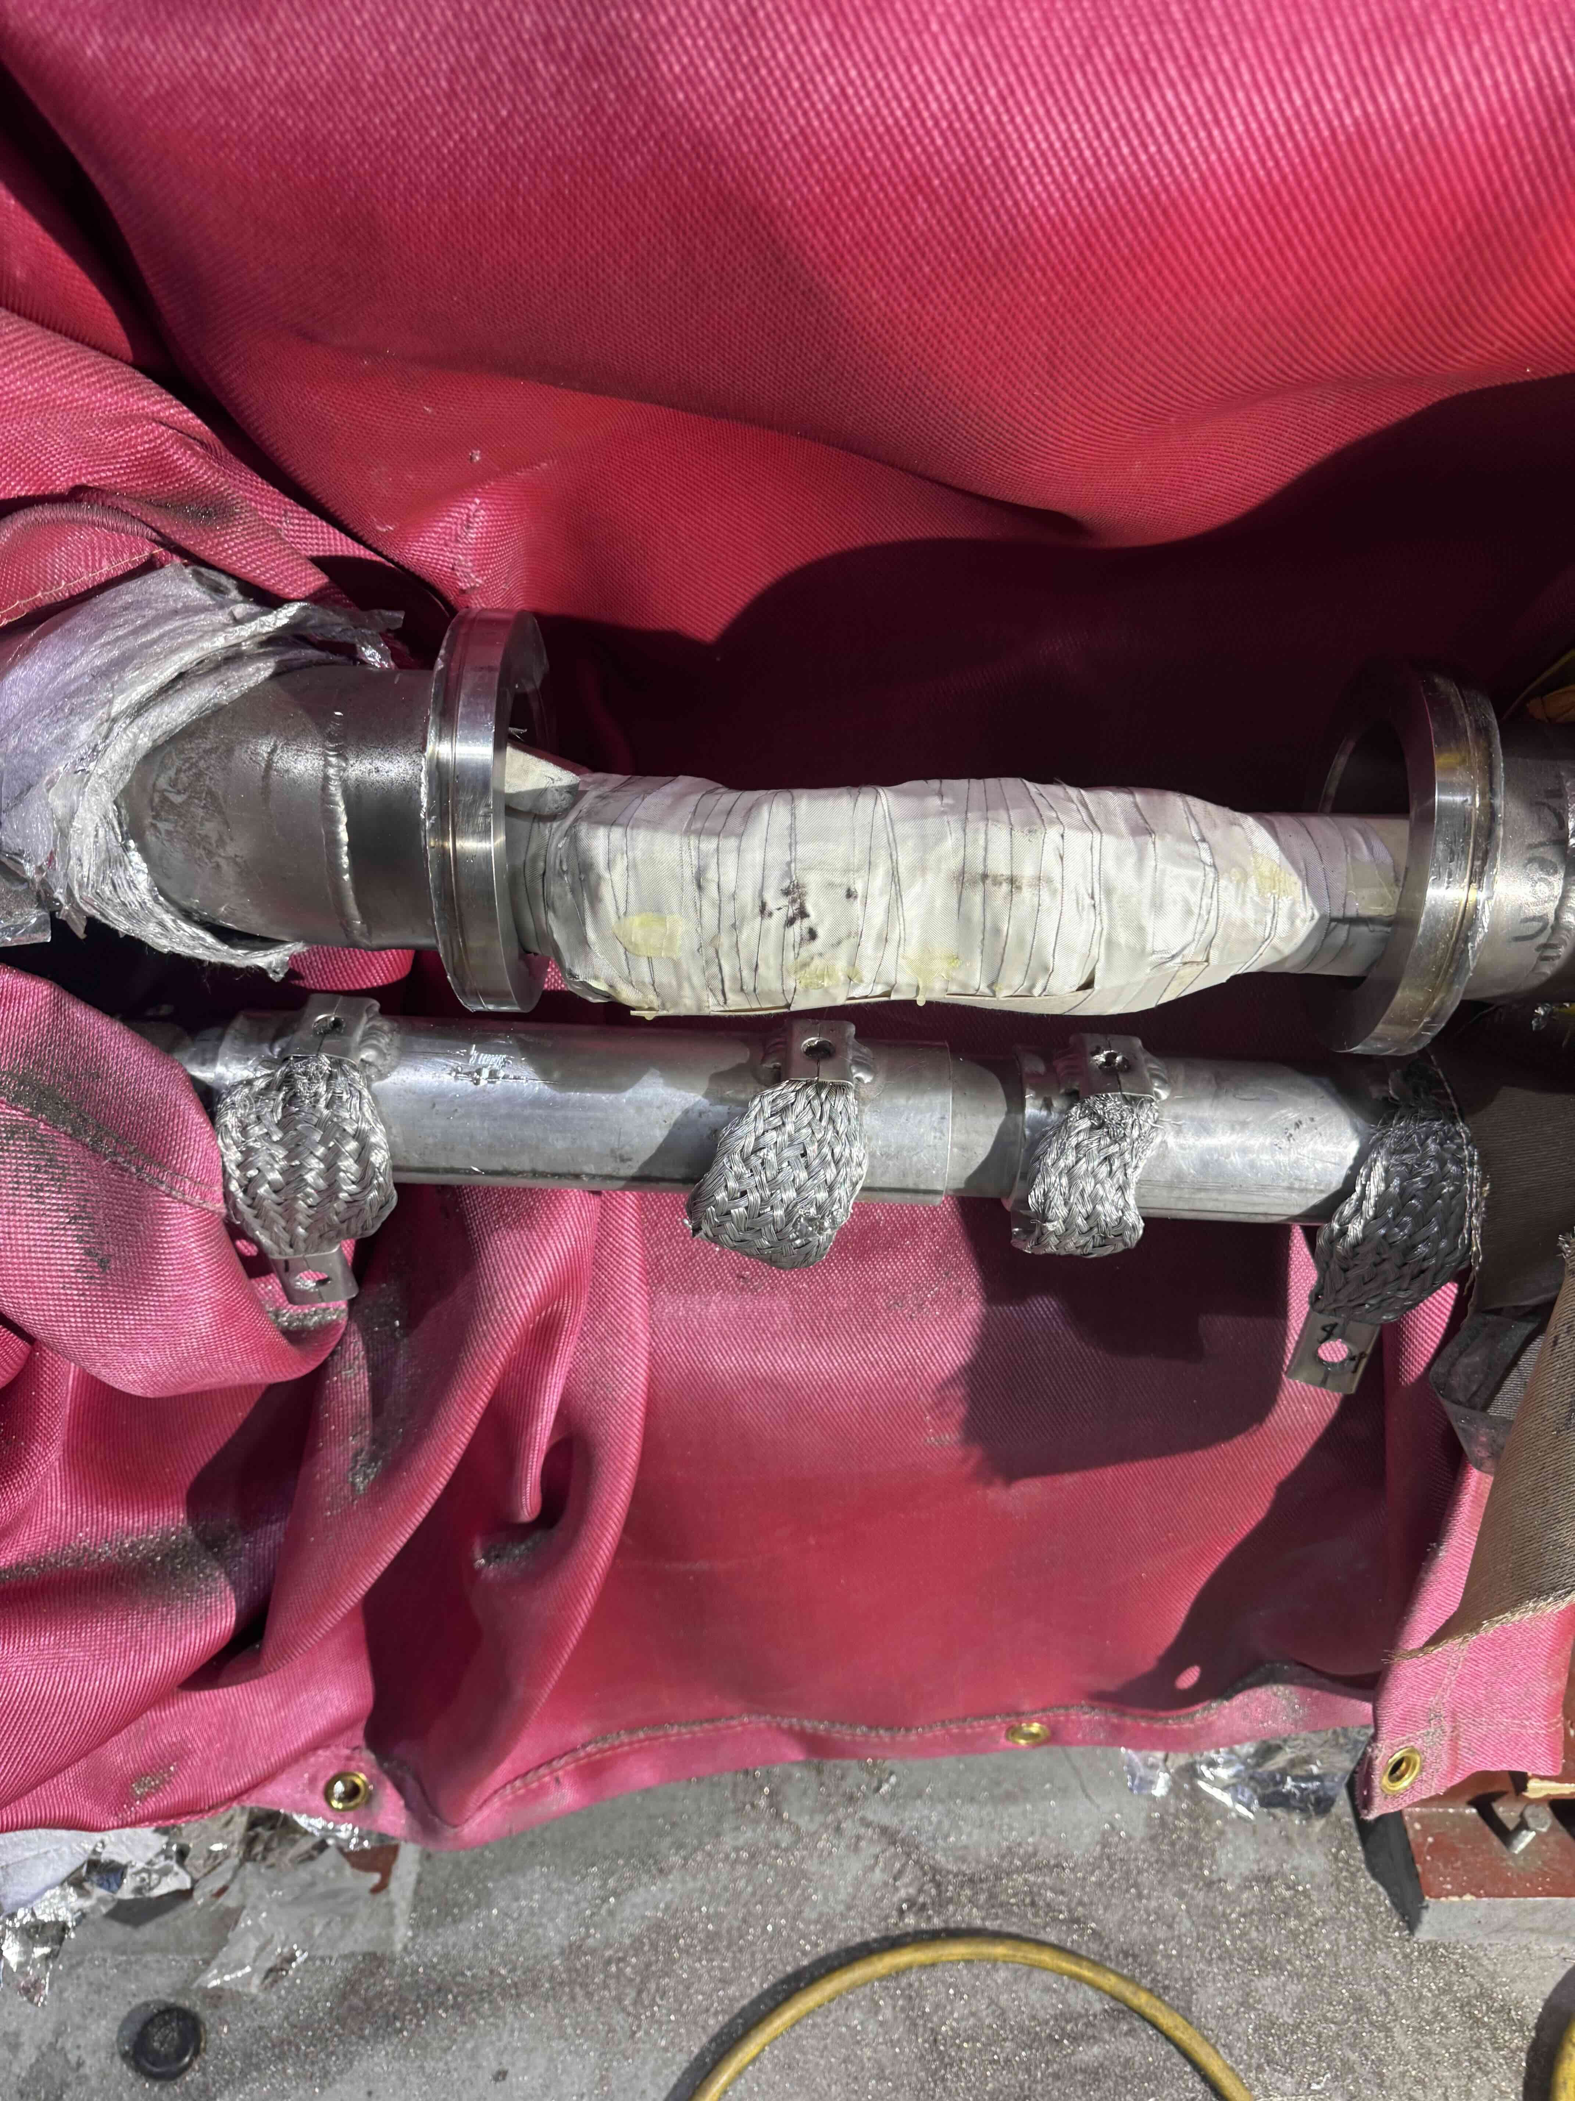

Slide 4
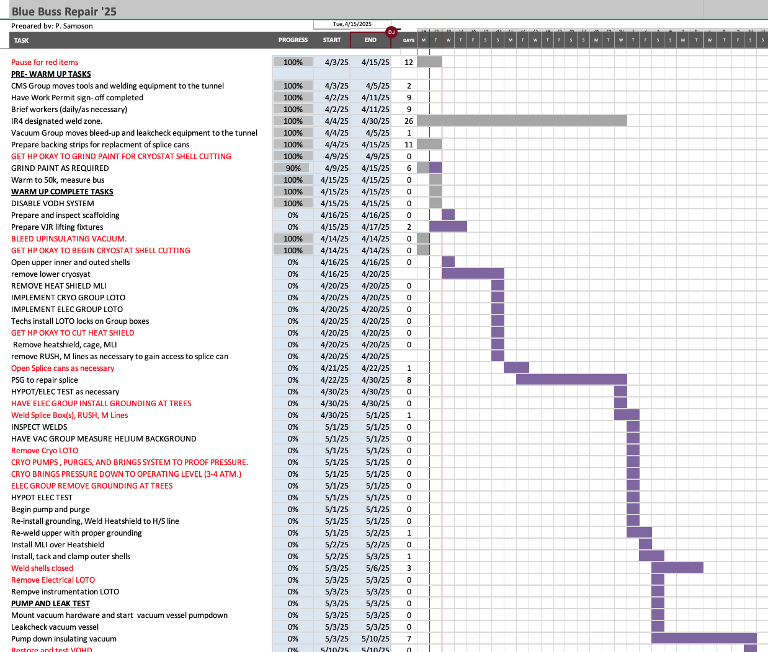

Slide 5
Maintenance in the injectors tomorrow
BLIP will run: No LINAC Access
PSEG outage until 1800hrs: No Booster Main Magnet

Slide 6
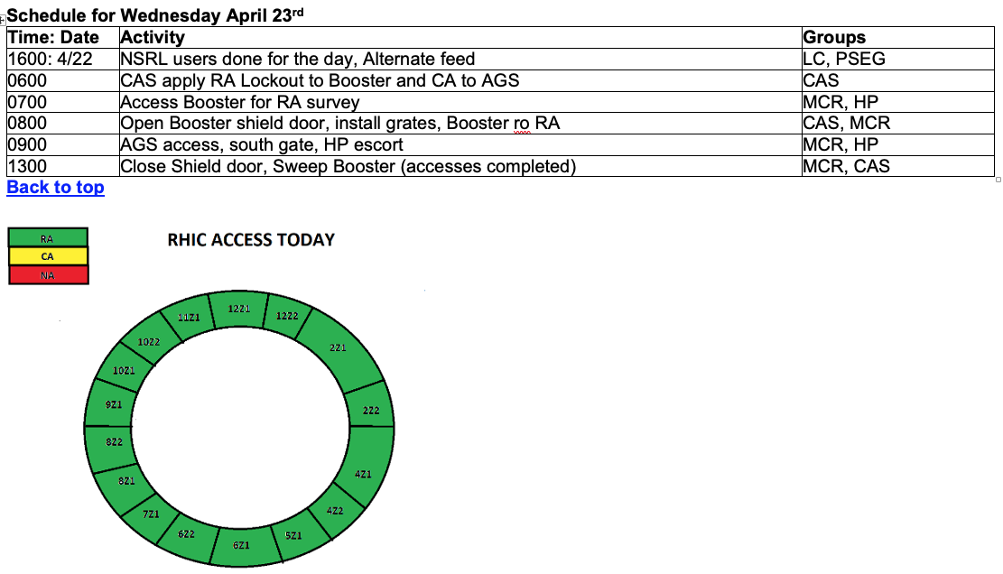
Access cartoon from “This_Week” (https://www.agsrhichome.bnl.gov/AGS/Accel/Maintenance/Schedules/This_week.htm#daily )

Slide 7
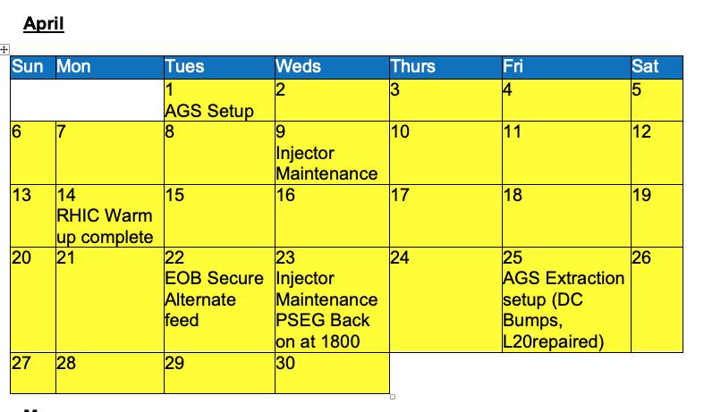

Slide 8
