Slide 1
Preinjector Status
D. Raparia
Time Meeting
April 29, 2025

Slide 2
Tandem
Tandem is delivering Au⁺³¹,³⁴ beams for NSRL.
Ta, Si, Ag, and Au⁺³¹,³⁴ beams are scheduled for NSRL this week.
This evening, Au⁺³¹ will be delivered to AGS for setup.
On 5/28, a new user utilized the beam from MP7, and an external user is scheduled for beam time over the upcoming weekend.
At MP6, repair work is ongoing and is expected to be completed soon.

Slide 3
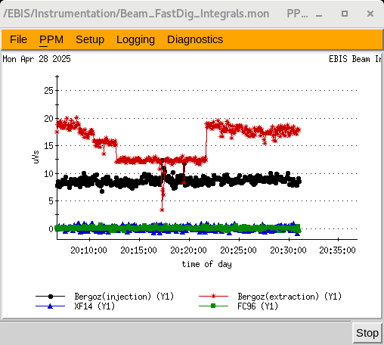
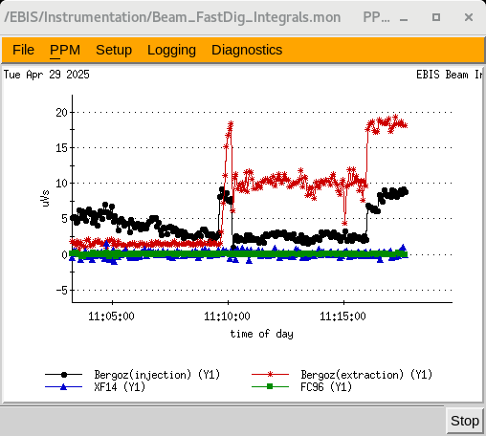
EBIS
LION2: Au, Si beam are fine , but Carbon beam is unstable, laser optics need some work
Ion extraction from EBIS using
-Si+ and Au+ was injected into EBIS from LION and extracted after further ionization and confinement to the Bergoz toroid at the EBIS exit
LEBT solenoid issues delayed injection into RFQ
RFQ RF PA were fixed on last Thursday
No beam through RFQ yet.
Setting up Si⁺⁹ today for EtB
Extracted Si (4/29)
Extracted Au (4/28)

Slide 4
New EBIS schedule

Slide 5
Linac, providing beam to NSRL, AGS, 200 MeV Polarimeter and BLIP
4/24: mod 4 , 100 Ohm , 50 watts resistor replacement in modulator
4/27: Mod 4, 4616 tube replacement
Several RFQ, Mod 1, 4 7, and 8 tripes
Total blip beam off time ~ 10 Hrs
OPPIS providing PP to NSRL, AGS and 200 MeV polarimeter
Next BLIP runs
Th Target: 5/23 to 6/3, 200 MeV, 150 uA
La Target: 6/4 to 6/6 (Tentative), 117 MeV, 62 uA
Th Target: 6/16 to 6/27 , 200 MeV, 150 uA

