Slide 1
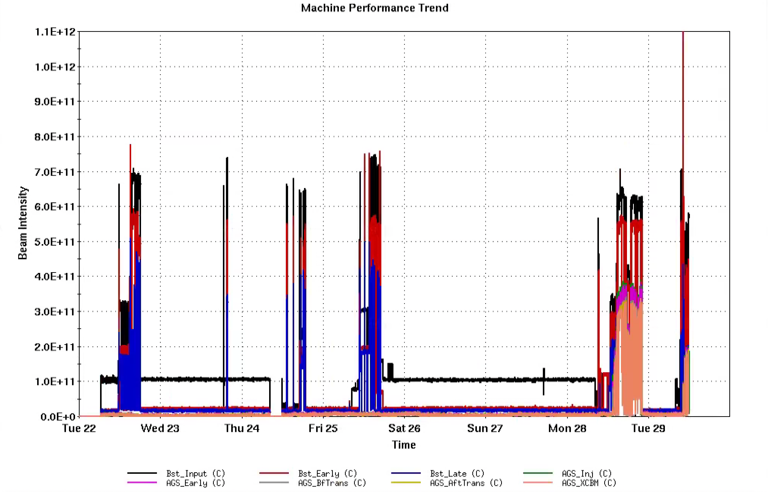
AGS Status: Time meeting 4/29/25
Extraction BLW supply work continues. Current outlook:
  Modifications complete in both supplies.
  Final testing on dummy load and into the ring next few days
  Turnover to operation early next week
L20 Septum operational, AGS development resumed starting Mon 4/28
Booster and AGS studies
  ORM for AI/ML optimization
  Space charge/emittance studies
  Polarization efficiency
Injector intensities

