Slide 1
sPHENIX status
Kin Yip
sPHENIX Director of Operations
Time Meeting
Apr. 29, 2025

Slide 2
sPHENIX Status
We continue taking cosmic data for alignment and are completing a lot of “summer tasks” now.
TPC: 5/6 line lasers have been implemented; and the TPC group this week is taking useful data with these lasers for static distortion measurements.
We’ve replaced a pump for each of the MVTX/INTT cooling systems.
DAQ is ready while the experts attempt to improve a few aspects.
We’re still working with C-AD, F&O and the vendor (Carrier) to fix two chillers outside 1008C, one with compressor issue and another one with pump issue.
  Reliable chiller is necessary for sPHENIX detector operation .

Slide 3
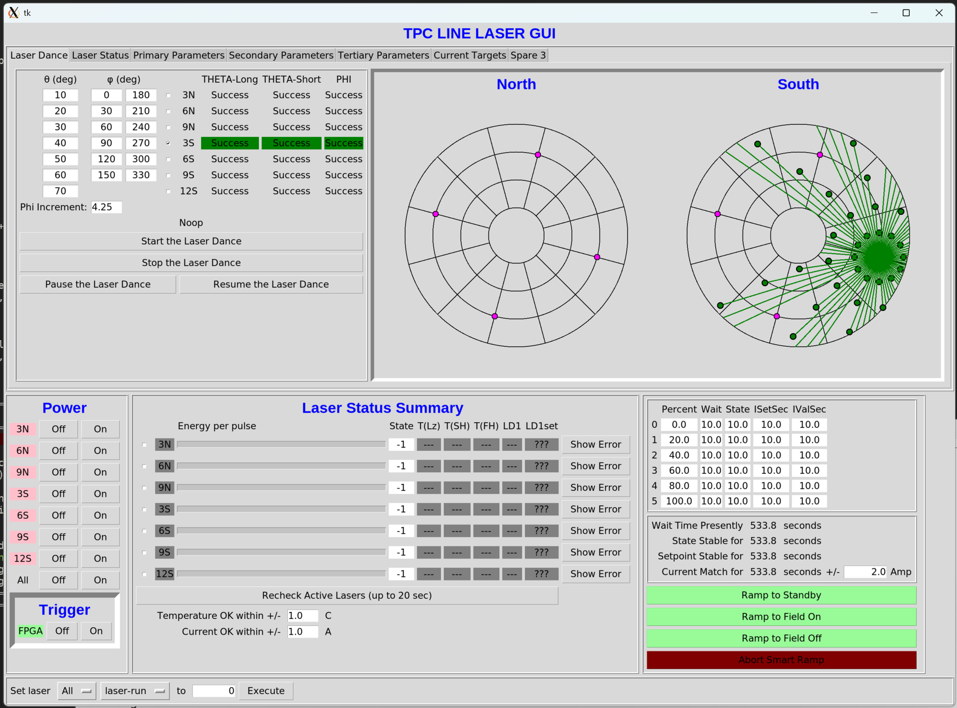
Line Laser Update
TK Hemmick

