Slide 1
Time meeting
Accelerator Operations Support

Slide 2
RHIC repair update :
Short located, repaired
Presently closing up splices and testing prior to welding the Main Line closed
Cryostst at Q1-Q2 has been welded closed
POD meetings Daily
Streaming and here
Progress updated in real time HERE

Slide 3
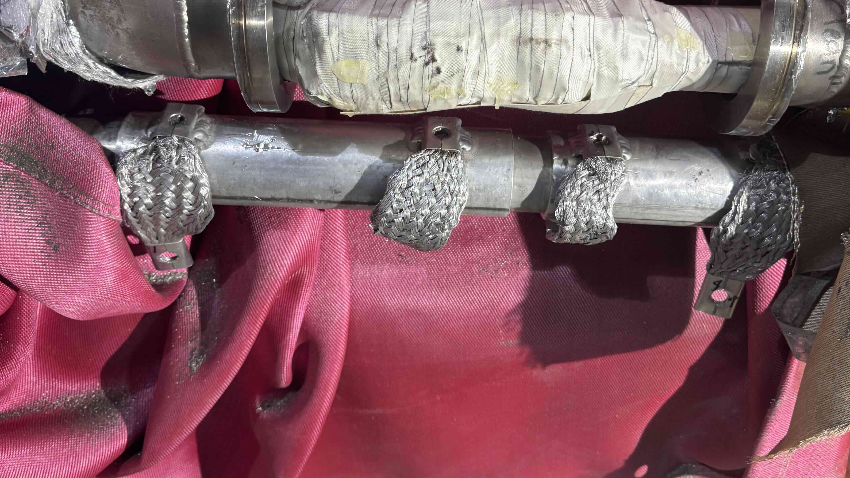
Splice can #3 before

Slide 4
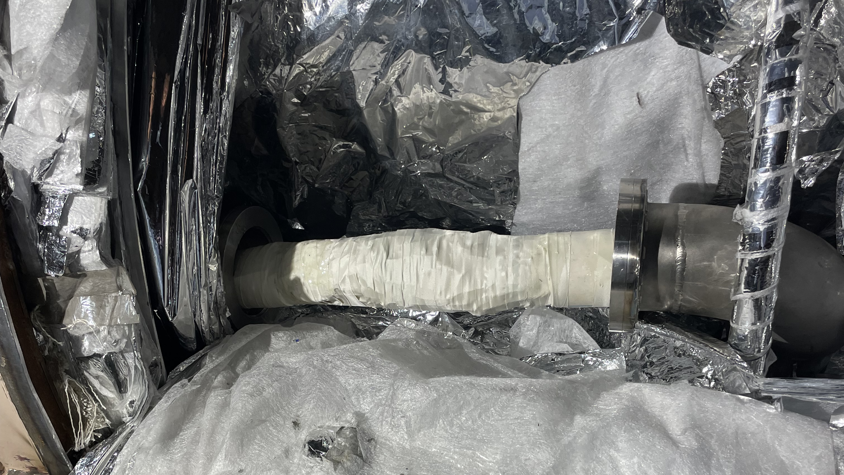
Splice can #3 after (nice!)

Slide 5
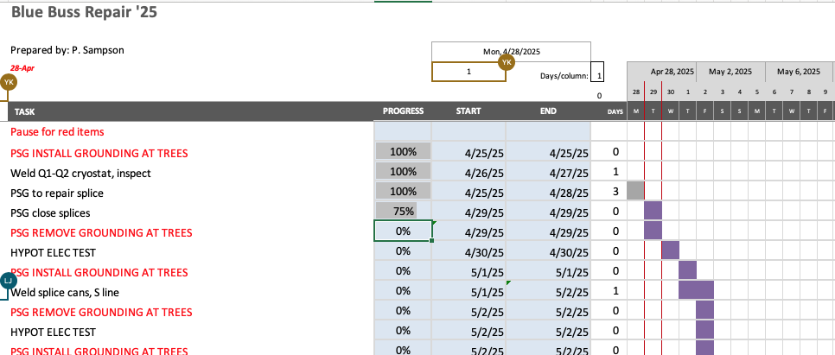

Slide 6
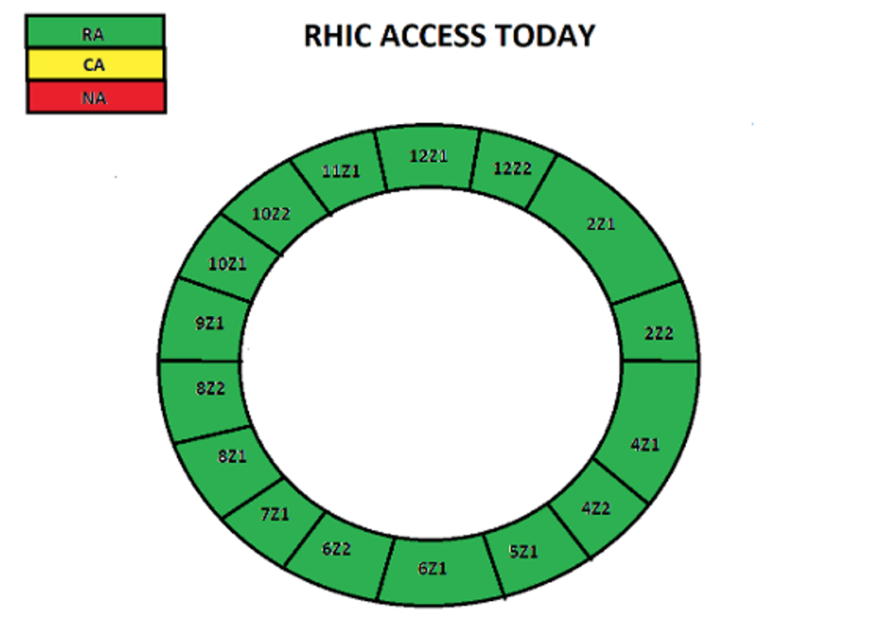
Access cartoon from “This_Week (https://www.agsrhichome.bnl.gov/AGS/Accel/Maintenance/Schedules/This_week.htm#daily )

Slide 7
