Slide 1
RHIC Time Meeting
Medani P. Sangroula
Scheduling Physicist
05/06/2025

Slide 2
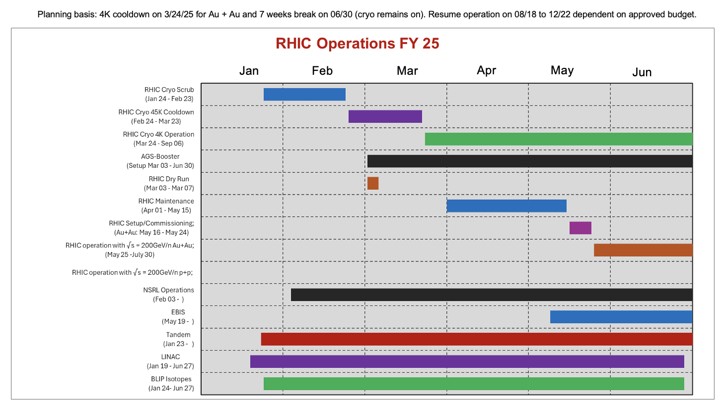
RHIC Schedule
More likely that planning basis will change.
Planning basis: 4K cooldown on 3/24/25 for Au + Au and 7 weeks break on 06/30 (cryo remains on). Resume operation on 08/18 to 12/22 dependent on approved budget.
Last revision: 05/05/2025
May 25
May 19
Jun 27

Slide 3
RHIC Schedule
Performing hi-pot testing after welding the splice can.
Unfortunately, these testing are failed on both rings due to moistures present after the power dips on last Friday caused by bad weather.
The RHIC commissioning date is slightly delayed to May 25th.
Aim to provide two days of Au 31+ for the beam development after the AGS H11 extraction bump repair.
Today, we will provide Au31+ beam.

