Slide 1
sPHENIX status
Kin Yip
sPHENIX Director of Operations
Time Meeting
May 6, 2025

Slide 2
sPHENIX Status
We continue taking cosmic data for alignment and are completing “summer tasks” in the remaining time before the RHIC beam arrives.
TPC: Performed line laser scans last week (for static distortion measurements).
now made “turnkey”;
gaining experience and continuing to improve;
DAQ continues to improve (e.g. fixed the remaining failure mode that requires reboot).
We stopped taking data since last Fri. to allow C-AD and the vendor (Carrier) to work to fix the water flow problem & two chillers, and add a rental chiller outside 1008C.
The goal is to get the water/chiller systems back by Wed.
Reliable chiller and water system are necessary for sPHENIX detector operation.

Slide 3
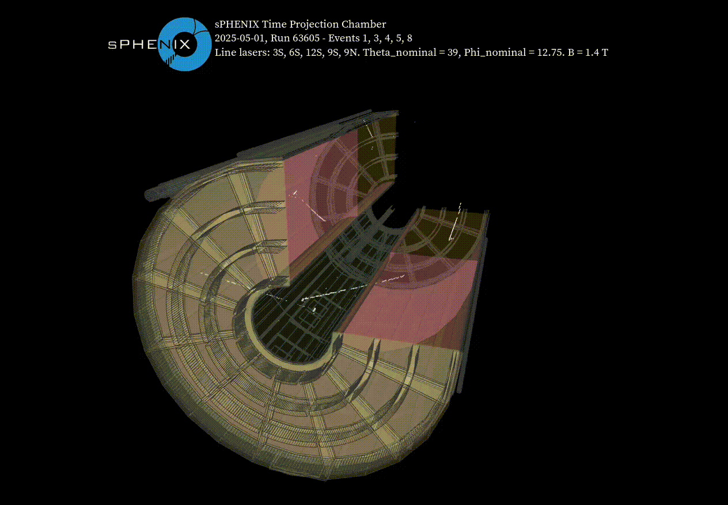
First Reconstructed Tracks and Evt Display (with line laser)
5 separate events give 5 different laser shots
Firing at θ=39°, φ=12.75°

