Slide 1
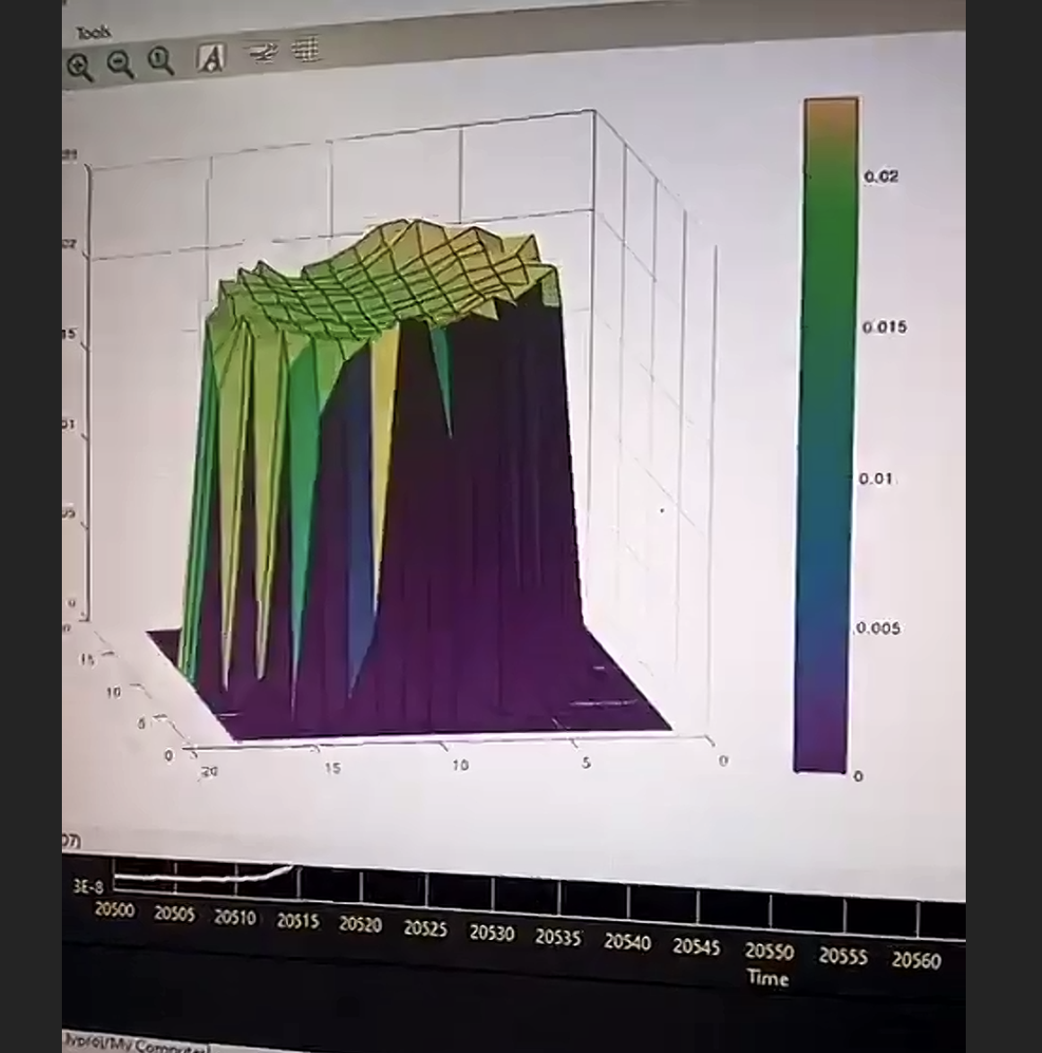
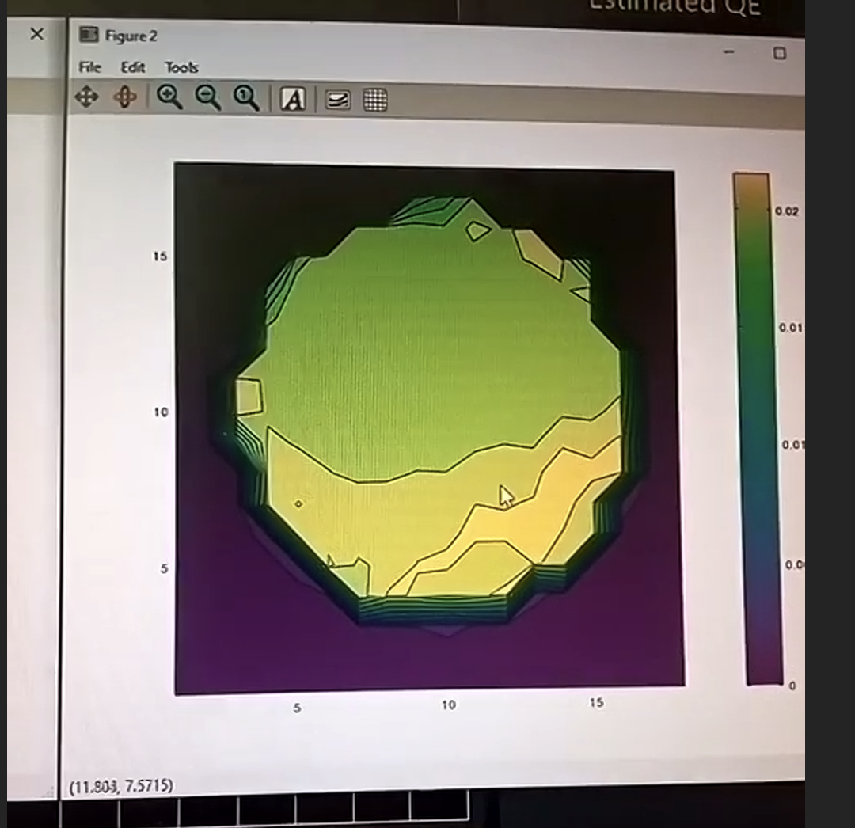
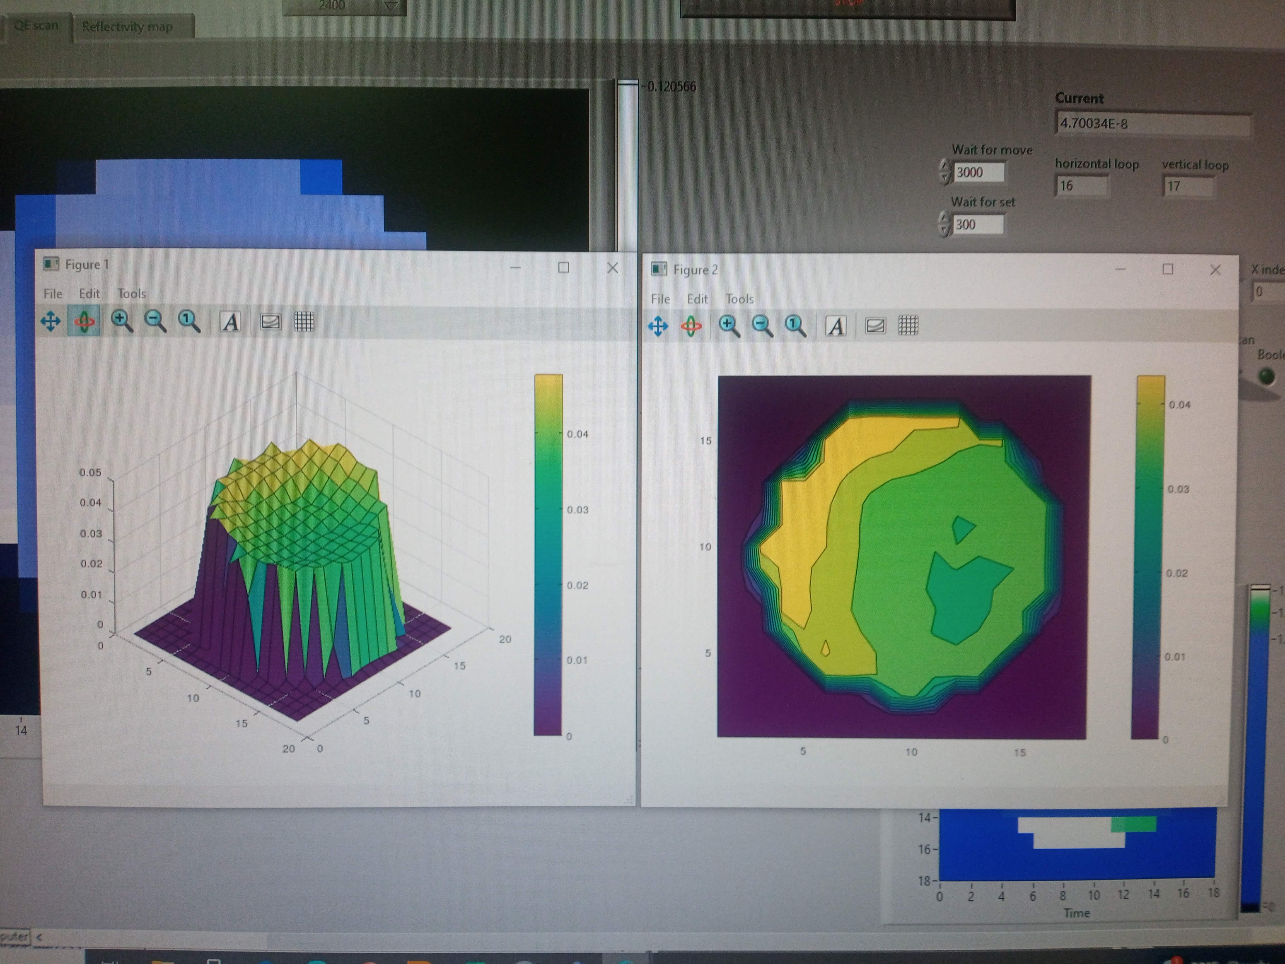
CeC status, 5/6/25
Sample 1
NaKSb Cathode
Some progress has been made towards better uniformity (+/-10% within ROI) as well as higher QE (2 - 4%).
A new one will be grown tomorrow.
4 good ones will in installed in the garage.
Vacuum group will start preparation to remove garage next Monday.
Sample 2
@ L. Cultrera

