Slide 1
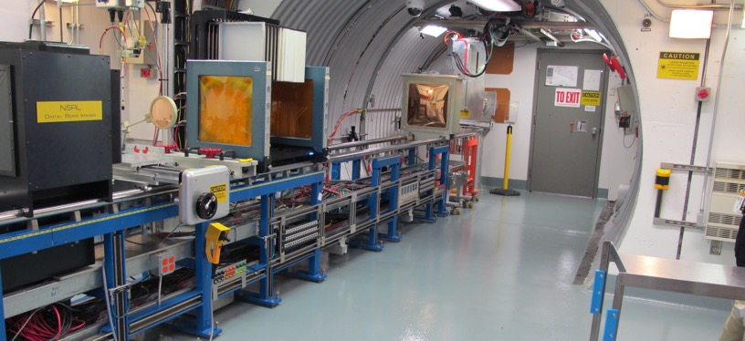
NSRL Time Meeting Report
6 May2025
Michael Sivertz

Slide 2
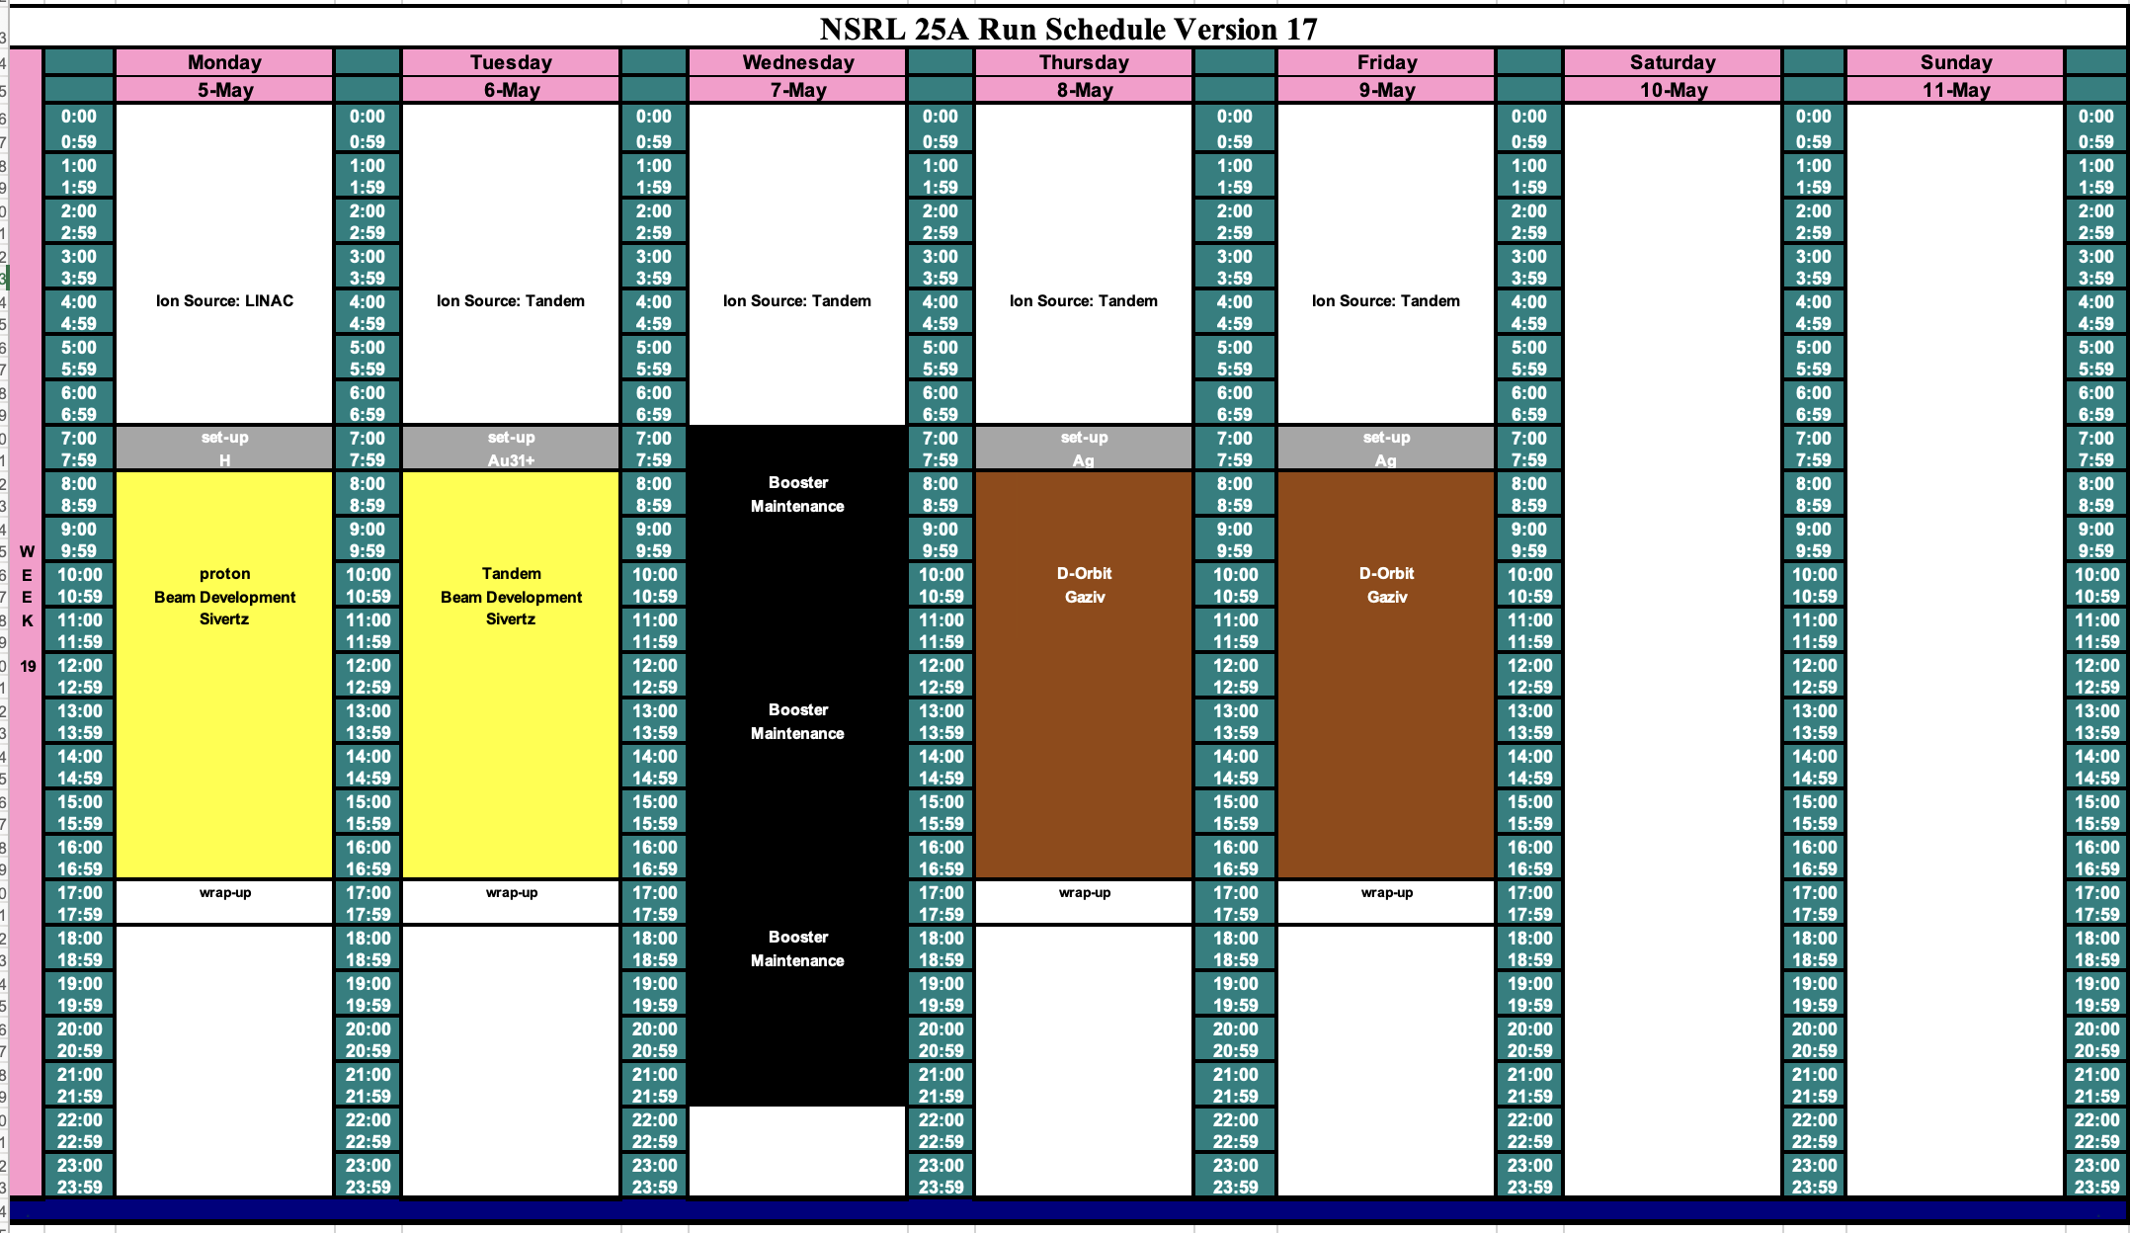
Schedule for this week

Slide 3
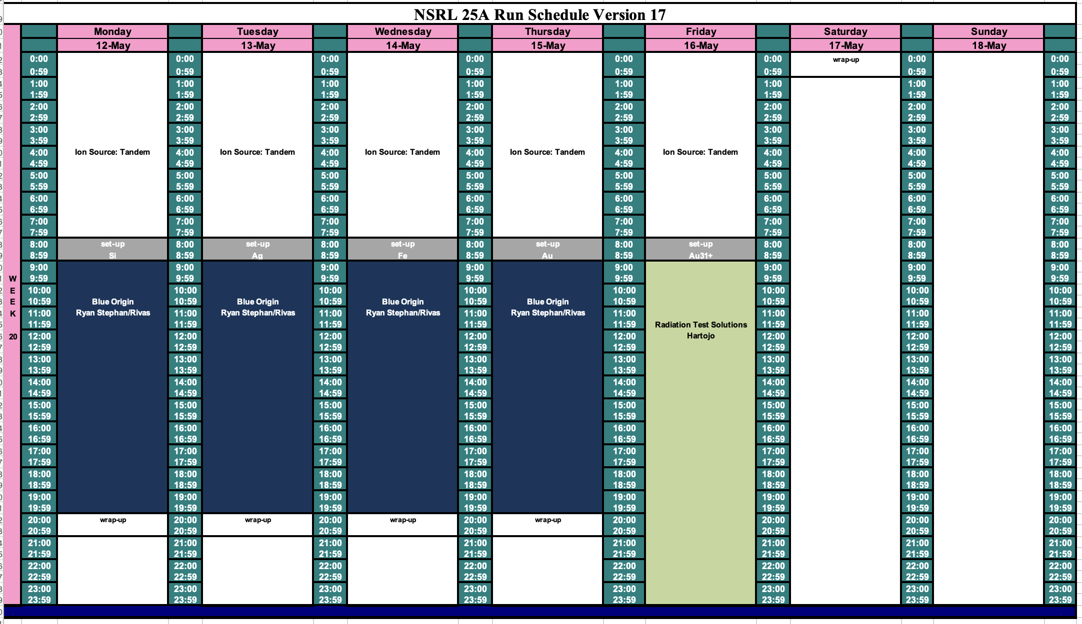
Schedule for next week

Slide 4
Future Schedule
Planning to spend the week of 19 May doing beam development for the NASA radiobiology program starting 2 June 2025.
The NASA radiobiology program is crucially dependent upon EBIS as the ion source.
Without EBIS, the June radiobiology program will have to be postponed or cancelled.

