Slide 2
Data courtesy C. Naylor

Slide 3
Data courtesy C. Naylor

Slide 4
Data courtesy C. Naylor

Slide 5
Data courtesy C. Naylor

Slide 6
Data courtesy C. Naylor

Slide 7
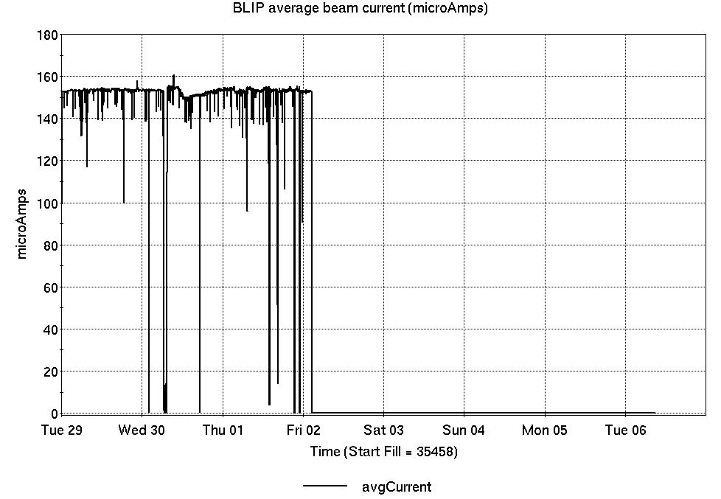
Operations for BLIP
4/29-5/6/2025:
200 MeV production concluded Friday.
64.73 hr production
8.27 hr failures
Availability: 88.7%
No BLIP
this past week

Slide 8
NSRL activity past week: 4/29-5/6/2025 (as of 0800)
NSRL running continues; various users along with beam setup/development for upcoming schedule.
Tandem Au, Si, I, Ta and Linac protons in use, for single ion modes.
Running 25-A schedule since 3 February. Schedule posted, updates to 28 June for beams & users. 25-C schedule also in planning stages for July-September.
Availability: 84.1%

Slide 9
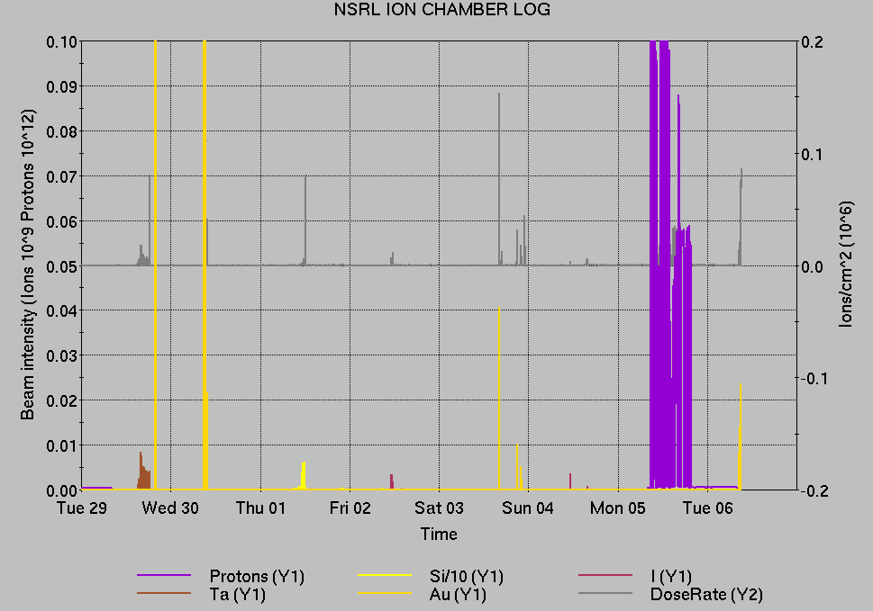
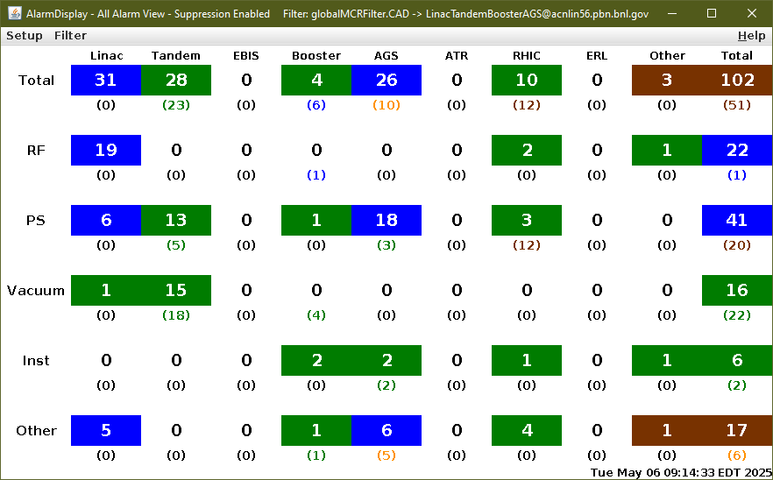
Notes from Operations
Notable failures (>1 hr)
RHIC Blue main dipole system failure,
ongoing
AGS extraction bump failures, ongoing
Power dip (2x), affecting Linac for BLIP,
OPPIS, and systems complex-wide
  AGS cold snake failure, ongoing
Tandem MP7 tuning to establish Ta, I intensity
Booster tuning for NSRL Si beams
TtB-17 vacuum valve failure, no remote control
Linac source failure, extractor voltage
tuned to reduce sparking
Linac Mod 8 grid deck fault, reset
Linac chiller trip
AGS A17 cold snake quad PS failure,
ongoing
Other notes
Various Tandem tuning, Linac trips/resets
Over 46 hours injector pp setup, other studies
(when injector systems are available)

Slide 10
Reminder from Operations
MCR beam operations continue
  Operator/OC shifts continue for NSRL users, 2 shifts/5 days this week and next.
    NSRL ions from Tandem (pending resumption of AGS Au); Linac protons as required
    GCR pending EBIS restart.
  No BLIP production until 23 May.
  RHIC beam setup suspended pending repair/cooldown
    AtR beam pending extraction PS failures.
  AGS Polarized proton setup, other studies continue 2 shifts/5 days pending failures
Note: MCR will not be occupied continuously.
  No OC nor Operator on duty overnight. Contact CAS in off hours (x2024) for urgent issues when MCR is not staffed.
Changes? Time to update is now. Expect calls at all hours.
  Alarm response instructions: Groups prompted for updates
  http://directory.pbn.bnl.gov/
    CHECK AND EDIT YOUR OWN CONTACT INFO
  https://www.cadops.bnl.gov/Operations/personnel/call_in_lists/
    CHECK YOUR CALLIN LIST: expect contact off-hours

Slide 11
Keytree notes
Remote keytree systems require a database lookup to validate and authorize distribution of keytokens. The Keytrak system’s database is available for lookup functionality, but can no longer be modified in any way to add or edit qualified personnel.
Personnel affected:
New employees, experimenters arriving after 12/1/2024 could not be enrolled in database
Existing employees & experimenters, not already enrolled, cannot be added or modified in database
Remote keytrees affected:
Iris scan @NSRL
BNLID scan @AGS South gate, North Conjunction Gate
Iris scan @RHIC STAR, sPHENIX, IP12, IP4
Keytrees NOT affected:
BNLID scan @Linac, Booster
BNLID scan @RHIC IP2
MCR keytrees

Slide 12
Keytree notes, continued
Mitigation:
Choose entrants that are currently enrolled to perform the work in the enclosure under Controlled Access (CA).
Obtain CA keys from MCR for remote gate watch
Arrange for local gate watch using other tokens for entrants.
Arrange for Restricted Access, and allow for delays incurred to sweep areas.
CAUTION
Follow procedures. Gate Watch staff will remain vigilant.
  No “piggy-backing” – one key/token per entrant.
  Access keys are not candy! Authenticated entrant retains possession.
Radiological Controls and the Access Controls System are not to be circumvented. This is (has been) enforced with disciplinary action (dismissal).

Slide 14
Notes:
Reliability comparisons to previous runs

Slide 15
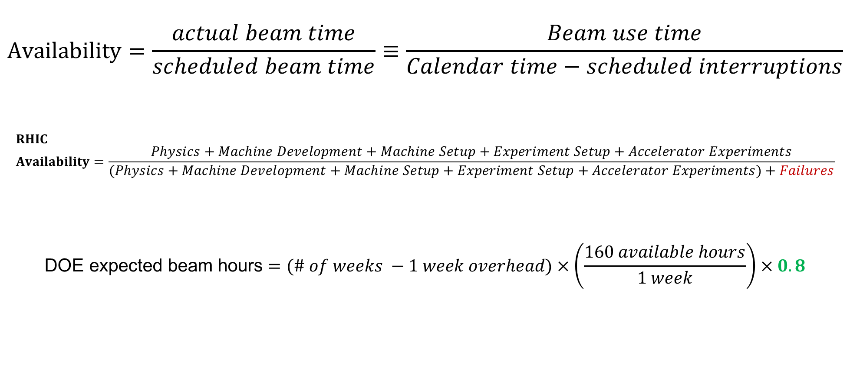
Availability, expected beam hours
$$Availability=\frac{actual beam time}{scheduled beam time}≡\frac{Beam use time}{Calendar time−scheduled interruptions}$$
$$RHIC \\ Availability=\frac{Physics+Machine Development+Machine Setup+Experiment Setup+Accelerator Experiments}{(Physics+Machine Development+Machine Setup+Experiment Setup+Accelerator Experiments)+Failures}$$
$$\text{DOE} \text{expected} \text{beam} \text{hours}=(\# of weeks −1 week overhead)×\left(\frac{160 available hours}{1 week}\right)×0.8$$
Notes:
Normally hidden. Explains how the 85% from DOE comes in to play, & general availability metrics

