Slide 1
Time meeting
Accelerator Operations Support

Slide 2
LINAC RF area Access today, Injector Maintenance tomorrow
Long day in Booster and AGS for new fire detection commissioning
Both in RA most of the day
LINAC Zones 3&4 access tomorrow
Meeting here at 3pm and streaming

Slide 3
RHIC repair update :
Main Line closed, leak tight
Final welds awaiting resolution of Hi-Pot issues
RUSH Lines at D0-Q1 welded today, pumping down now
POD meetings Daily
Streaming and here
Progress updated in real time HERE

Slide 4

Mitigating Moisture
ESF, F&O, CAD all working to reduce moisture in valve boxes
Heat, AC, and air recirculation being added
PSG working with others, diagnosis continues…

Slide 5
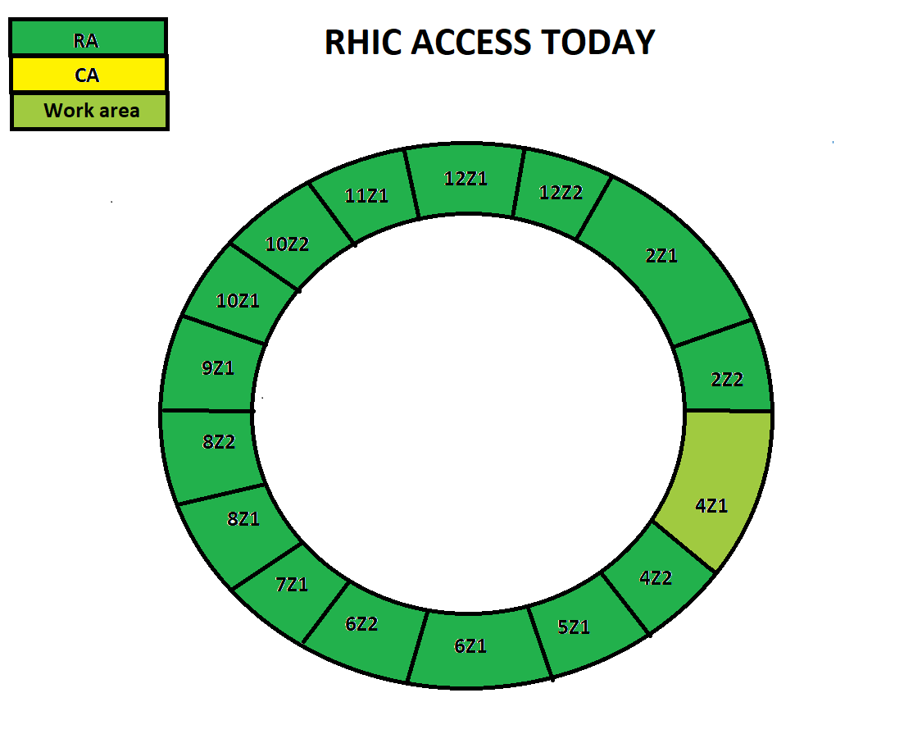
Access cartoon from “This_Week (https://www.agsrhichome.bnl.gov/AGS/Accel/Maintenance/Schedules/This_week.htm#daily )

Slide 6
