Slide 1
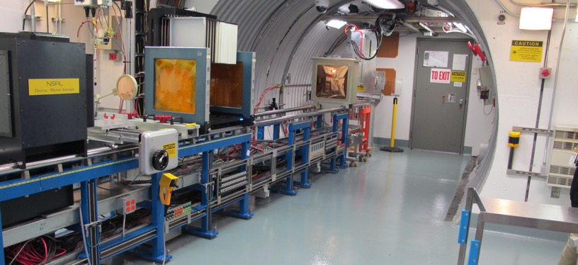
NSRL Time Meeting Report
13 May 2025
Michael Sivertz

Slide 2
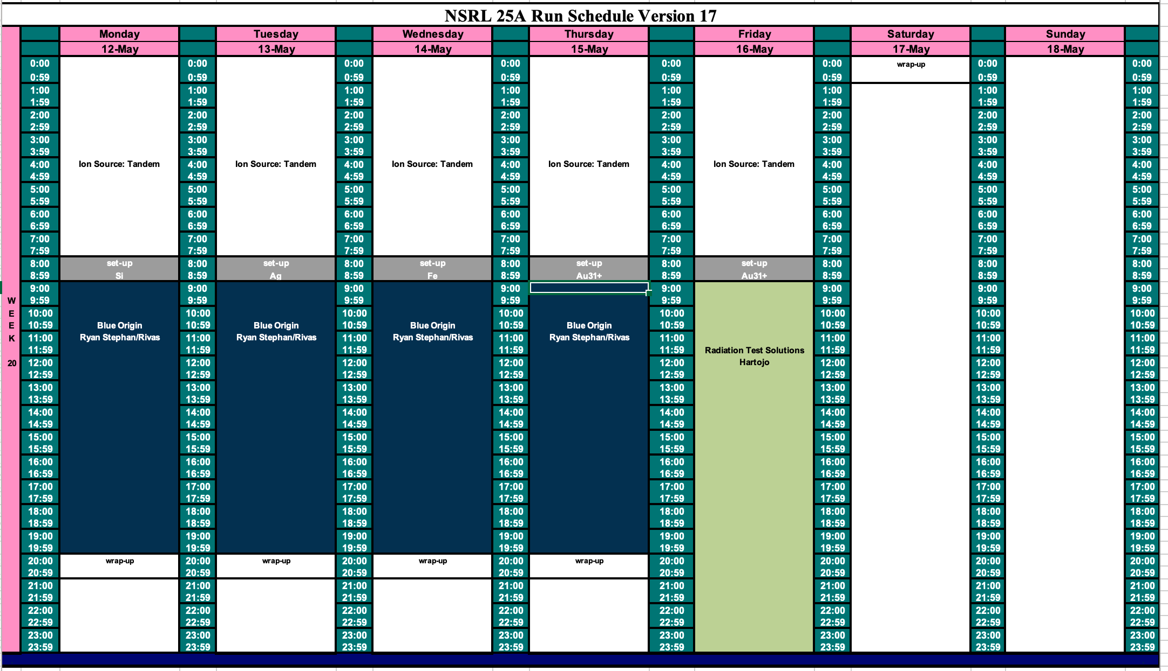
Schedule for this week

Slide 3
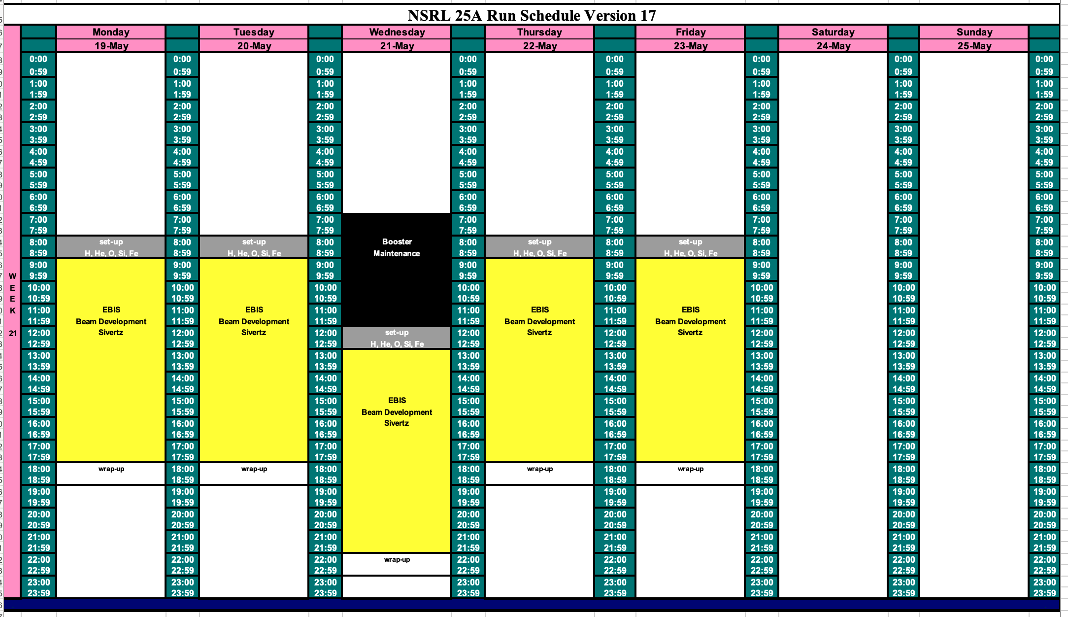
Schedule for next week

Slide 4
Future Schedule
Planning to spend the week of 19 May doing EBIS beam development.
Boeing will run with ions from EBIS for the week following Memorial Day.
The NASA radiobiology program starts 2 June 2025 running through 27 June.
The NASA radiobiology program is crucially dependent upon EBIS as the ion source.
Without EBIS, the June radiobiology program will have to be postponed or cancelled.

