Slide 1
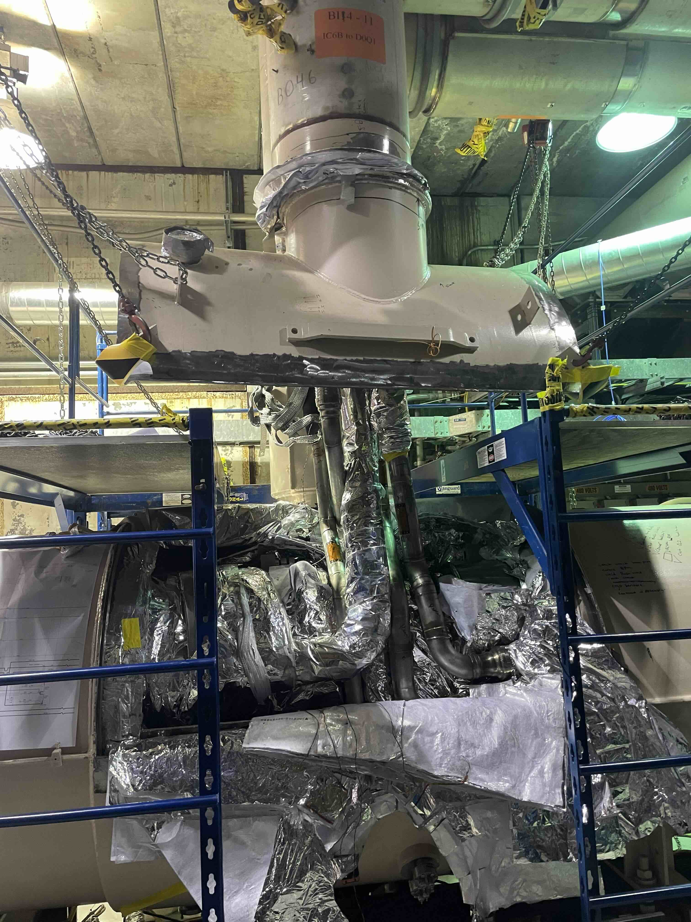
Time Meeting
Accelerator Operations Support

Slide 2
AGS Access Today
Repair RF station K
Switch G09C bump to magnet load for testing
LINAC Providing beam for development

Slide 3

901 power outage
Scheduled 8-hour outage this Saturday
All Tandem systems EXCEPT ODH
Coordinate shutdown
~3 days recovery expected

Slide 4

RHIC Repair status:
All cryostats closed last Saturday
Pump down Saturday and Sunday
Suspected leak, checked welds, nothing found
Found a leak on a pressure relief valve in the triplet area
Pump and purge to follow
Update here at 3pm POD meeting here and streaming
Progress updated in real time HERE

Slide 5
Other RHIC items:
Closing up RHIC sector 2 tomorrow for testing
Emergency generator tests for May to be completed this week and next
Adjacent areas (Berms etc.) will be locked starting this week
ORC items to be rechecked prior to setup with beam

Slide 6
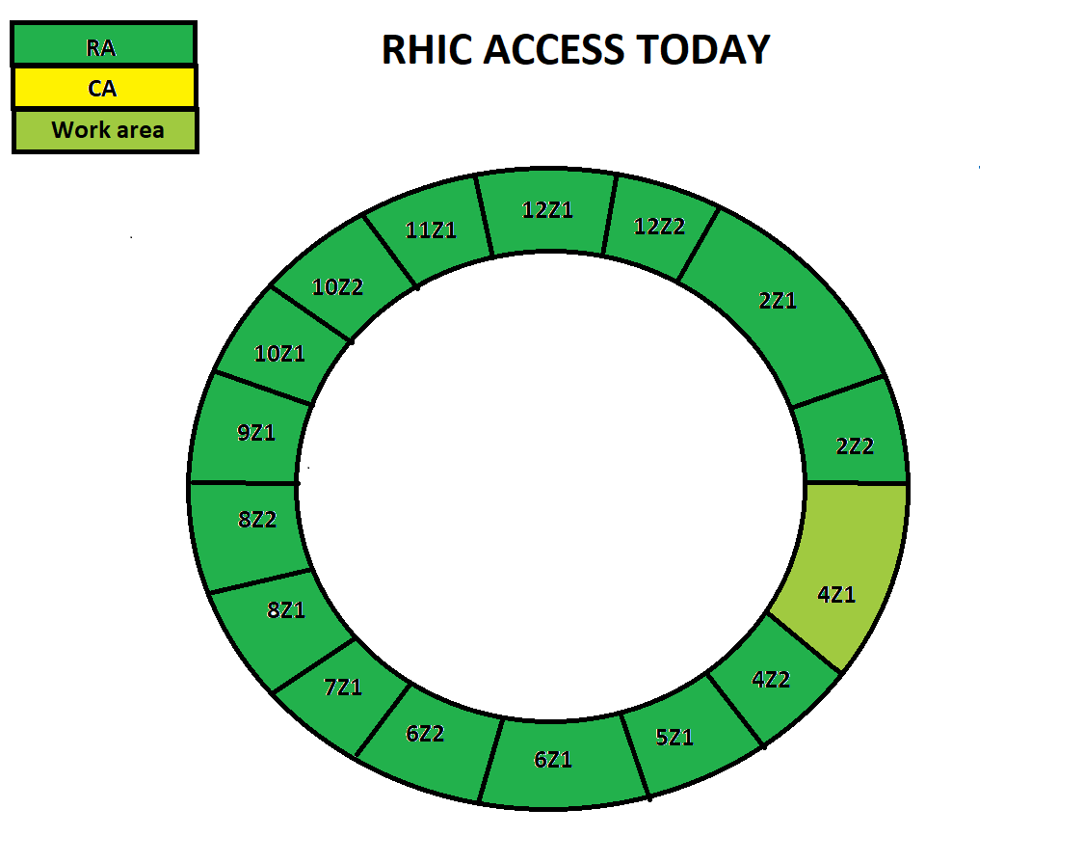
Access cartoon from “This_Week (https://www.agsrhichome.bnl.gov/AGS/Accel/Maintenance/Schedules/This_week.htm#daily )

Slide 7
