Slide 1
Preinjector Status
D. Raparia
Time Meeting
May 20, 2025

Slide 2
Tandem
Fe⁺²⁰, Ag⁺²⁸ and Au⁺³¹,³⁴ ,beams from MP7 were delivered for NSRL last week.
May 17: Power outage , recovery is progressing well
Rebuilding the ion source, expected completion today (5/20)
Beam expected to resume: Thursday May 22.
After recovery, it will switch to Au31+ beam delivery for RHIC.
MP6 charging system issues are on going

Slide 3
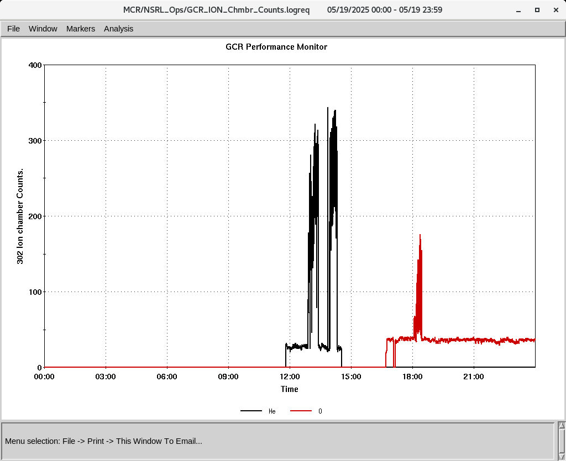
EBIS
He^{2+,} Si^{11+,} O^{7+,} and Fe¹⁵⁺ are transported to end EtB
He²⁺ and O⁷⁺ were used for setup Yesterday (5/19)
EBIS LION2 source target issue, opened to replace Fe
The EBIS platform power supply (PS) is currently limited to 45 kV.
-This voltage is sufficient for GCR, but inadequate for heavier ions, troubleshooting started this morning by pulse power group
He+2(black) O+7 (red)
at NSRL

Slide 4
Linac, providing beam to NSRL, AGS, 200 MeV Polarimeter
Linac running smoothly
5/19 : setup for BLIP 2.5 Hrs
OPPIS providing PP to NSRL, AGS and 200 MeV polarimeter
( OPPIS work on cryo pump.)
Next BLIP runs
Th Target: 5/23 to 6/3, 200 MeV, 150 uA
La Target: 6/4 to 6/6 (Tentative), 117 MeV, 62 uA
Ti Foil: 6/9/ to 6/10 : 66 MeV, 0.1 uA
Th Target: 6/16 to 6/27 , 200 MeV, 150 uA

