Slide 1
sPHENIX status
Kin Yip
sPHENIX Director of Operations
Time Meeting
May 20, 2025

Slide 2
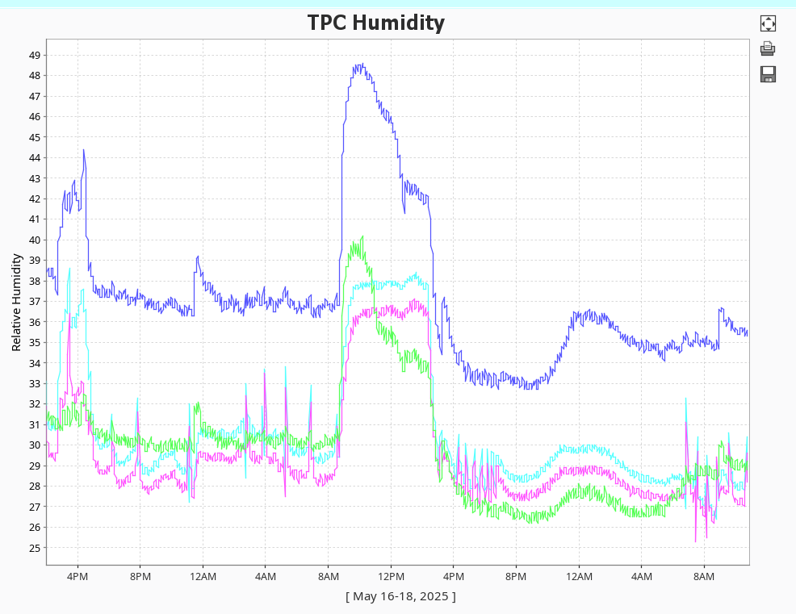
sPHENIX Status
New rental generator (3rd attempt, with a different voltage regulator) for the rental chiller works and we have been using it since last Fri. afternoon (May 16) with no issue.
May 17: Tunnel exhaust fans turning
on due to VODH alarm brought humid
air into IR8 and the humidity dropped
only after the fans were turned off.
There were puddles of water on the
floor in IR8.
Our “dry run” was completed last week, concluding with discussion of lessons learned and improvements last Thur.
TPC and other detectors further optimize their operation such as how best to deal with trips and also making calibrations. We continue to take cosmic data before RHIC beams arrive.

