Slide 1
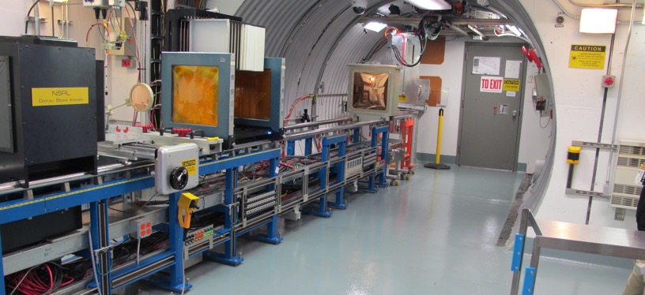
NSRL Time Meeting Report
20 May 2025
Michael Sivertz

Slide 2
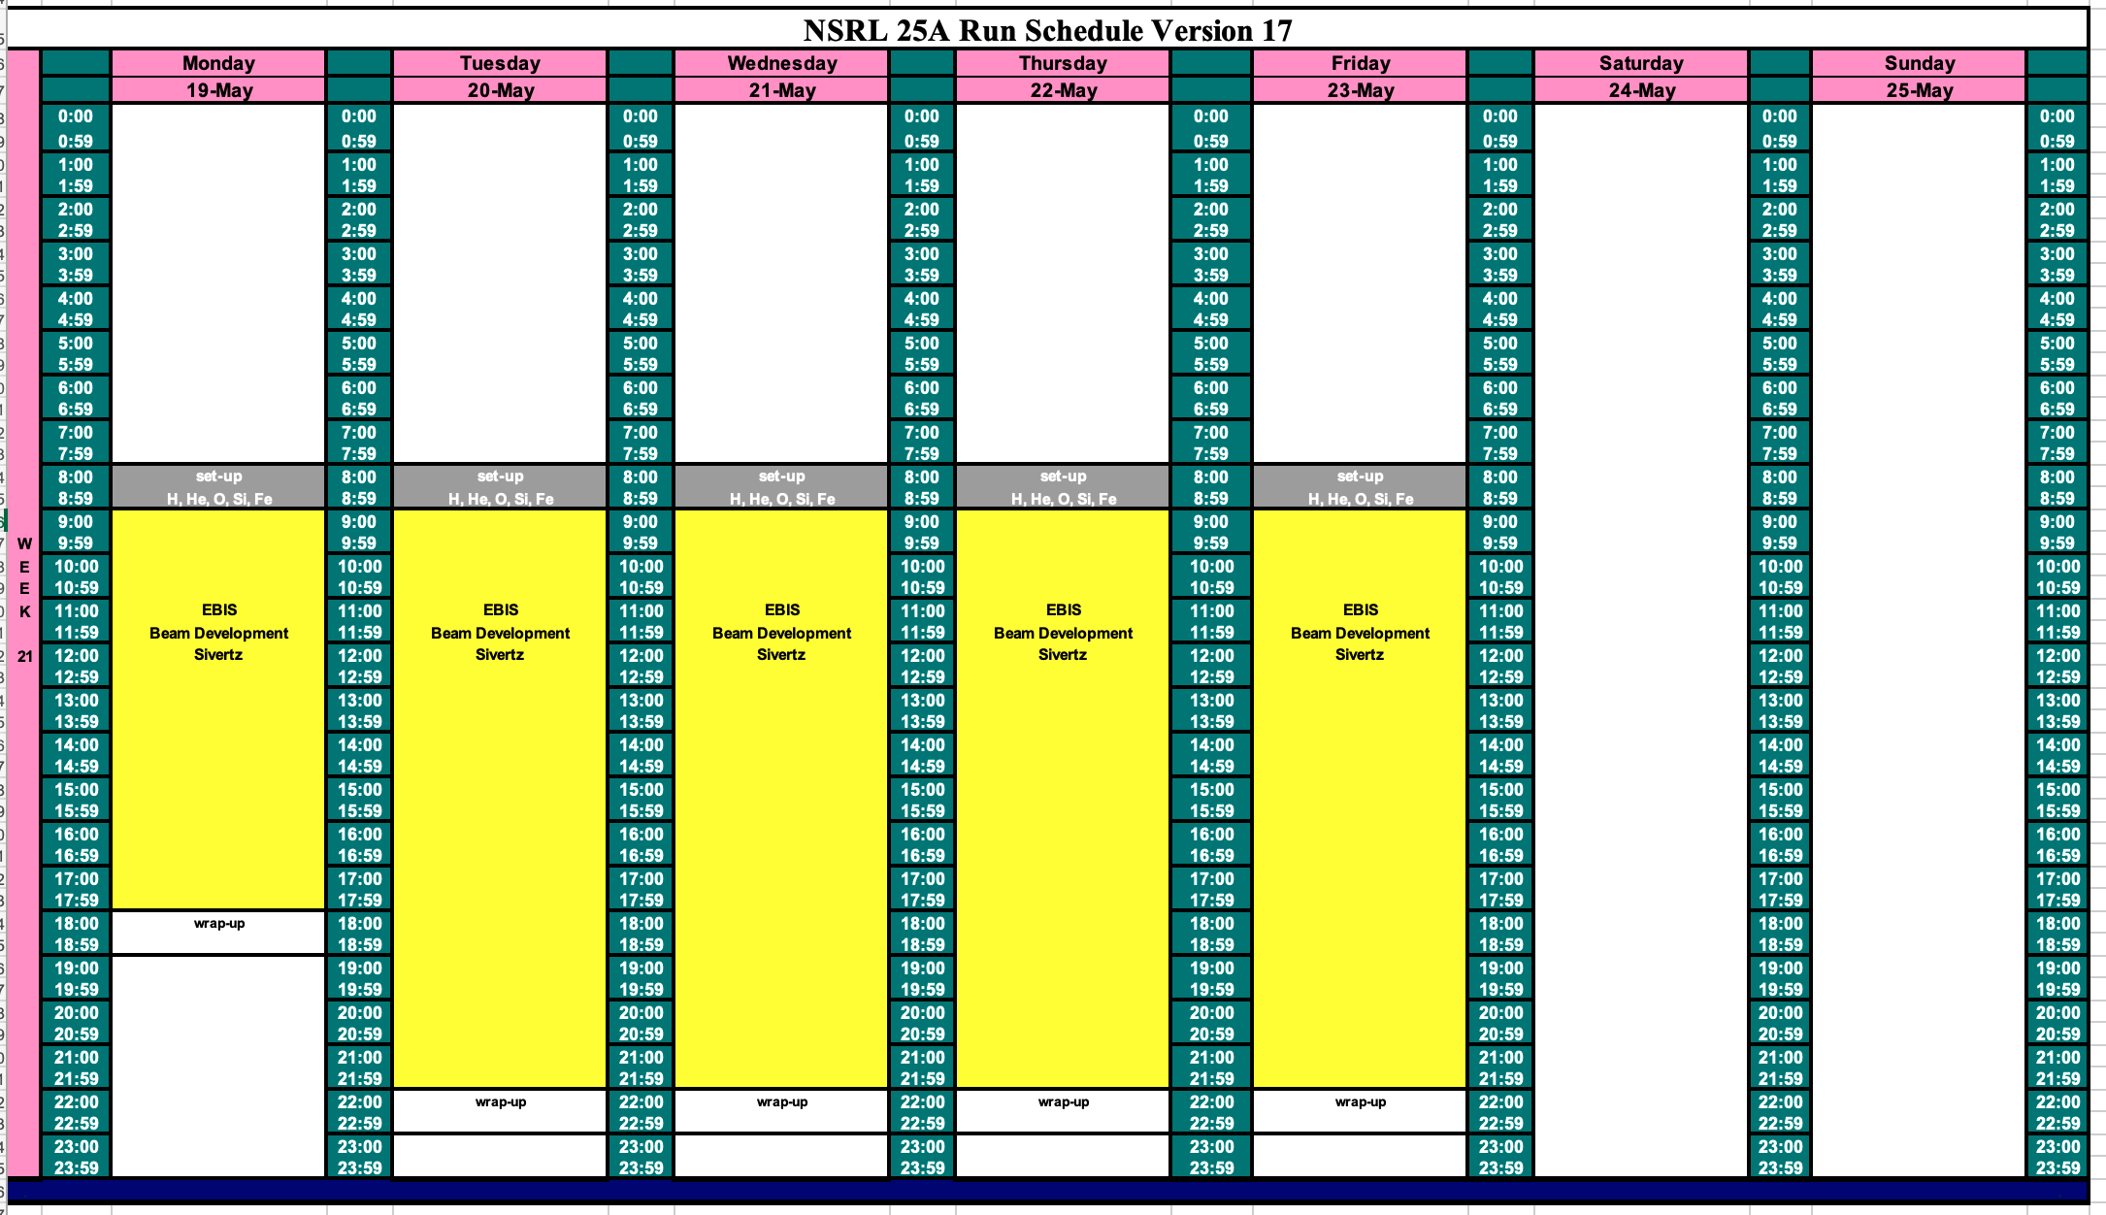
Schedule for this week

Slide 3
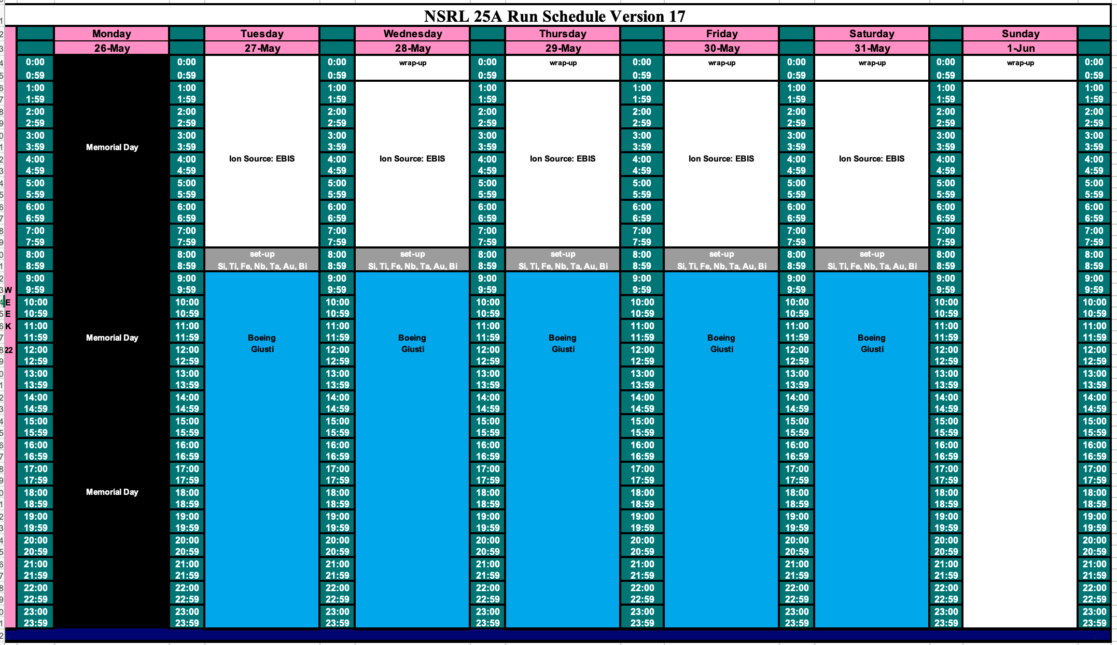
Schedule for next week

Slide 4
Future Schedule
Planning to spend the week of 19 May doing EBIS beam development.
No Booster Maintenance this week.
Boeing will run with ions (Si, Ti, Fe, Nb, Ta, Au, Bi) from EBIS for the week following Memorial Day.
The NASA radiobiology program starts 2 June 2025 running through 27 June.

