Slide 2
Data courtesy C. Naylor

Slide 3
Data courtesy C. Naylor

Slide 4
Data courtesy C. Naylor

Slide 5
Data courtesy C. Naylor

Slide 6
Data courtesy C. Naylor

Slide 7
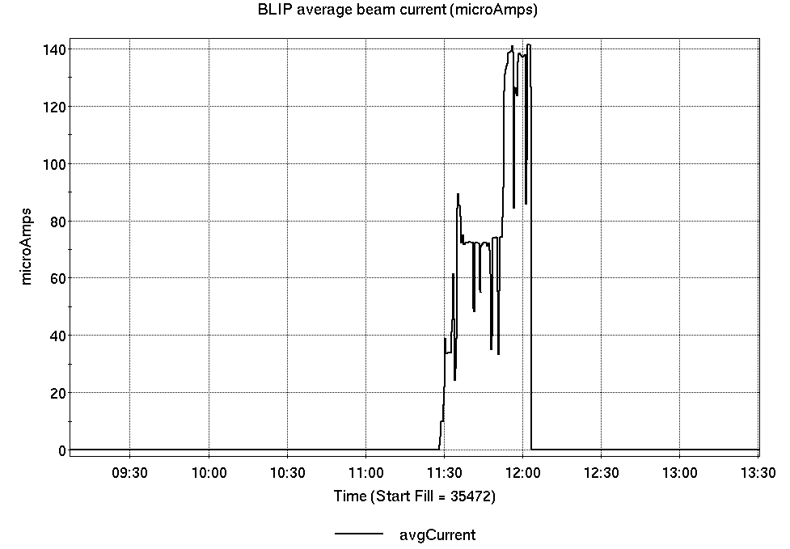
Operations for BLIP
5/13-20/2025:
2.2 hr Machine Setup on Monday.
No failures.
No BLIP
this past week

Slide 8
NSRL activity past week: 5/13-20/2025 (as of 0800)
NSRL running continues; various users along with beam setup/development for upcoming schedule.
Tandem Si, Fe, Ag, Au; Linac protons;
EBIS He, O in Booster and delivered to NSRL.
Running 25-A schedule since 3 February. Schedule posted, updates to 28 June for beams & users. 25-C schedule yet to be published for July-September.
Availability: 92.0%

Slide 9
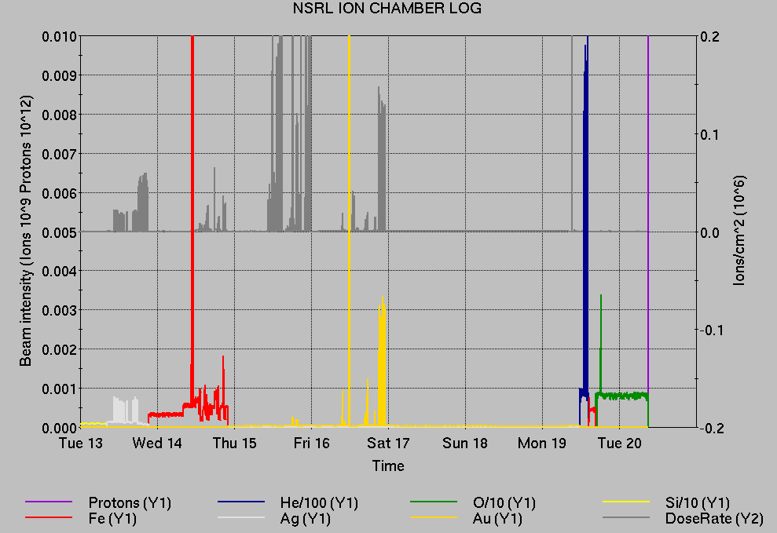
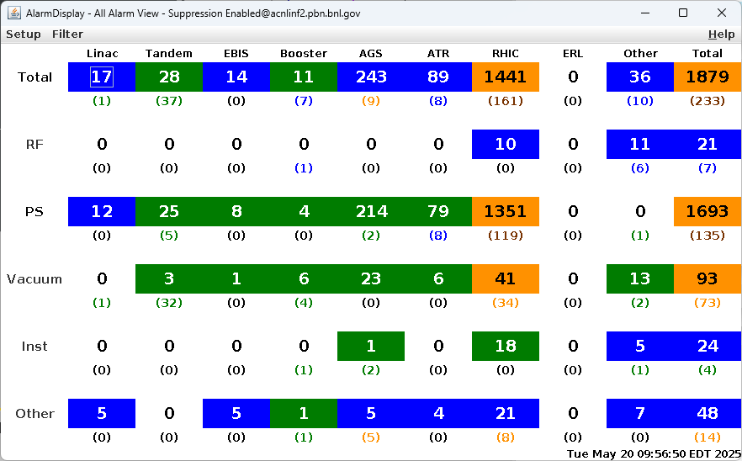
Notes from Operations
Notable failures (>1 hr)
RHIC Blue main dipole system failure, ongoing
AGS extraction bump failures, ongoing
AGS G10 kicker failure, ongoing, requiring access
EBIS LION2 source target issue, opened to examine/replace Fe
Access for AGS RF station K repairs, flow switch replaced
Other notes
Various Tandem tuning, accesses for MP6. Restoration from planned outage pending.
Linac OPPIS work on cryo pump.
Various Booster, AGS RF trips/resets/tuning
Over 25 hours injector pp setup, other studies (when injector systems are available)

Slide 10
Reminder from Operations
MCR beam operations continue
Operator/OC shifts continue for NSRL users, 2 shifts/5 days this week and next.
NSRL ions from Tandem (pending resumption of AGS Au); Linac protons as required.
GCR pending EBIS restoration of ion beams.
BLIP production resumes 23 May.
RHIC beam setup pending cooldown, testing repair
AtR beam pending extraction PS failures.
Dedicated Au beam setup anticipated 27 May
AGS Polarized proton setup, other studies continue 2 shifts/5 days
Note: MCR will not be occupied continuously.
No OC on duty overnight or weekend. No Operators overnight before Friday.
Contact CAS in off hours (x2024) for urgent issues when MCR is not staffed.
Changes? Time to update is now. Expect calls at all hours.
Alarm response instructions: Groups prompted for updates
http://directory.pbn.bnl.gov/
CHECK AND EDIT YOUR OWN CONTACT INFO
https://www.cadops.bnl.gov/Operations/personnel/call_in_lists/
CHECK YOUR CALLIN LIST: expect contact off-hours

Slide 11
Keytree notes
Remote keytree systems require a database lookup to validate and authorize distribution of keytokens. The Keytrak system’s database is available for lookup functionality, but can no longer be modified in any way to add or edit qualified personnel.
Personnel affected:
New employees, experimenters arriving after 12/1/2024 could not be enrolled in database
Existing employees & experimenters, not already enrolled, cannot be added or modified in database
Remote keytrees affected:
Iris scan @NSRL
BNLID scan @AGS South gate, North Conjunction Gate
Iris scan @RHIC STAR, sPHENIX, IP12, IP4
Keytrees NOT affected:
BNLID scan @Linac, Booster
BNLID scan @RHIC IP2
MCR keytrees

Slide 12
Keytree notes, continued
Mitigation:
Choose entrants that are currently enrolled to perform the work in the enclosure under Controlled Access (CA).
Obtain CA keys from MCR for remote gate watch
Arrange for local gate watch using other tokens for entrants.
Arrange for Restricted Access, and allow for delays incurred to sweep areas.
CAUTION
Follow procedures. Gate Watch staff will remain vigilant.
No “piggy-backing” – one key/token per entrant.
Access keys are not candy! Authenticated entrant retains possession.
Radiological Controls and the Access Controls System are not to be circumvented. This is (has been) enforced with disciplinary action (dismissal).

Slide 14
Notes:
Reliability comparisons to previous runs

Slide 15
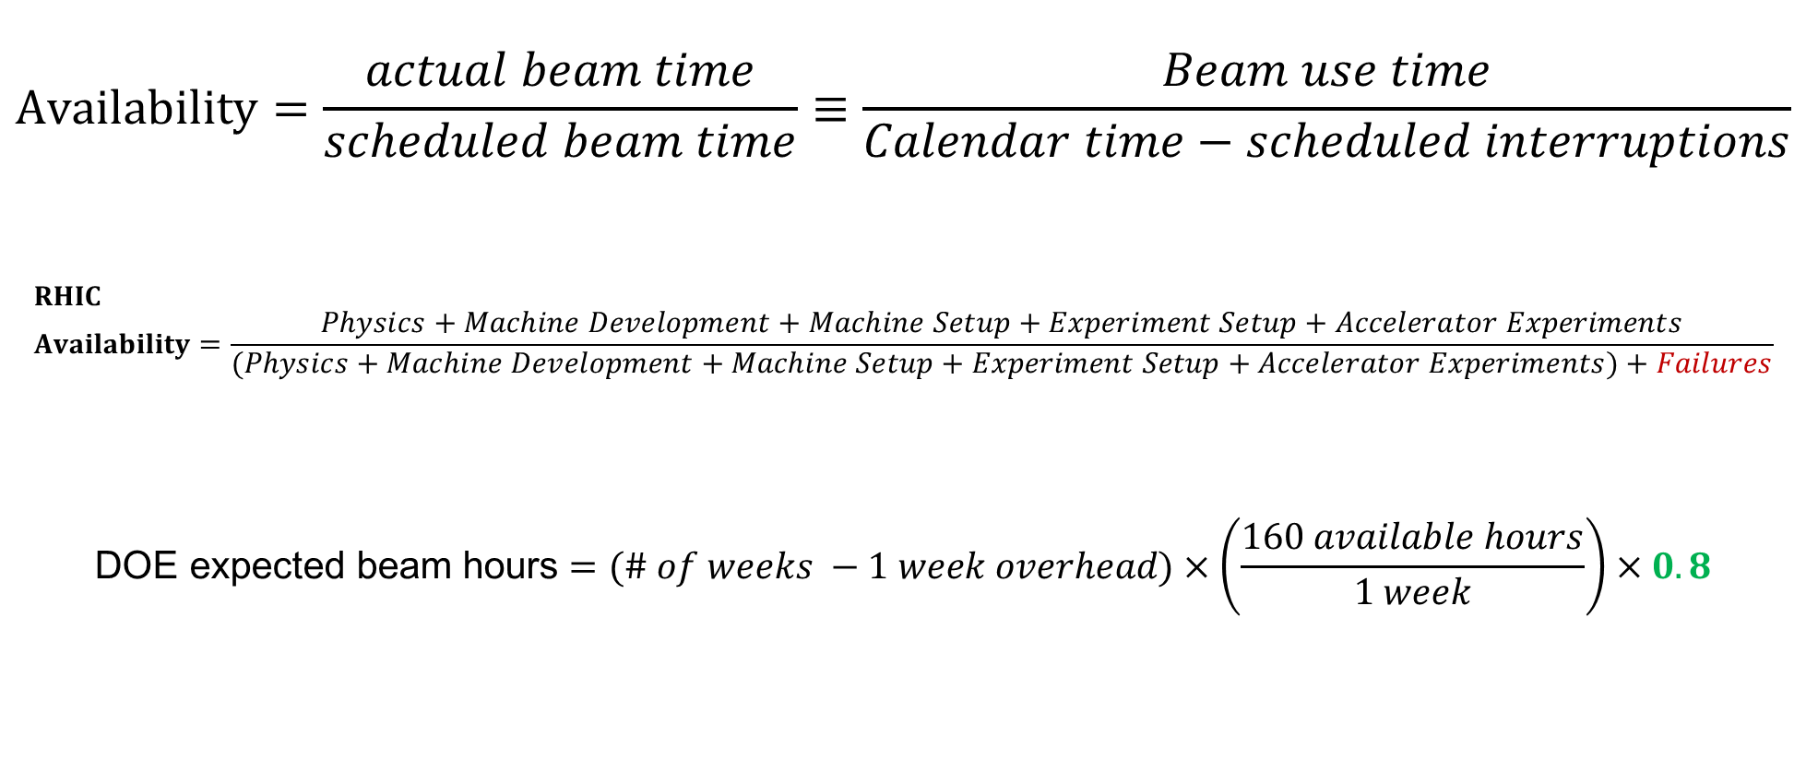
Availability, expected beam hours
$$Availability=\frac{actual beam time}{scheduled beam time}≡\frac{Beam use time}{Calendar time−scheduled interruptions}$$
$$RHIC \\ Availability=\frac{Physics+Machine Development+Machine Setup+Experiment Setup+Accelerator Experiments}{(Physics+Machine Development+Machine Setup+Experiment Setup+Accelerator Experiments)+Failures}$$
$$\text{DOE} \text{expected} \text{beam} \text{hours}=(\# of weeks −1 week overhead)×\left(\frac{160 available hours}{1 week}\right)×0.8$$
Notes:
Normally hidden. Explains how the 85% from DOE comes in to play, & general availability metrics

