Slide 1
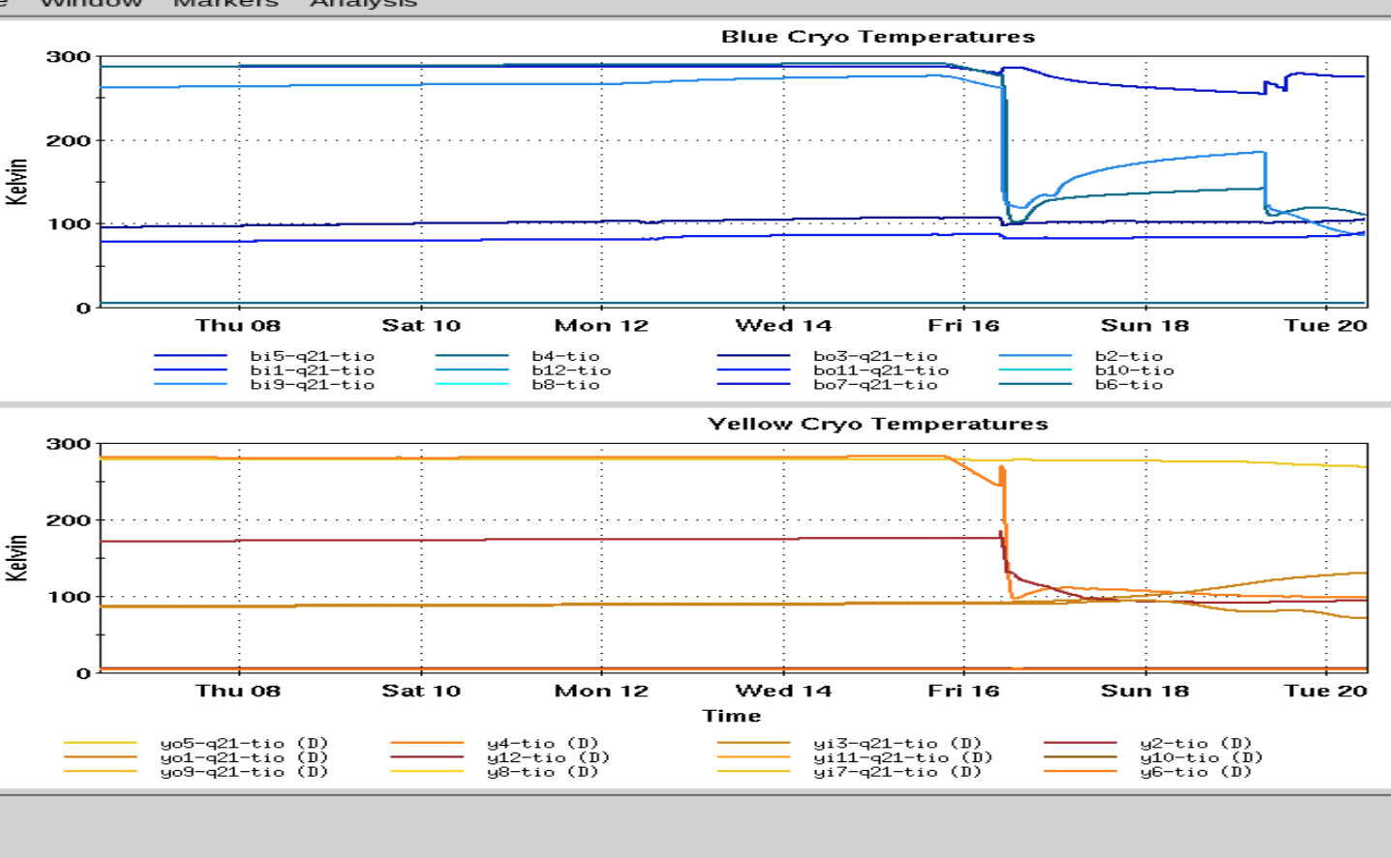
Time Meeting
Accelerator Operations Support

Slide 2
Status
LINAC: Running setup, BLIP later in the week
Booster Running for setup

Slide 3
AGS
Repair RF station K
Switch G09C Ready, H110 testing into dummy
G10: troubleshooting
Access today and tomorrow

Slide 4

901 power outage
Successfully competed
Recovery under way
Beam Thursday…

Slide 5
RHIC :
Cooling down…
Progress updated in real time HERE

Slide 6
Other RHIC items:
RHIC sector 2 closed for testing
Emergency generator tests for May completed
Adjacent areas (Berms etc.) will be locked starting this week
ORC items items rechecked prior to setup with beam
4Z1 and berms to be swept for RF testing Thursday & Friday

Slide 7
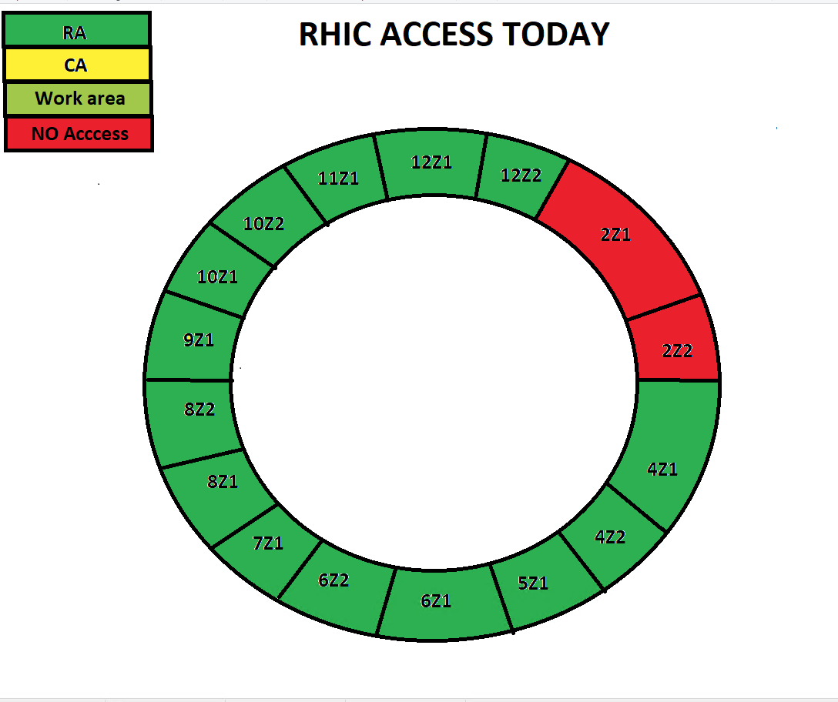
Access cartoon from “This_Week (https://www.agsrhichome.bnl.gov/AGS/Accel/Maintenance/Schedules/This_week.htm#daily )

Slide 8
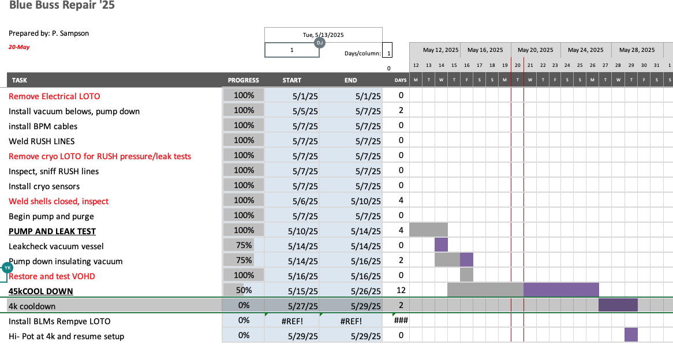

Slide 9
Injector Maintenance Tomorrow:
AGS RA 0700-1600hrs
Booster& LINAC: Morning outside am work, no access
Planning and scheduling meeting here at 3pm
No POD meetings as cooldown is underway

