Slide 1
Preinjector Status
D. Raparia
Time Meeting
May 27, 2025

Slide 2
Tandem
After recovery from the power outage, the Au⁺³¹ beam is now ready.
Beam delivery to the Booster is scheduled to begin tomorrow.
The MP6 charging system repair has been completed, in the process of closing up MP6.
An external user will begin using the beam from MP6 starting Sunday for a duration of three days.

Slide 3
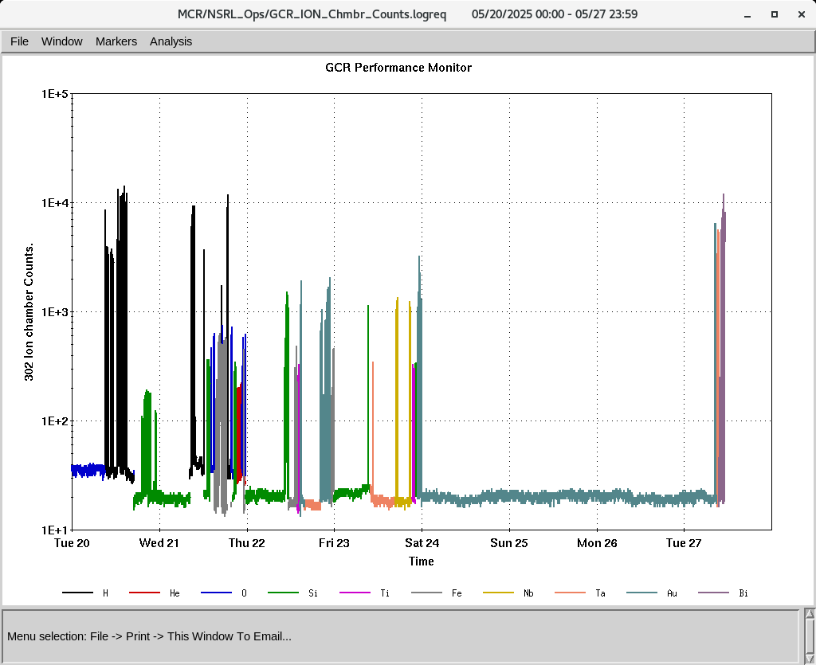
EBIS
GCR ions He²⁺, Si¹¹⁺, O⁷⁺, and Fe¹⁵⁺ have been successfully transported to NSRL.
Heavy ions Si¹¹⁺, Fe²⁰⁺, Ti¹⁷⁺, Ta³⁸⁺, Nb²³⁺, Au⁴⁷⁺, and Bi⁴⁷⁺ have also been delivered to NSRL.
The EBIS platform power supply (PS) has been repaired and is now fully operational up to 80 kV.
EBIS super cycle timing issue
-
IONS to NSRL

Slide 4
Linac, providing beam to NSRL, AGS, 200 MeV Polarimeter
OPPIS providing PP to NSRL, AGS and 200 MeV polarimeter
BLIP run. Started on Friday 5/23, 200 MeV, 150 uA
-5/24: Mod 7 , beam loading
-5/25 : RFQ Tripped
-5/27 :Ion source extractor sparking , switch to to source 2
- Total down time 4.5 Hrs
Next BLIP runs
La Target: 6/4 to 6/6 (Tentative), 117 MeV, 62 uA
Ti Foil: 6/9/ to 6/10 : 66 MeV, 0.1 uA
Th Target: 6/16 to 6/27 , 200 MeV, 150 uA

