Slide 1
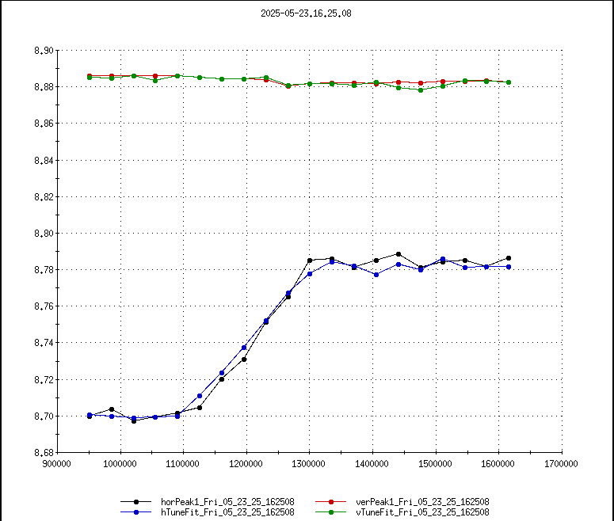
AGS Status: Time meeting 5/27/25
Booster setup of ions to NSRL proceeding well
AGS Polarized proton work
Single resonance crossing user (user 8) set up for studies
AGS Extraction bumps
G09 returned to service continues to operate well
H11 troubleshooting of modification continues on ’dummy load’ (power load disconnected from ring magnets).
Decision Thursday 5/29 about whether to proceed with RHIC setup using both BLWs supplies or just G09.
AGS extraction kicker (G10)
Pulsed at operating current, timing and amplitude issues addressed.
Some features (30 MHz signal on readback) probably not affecting the beam, to be investigated over time
Qy
Qx
Resonance condition

