Slide 1
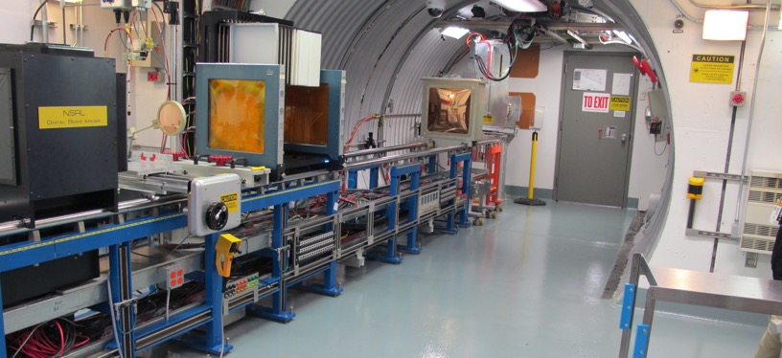
NSRL Time Meeting Report
27 May 2025
Michael Sivertz

Slide 2
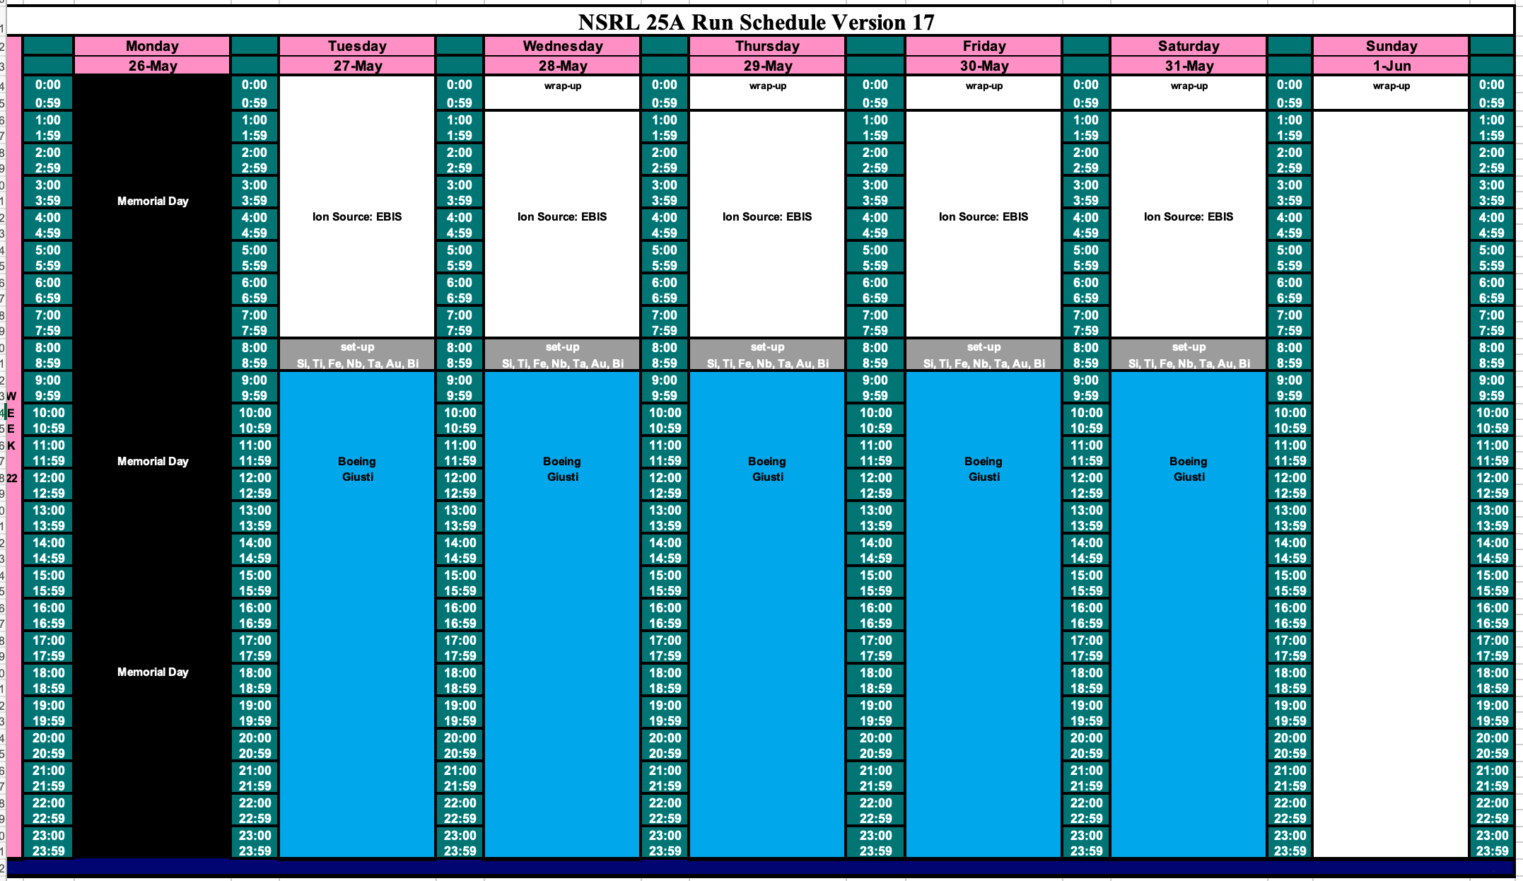
Schedule for this week

Slide 3
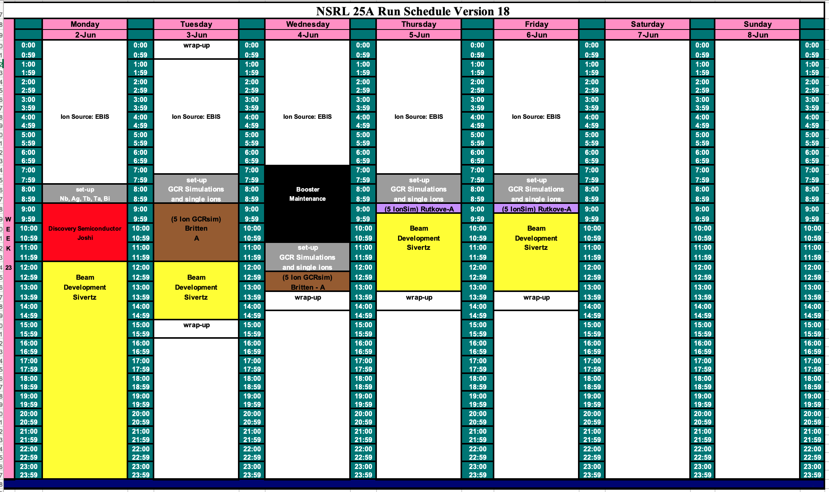
Schedule for next week

Slide 4
Future Schedule
The week of EBIS beam development went better than expected.
Most of the ions required for Boeing were prepared, except for Ta and Bi.
Boeing will run with ions (Si, Ti, Fe, Nb, Ta, Au, Bi) from EBIS for the week following Memorial Day.
The NASA radiobiology program starts 2 June 2025 running through 27 June.
Still need to work on beam intensity, particularly He.
Hope to make progress on He intensity the evening of 2 June.

