Slide 2
Data courtesy C. Naylor

Slide 3
Data courtesy C. Naylor

Slide 4
Data courtesy C. Naylor

Slide 5
Data courtesy C. Naylor

Slide 6
Data courtesy C. Naylor

Slide 7
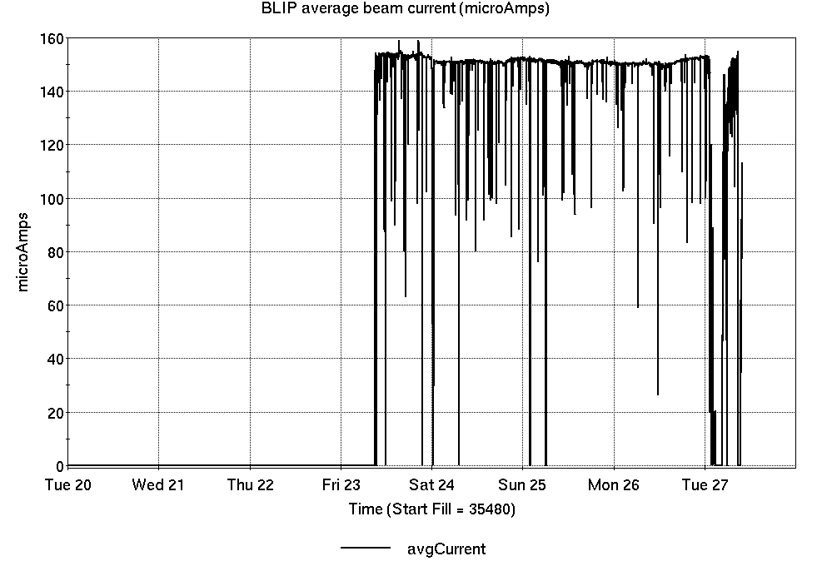
Operations for BLIP
5/20-27/2025:
200 MeV production began Friday.
89.78 hr production
4.68 hr failures
Availability: 95.1%
No BLIP
this past week

Slide 8
NSRL activity past week: 5/20-27/2025 (as of 0800)
NSRL running continues. No users; beam setup & development for upcoming schedule.
No Tandem ions; Linac protons.
EBIS He, O, Si, Ti, Fe, Nb, Au in Booster and delivered to NSRL. Ta, Bi pending.
Running 25-A schedule since 3 February. Schedule posted, updates to 28 June for beams & users. 25-C schedule yet to be published for July-September.
Availability: 77.4%

Slide 9
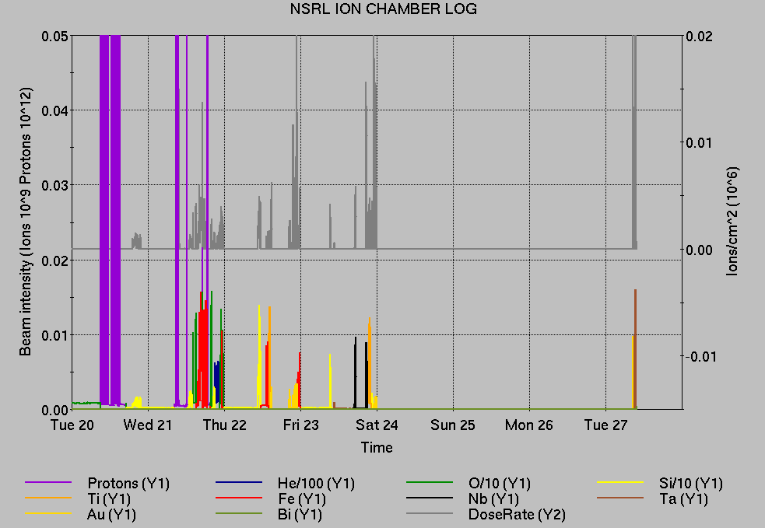
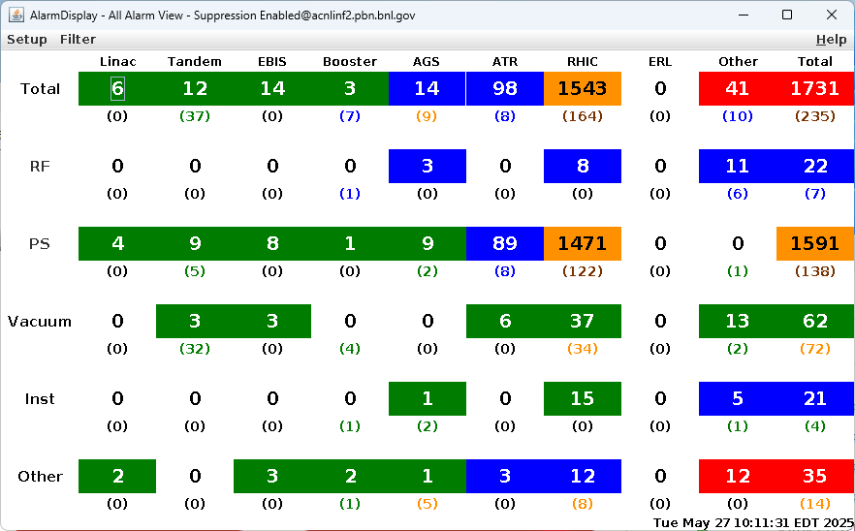
Notes from Operations
Notable failures (>1 hr)
RHIC Blue main dipole system failure, awaiting cooldown & testing
AGS extraction bump failures, ongoing
AGS G10 kicker failure, repairs completed
EBIS HV pulser PS failure, various repairs
EBIS HV cage issue, disconnected cable removed
EBIS timing failures, supercycle software bug fixed
Booster MMPS trips (7x), various repairs
Linac hi-intensity source extractor failure, switch to Source 2 in progress.
Other notes
Linac RF tuning to improve losses, other trips/resets.
Various Booster, AGS, EBIS PS & RF trips/resets
Over 21 hours injector pp setup, other studies (when injector systems are available)

Slide 10
Reminder from Operations
MCR beam operations continue
Operator/OC shifts continue for NSRL users, 2 shifts/5 days this week and next.
No ions from Tandem; Linac protons as required; Ion beams from EBIS.
BLIP production continues through 3 June, with additional run to follow.
RHIC beam setup pending cooldown, testing repair
AtR beam pending extraction PS failures.
Dedicated Tandem Au beam setup anticipated 30 May
AGS Polarized proton setup, other studies continue 2 shifts/5 days
Note: MCR will not be occupied continuously.
No OC on duty overnight until RHIC start. Contact CAS in off hours (x2024) for urgent issues when MCR is not staffed.
Changes? Time to update is now. Expect calls at all hours.
Alarm response instructions: Groups prompted for updates
http://directory.pbn.bnl.gov/
CHECK AND EDIT YOUR OWN CONTACT INFO
https://www.cadops.bnl.gov/Operations/personnel/call_in_lists/
CHECK YOUR CALLIN LIST: expect contact off-hours

Slide 11
Keytree notes
Remote keytree systems require a database lookup to validate and authorize distribution of keytokens. The Keytrak system’s database is available for lookup functionality, but can no longer be modified in any way to add or edit qualified personnel.
Personnel affected:
New employees, experimenters arriving after 12/1/2024 could not be enrolled in database
Existing employees & experimenters, not already enrolled, cannot be added or modified in database
Remote keytrees affected:
Iris scan @NSRL
BNLID scan @AGS South gate, North Conjunction Gate
Iris scan @RHIC STAR, sPHENIX, IP12, IP4
Keytrees NOT affected:
BNLID scan @Linac, Booster
BNLID scan @RHIC IP2
MCR keytrees

Slide 12
Keytree notes, continued
Mitigation:
Choose entrants that are currently enrolled to perform the work in the enclosure under Controlled Access (CA).
Obtain CA keys from MCR for remote gate watch
Arrange for local gate watch using other tokens for entrants.
Arrange for Restricted Access, and allow for delays incurred to sweep areas.
CAUTION
Follow procedures. Gate Watch staff will remain vigilant.
No “piggy-backing” – one key/token per entrant.
Access keys are not candy! Authenticated entrant retains possession.
Radiological Controls and the Access Controls System are not to be circumvented. This is (has been) enforced with disciplinary action (dismissal).

Slide 14
Notes:
Reliability comparisons to previous runs

Slide 15
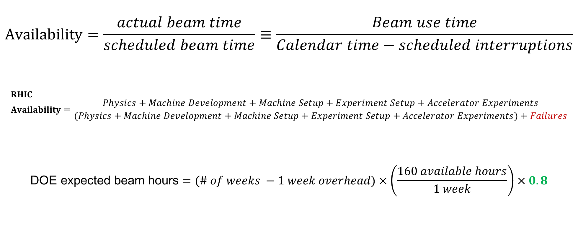
Availability, expected beam hours
$$Availability=\frac{actual beam time}{scheduled beam time}≡\frac{Beam use time}{Calendar time−scheduled interruptions}$$
$$RHIC \\ Availability=\frac{Physics+Machine Development+Machine Setup+Experiment Setup+Accelerator Experiments}{(Physics+Machine Development+Machine Setup+Experiment Setup+Accelerator Experiments)+Failures}$$
$$\text{DOE} \text{expected} \text{beam} \text{hours}=(\# of weeks −1 week overhead)×\left(\frac{160 available hours}{1 week}\right)×0.8$$
Notes:
Normally hidden. Explains how the 85% from DOE comes in to play, & general availability metrics

