Slide 1
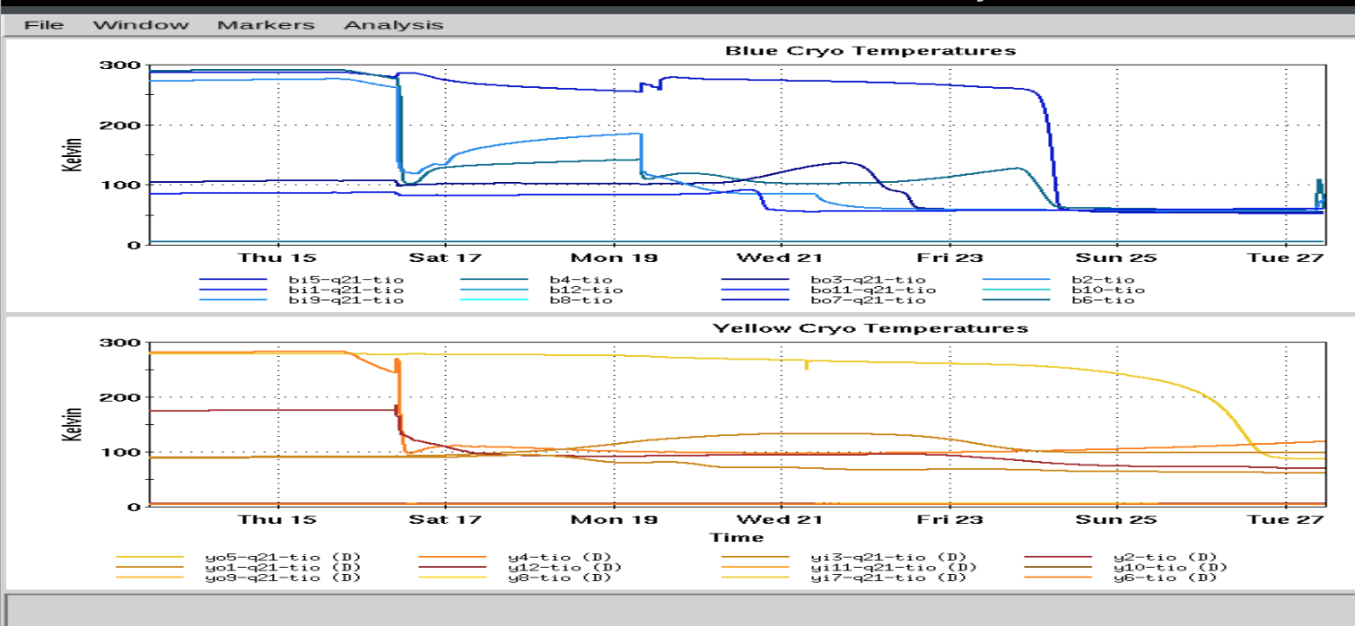
Time Meeting
Accelerator Operations Support

Slide 2
Status
LINAC: Running for setup and BLIP
Booster Running for setup and NSRL

Slide 3
AGS
Switch G09C Ready, H11 testing into dummy
G10: Ready
No access planned for this week

Slide 4
RHIC :
Cooling down…
Progress updated in real time HERE

Slide 5
Other RHIC items:
Emergency generator tests for May completed
Adjacent areas (Berms etc.) will be locked this week
ORC items items rechecked prior to setup with beam
Sector 2 and 4Z1 RF testing as necessary
RHIC Ring sweeps Friday, exps Saturday morning

Slide 6
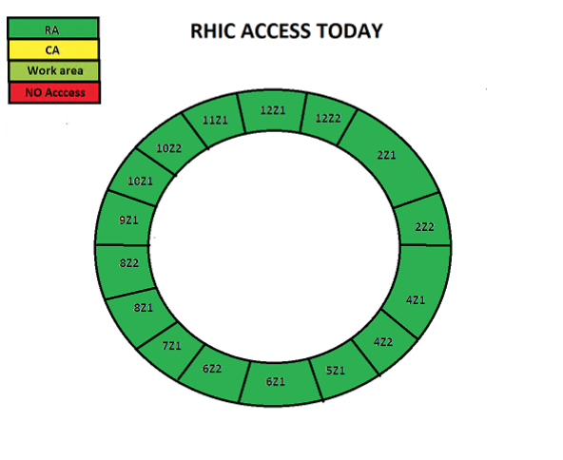
Access cartoon from “This_Week (https://www.agsrhichome.bnl.gov/AGS/Accel/Maintenance/Schedules/This_week.htm#daily )

Slide 7
