Slide 1
Preinjector Status
D. Raparia
Time Meeting
June 03, 2025

Slide 2
Tandem
MP7 is currently providing ions for RHIC setup., All 8 pulses are stable and good intensity
MP 7 Object foils will need to be changed in an upcoming maintenance day
MP6: Charging system has been repaired; Now both machines are operational.
Last Friday: Physics user utilized MP6.
This week (Mon–Wed): External user scheduled on MP6:Friday: Masahiro scheduled for beam time

Slide 3
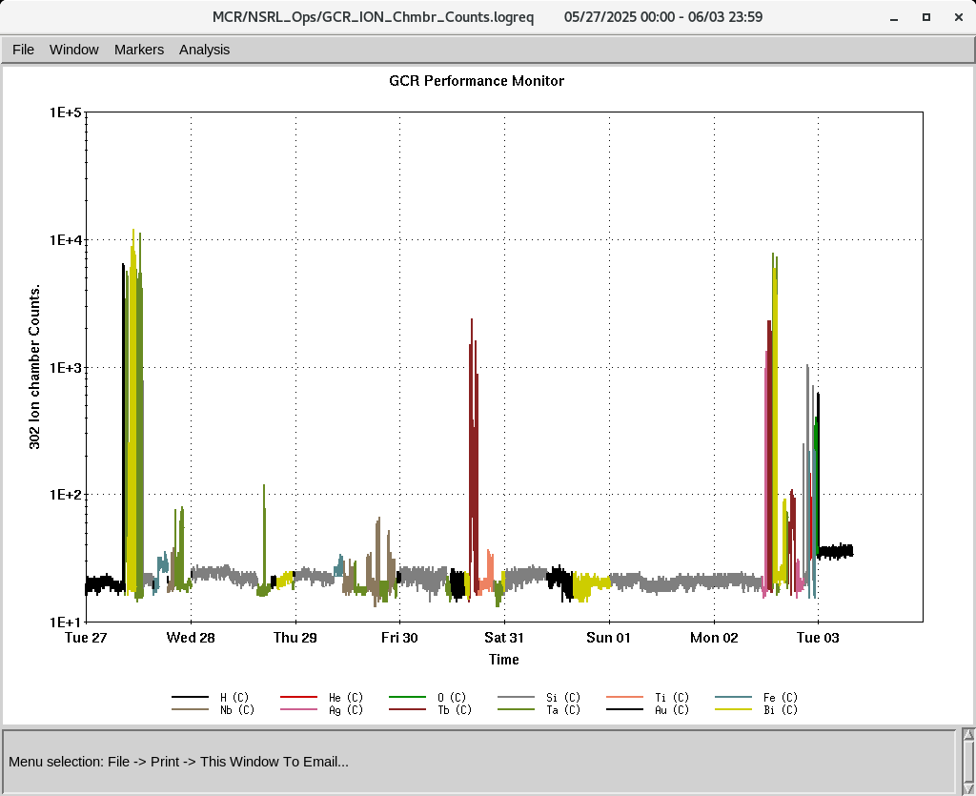
EBIS
All heavy ion beams ran successfully last week.
All required beams for GCR are ready, though He intensity still needs improvement. Working on it now
Tb and Ag beams are developed and delivered to NSRL.
Collector Power Supply has been tripping —Investigation continue.
This Morning Water system issue
IONS to NSRL
H, He⁺², O⁺⁷, Si⁺¹¹, Ti⁺¹⁷,
Fe^{+15,20}, Nb⁺²³, Ag⁺²⁹, Tb⁺³⁵,
Ta⁺³⁸, Au⁺⁴⁷, Bi⁺⁴⁷

Slide 4
Linac, providing beam to NSRL, AGS, 200 MeV Polarimeter
5/27
  Source switchover took 4.5 hours; Source 1 was sparking at the extractor.
  Mod 7 current transformer was replaced (2 hours).
5/31: Source 2 experienced arc discharge instability.
6/1:
  Mod 7 was crowbarring excessively. Found no clear cause. Bucket-A was the issue, so it was disconnected, running on Bucket-B for now.
  Mod 4 had high voltage banging due to a faulty diode stack and resistor, both replaced; system stable now (1.5 hours).
6/3 :BLIP run. Ended on today 5/23, 200 MeV, 150 uA
Total LINAC downtime: 8.5 hours.
OPPIS need to refill Rb on Sunday
OPPIS is successfully delivering beam to the 200 MeV line, Polarimeter Booster, and NSRL.
Next BLIP runs
La Target: 6/4 to 6/6, 117 MeV, 62 uA CANCELED
Ti Foil: 6/9/ to 6/10 : 66 MeV, 0.1 uA
Th Target: 6/16 to 6/27 , 200 MeV, 150 uA

