Slide 1
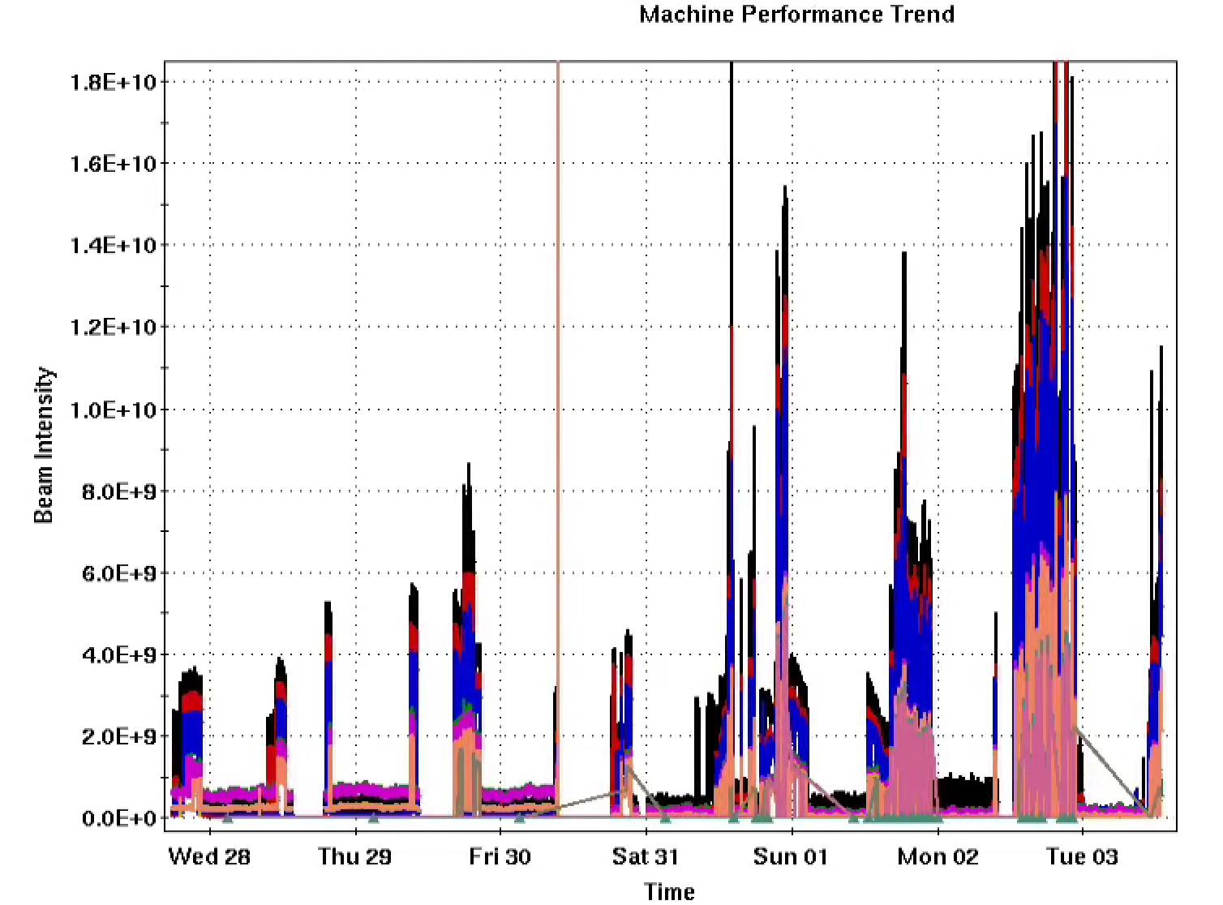
AGS Status: Time meeting 6/03/25
AGS Extraction Bumps and Kicker
H11 bump handed to operation 5/29, Au extraction to W. established shortly after
AGS extraction system operating reliably with some low-impact loose ends
Occasional misfiring of G10 (doesn’t affect beam extractions)
On-at-zero behavior of G09 sometimes causes beam loss (not a mode we need to run in)
Au beam for RHIC: 1.1-1.3e9 per bunch, four bunches per cycle available to RHIC
Some further tuning necessary to suppress flattop instability and raise intensity (not unusual)
AGS Polarized proton work
Single resonance crossing polarization studies proceeding when injectors are available for p^
Injector intensity (Au)

