Slide 1
sPHENIX status
Kin Yip
sPHENIX Director of Operations
Time Meeting
June 3, 2025

Slide 2
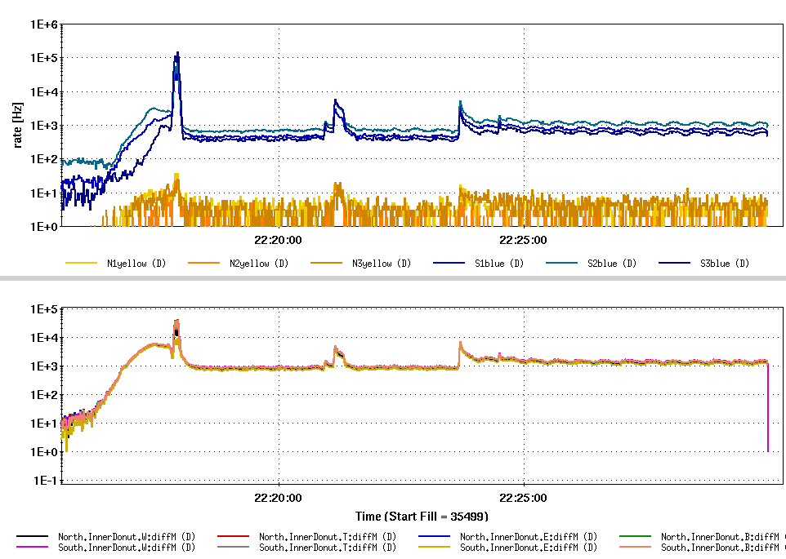
sPHENIX Status
DAQ : bufferbox operation has been further tuned ⇒ increases the rate that we can run on.
TPC: concluded pre-collision line laser calibration dataset; cooling system improved; preparing addition of digital current feature in firmware.
The generator of the ECW/Magnet Chiller (1008C) has its first oil change today (thanks to the C-AD HEMO).
Early look at the Donut Counter signals in our Magnet Bore (vs background counters in the tunnel). Thresholds are being tuned.
Bkg. counters
Donut counters

Slide 3
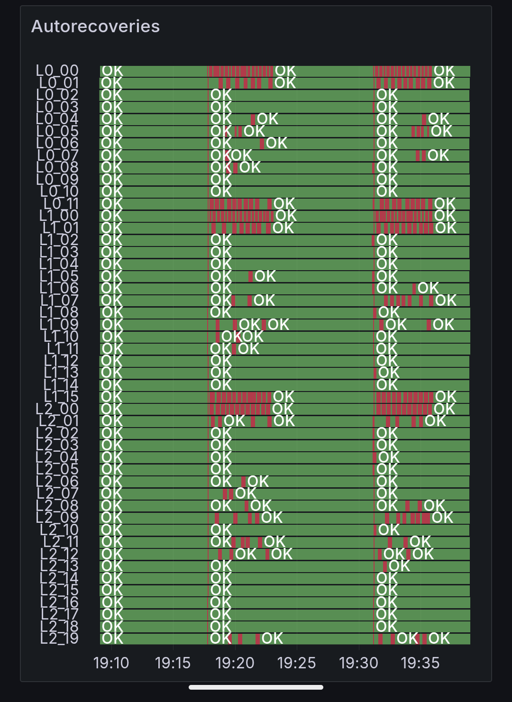
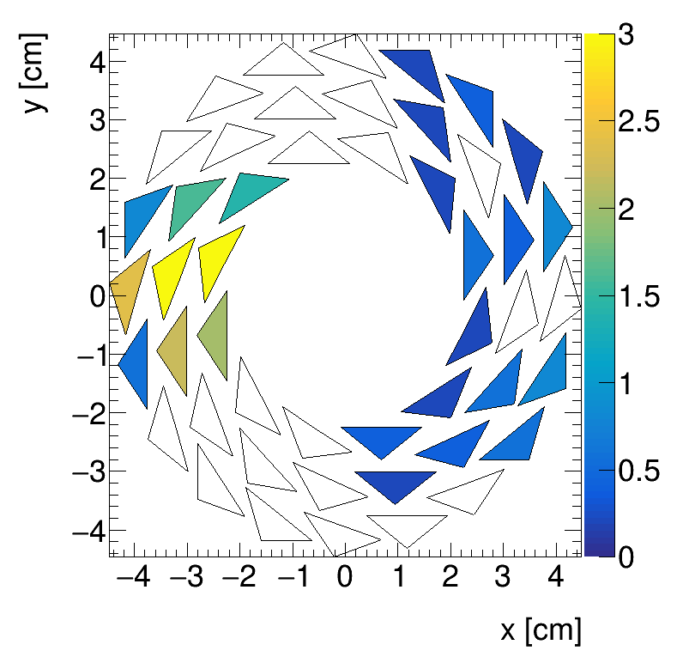
sPHENIX Status (cont.)
RHIC Fill 35517 yesterday evening, 1st test with MVTX with just the Blue beams ⎯ not the storage ramp, not a steered IR orbit yet etc. With all the caveats, MVTX auto-recoveries were still there:

