Slide 1
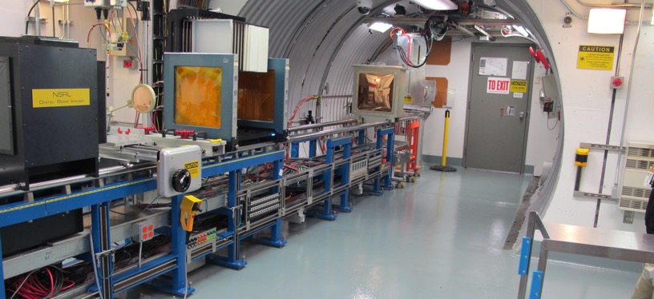
NSRL Time Meeting Report
3 June 2025
Michael Sivertz

Slide 2
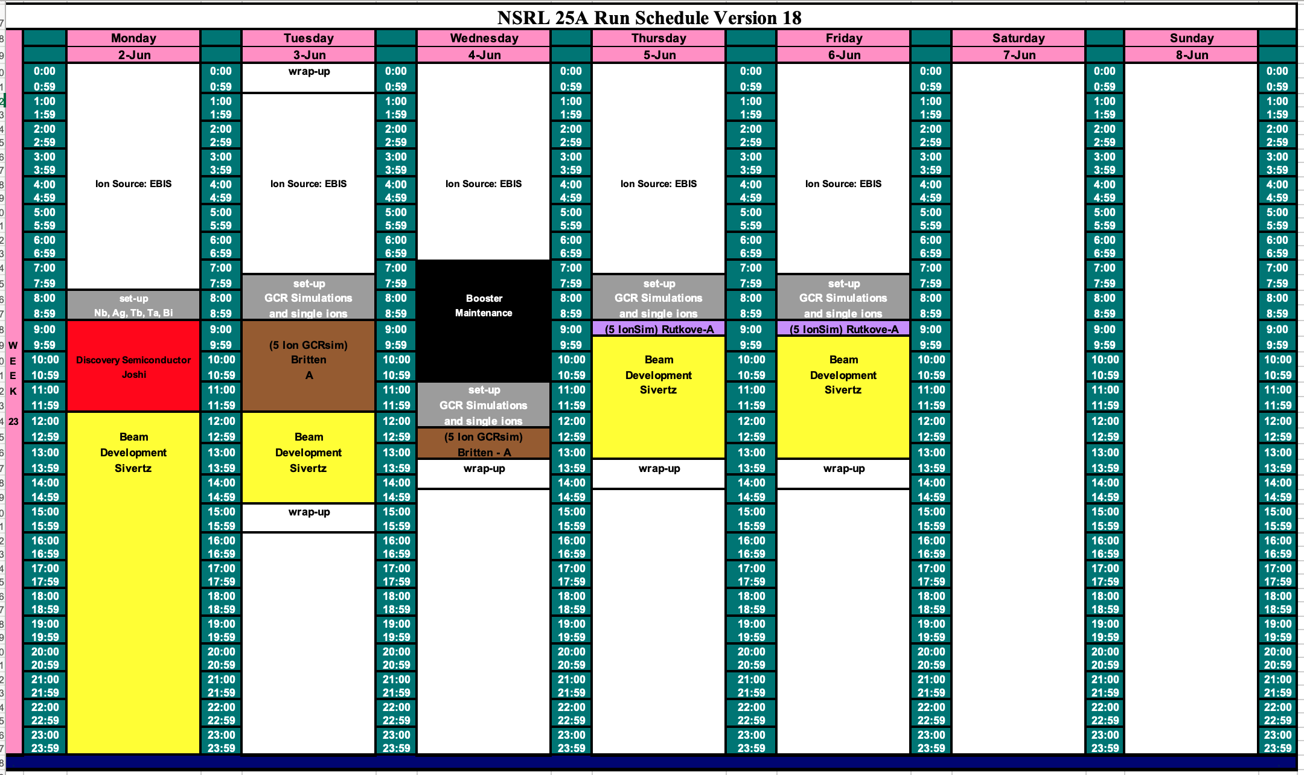
Schedule for this week

Slide 3
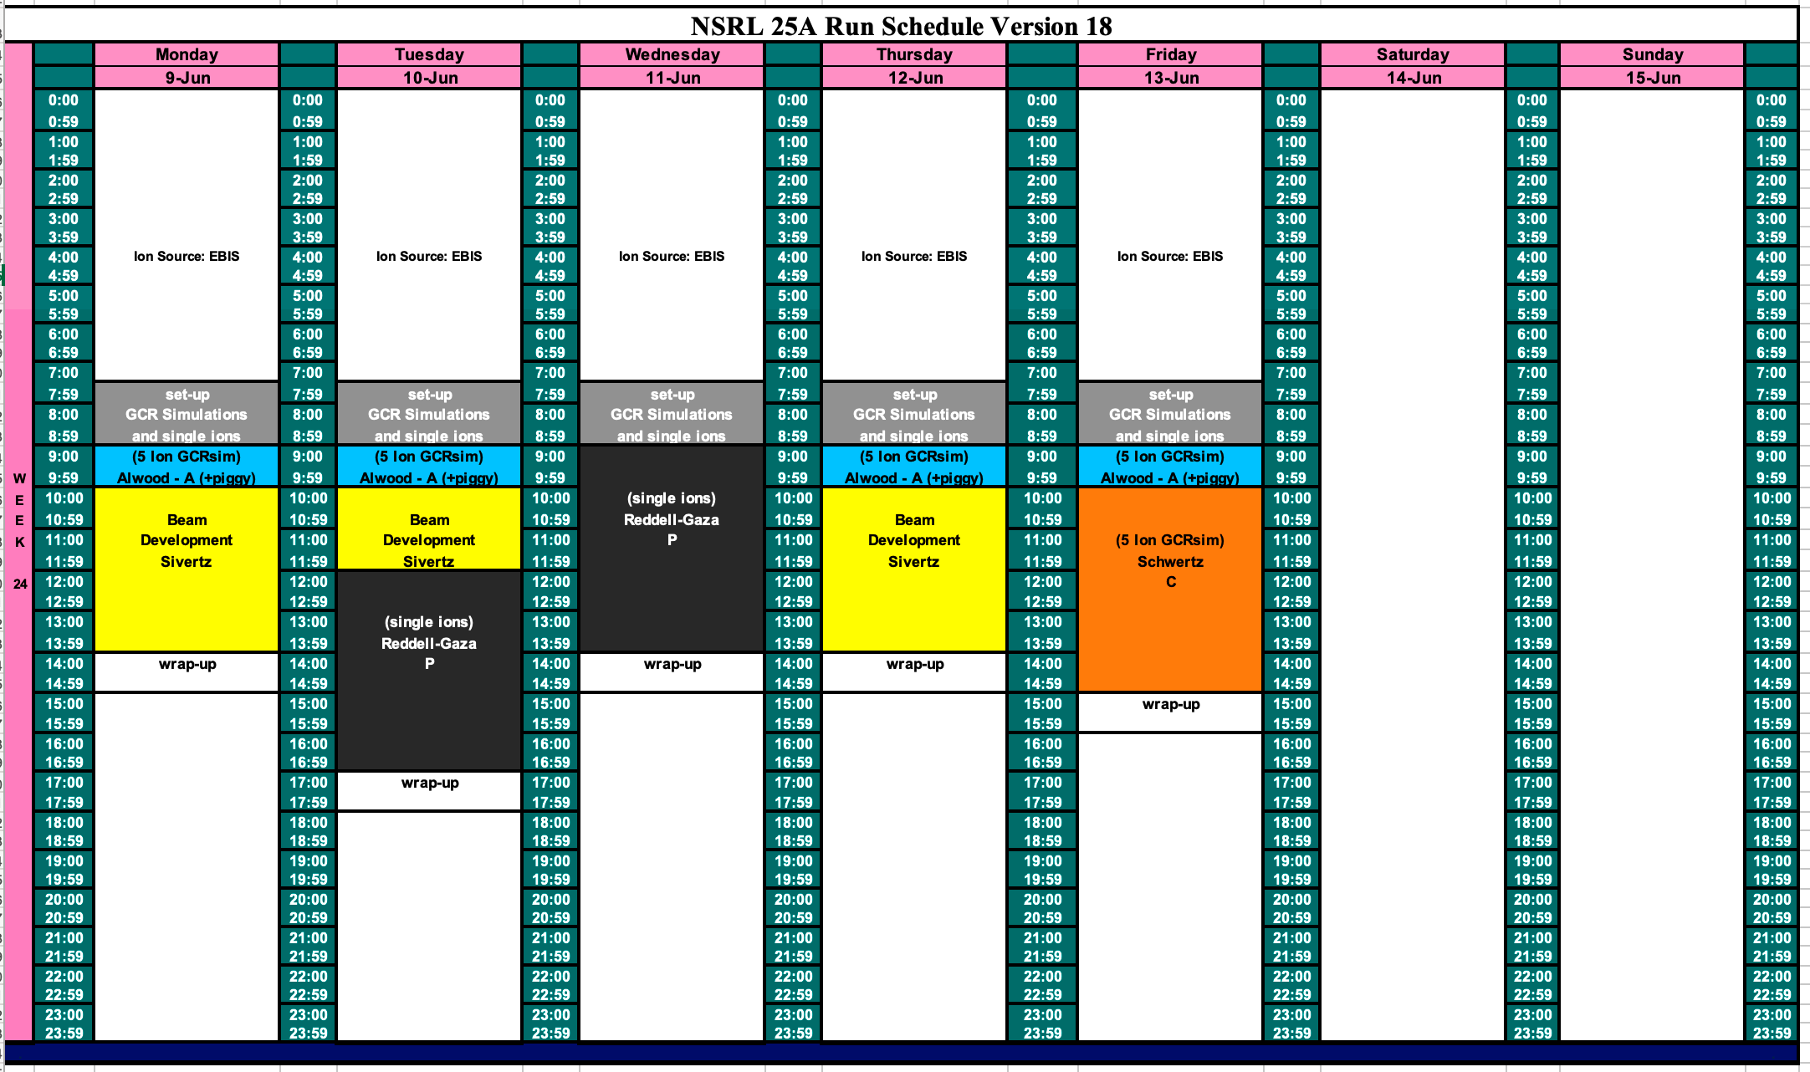
Schedule for next week

Slide 4
Future Schedule
EBIS and MCR made great progress developing heavy ion beams for last week’s Boeing run. We were slowed down a bit by Collector PS trips, but overall, the week was a success for Boeing.
The NASA radiobiology program starts today, 3 June, running through the end of June, 27 June.
Most of the experiments are 5-ion GCRSim beams.
Still need to work on beam intensity, particularly He.
Hope to make progress on He intensity while we are delivering beam.
Also need to develop Carbon beam.

