Slide 1
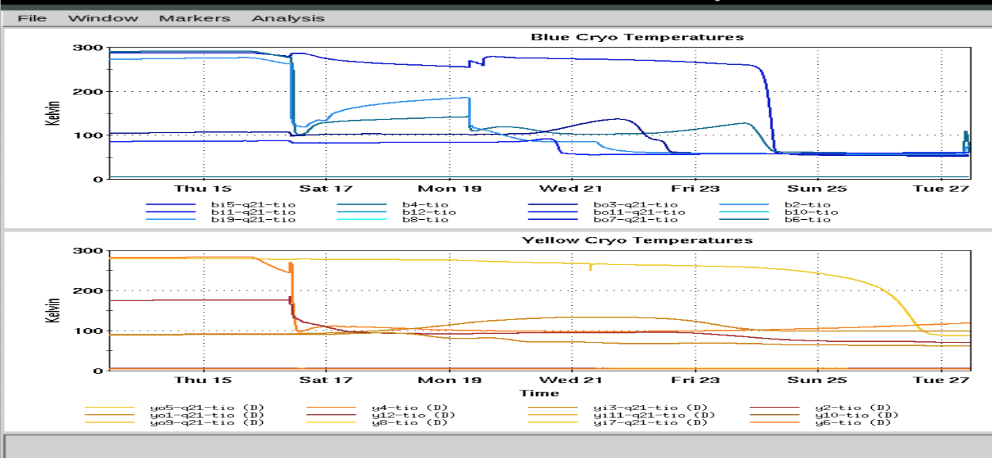
Time Meeting
Accelerator Operations Support

Slide 2

Status
LINAC: Running for setup and BLIP
Booster Running for setup and NSRL
AGS/AtR Running
RHIC Blue, running setup
Yellow: Cooldown

Slide 3
Maintenance tomorrow
Access limited to approved jobs, some controlled.
AGS & Booster: am Controlled Access
LINAC Access- none scheduled at this time
RHIC Access TBD, Experimental access EOB today until 1500hrs tomorrow
Sectors 2&4 opened early, then RFNA
Emergency power tests 1004A, 1008A, 1010A&1012A

