Slide 1
TAKE FIVE for Safety- Air Quality Health Advisories
Frank Craner
June 10, 2025

Slide 2
Air Quality Advisories: Protect Your Health
Each day, the State measures pollutant concentrations to determine an air quality index (AQI) value.
The highest AQI value for the individual pollutants is the AQI value for that day.
The AQI is divided into six levels each, for ozone and particulates that correspond to different levels of health concern.
New York State announces an Air Quality Health Advisory when the AQI value for ozone or fine particulates is forecast to be 100 or more.

Slide 3
Atmospheric Ozone
The highest ozone levels typically occur during summer months.
All people, and especially children, those who work or exercise outdoors, and those with respiratory diseases, should limit strenuous outdoor activity during the afternoon and early evening hours when ozone levels are highest.
If you have asthma or other respiratory problems, stay in a cool area where the air is filtered or air-conditioned, if possible.
Schedule outdoor exercise and children's outdoor activities for the morning hours.
Individuals who experience respiratory symptoms may wish to consult their doctors.

Slide 4
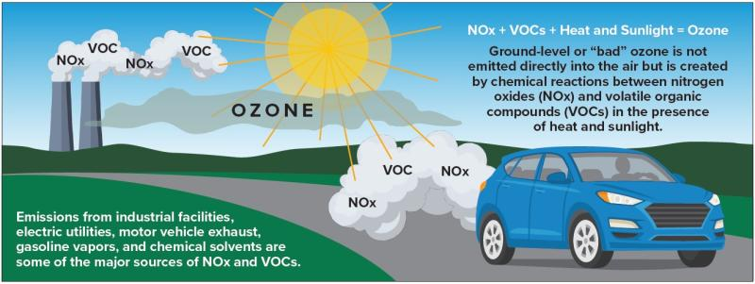
Production of Ozone in the Enviroment

Slide 5
Particulate
Particulate matter is a mixture of solid particles and liquids in the air.
Particles like dust, dirt, soot, or smoke can be seen with the naked eye, but other particles can only be seen using a microscope.
Particulate matter comes in many sizes and shapes and can include hundreds of different chemical substances.
Some particulates are emitted directly from sources like construction sites, unpaved roads, fields, smokestacks, or fires.
Emissions from power plants, industries, and automobiles also contribute to particulate formation.
The AQI is used to forecast particulate matter that can be inhaled, potentially causing serious health problems like difficulty breathing, heart and lung damage, and heart attacks.

Slide 6
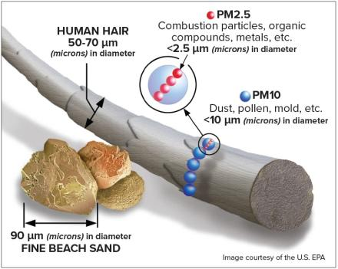
Particulate Sizes

Slide 7
Air Quality Index
AQI Range | Category | Health Effects
0-50 | Good | Satisfactory, little or no risk.
51-100 | Moderate | Acceptable, but moderate health concern for very small number of people who are unusually sensitive to air pollution for some pollutants.
101-150 | Unhealthy for Sensitive Groups | General public not likely to be affected. Members of sensitive groups may experience health effects.
151-200 | Unhealthy | Everyone may begin experience health effects and sensitive groups more serious health effects.
201-300 | Very Unhealthy | Health alert: everyone may experience more serious health effects.
301-500 | Hazardous | Health warnings of emergency conditions. The entire population is more likely to be affected.
For Daily Updates: Today's Air Quality Index (AQI) Forecast for New York State

