Slide 1
Preinjector Status
D. Raparia
Time Meeting
June 10, 2025

Slide 2
Tandem
MP7 is currently providing ions for RHIC setup
MP6 providing ions for external users
Au cathode was changed last night
MP 7 Object foils is planned to change next maintenance day (6/18)
Last week (Mon–Wed): External user
Masahiro’s Li beam time moved to 6/13
MP6 will provide beams for inhouse experiments

Slide 3
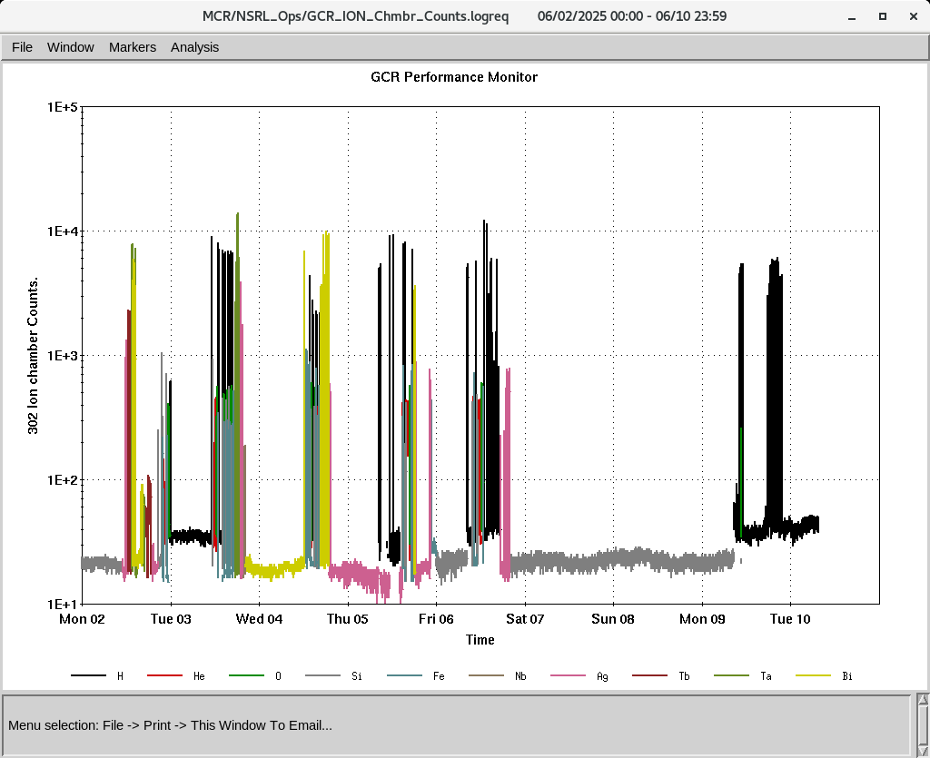
EBIS
All required beams for GCR is are being used
Required heavy ions were also used by NSRL
Tb and Ag ions were developed and delivered to NSRL
Water compressor issues
Collector Power Supply has been tripping , down since yesterday ,
Parts (high current transistors) are here
An overheated resistor was removed
Software issues
IONS to NSRL
H, He⁺², O⁺⁷, Si⁺¹¹,Fe^{+15,20}, Nb⁺²³, Ag⁺²⁹, Tb⁺³⁵, Ta⁺³⁸, Bi⁺⁴⁷

Slide 4
Linac, providing beam to NSRL, AGS, 200 MeV Polarimeter
BLIP was ended on last Tuesday (6/3).
6/6: BLIP setup for 66 MeV, 0.1 uA.
BLIP 66 MeV foil irradiation stated today at 12 noon
OPPIS is successfully delivering beam to the 200 MeV line, Polarimeter Booster, and NSRL.
Next and Last BLIP runs
Th Target: 6/16 to 6/27 , 200 MeV, 150 uA

