Slide 1
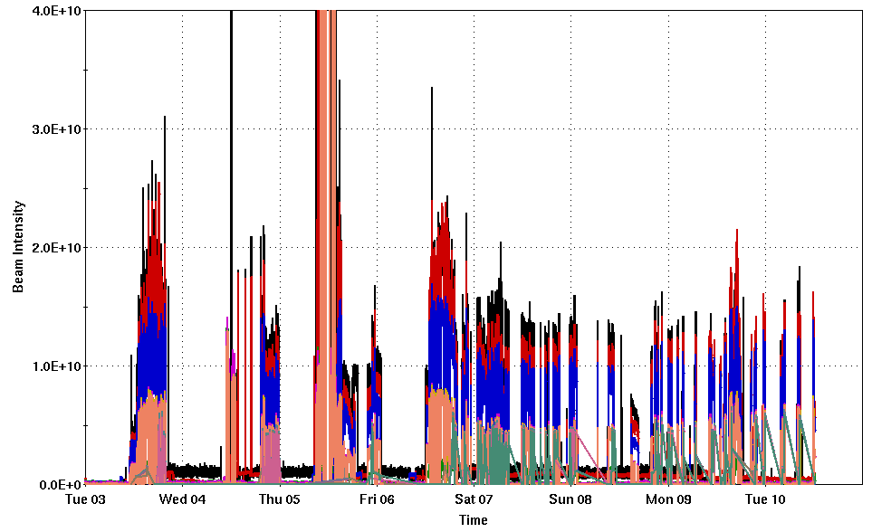
AGS Status: Time meeting 6/10/25
Au beam for RHIC: 1.1-1.3e9 per bunch, four bunches per cycle available to RHIC
Some further tuning necessary to suppress flattop instability and raise intensity (not unusual)
AGS Polarized proton work on hold during RHIC setup
Injector intensity (Au)
To maintain total AGS cycle intensities <8x10⁹,we would change to a merge scheme resulting in 3 bunches per AGS cycle (down from 4)

Slide 2
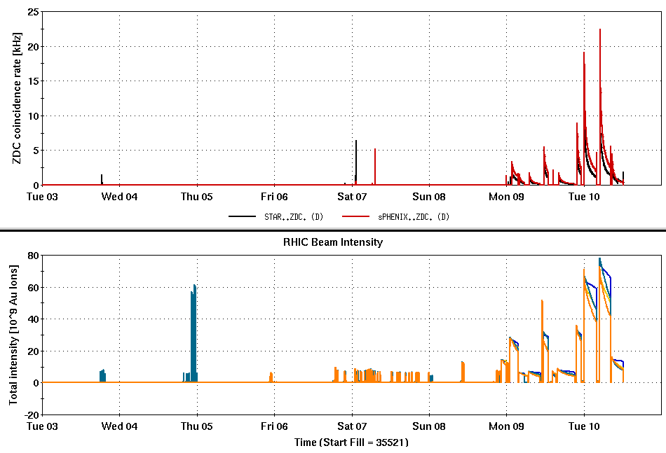
RHIC Status: Time Meeting 6/10/25
Ramp,stores,studies
Yellow delivered for injection evening of 6/5, for ramps on 6/6.
Nice work Cryo!
Two yellow transition complications delayed successful ramps
Failure of yellow dipole feedback (controls radius at transition), restored by resetting RTDL fec (significant interruption).
Reversal of gamma quad lead
Development proceeding well since then
Up to 56x56, 1 - 1.3x10⁹/bunch at store
Interleaving ramp development/setup and MVTX studies
Stochastic cooling setup to begin this afternoon, proceed over a few days
Yellow transition woes
Yellow (injection only)
Maintenance
Downtime from yellow RF, then yellow dipole

