Slide 1
sPHENIX status
Kin Yip
sPHENIX Director of Operations
Time Meeting
June 10, 2025

Slide 2
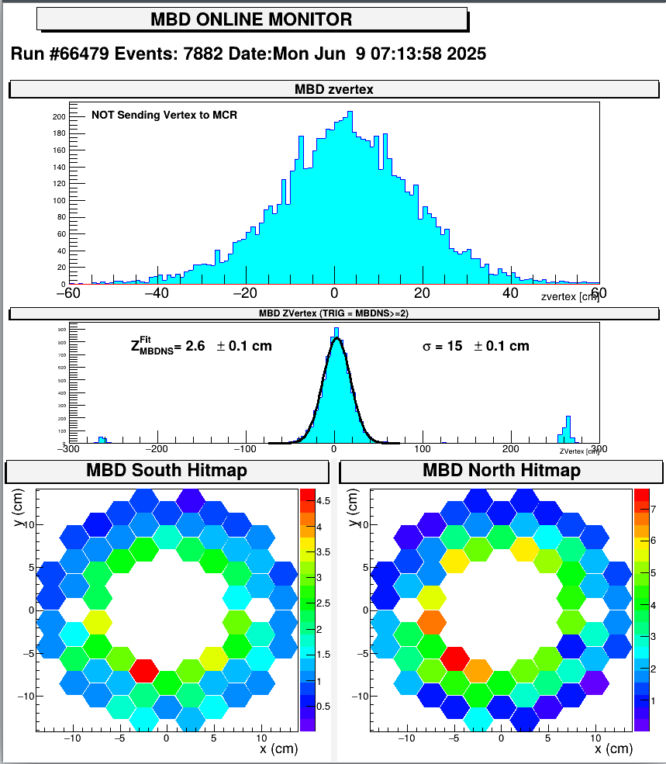
Collisions at sPHENIX
Thanks C-AD for all the works leading to this point.
As the collisions “arrived” on Monday <~ 2 am, sPHENIX Control Room started to set up and time in the detectors.
MBD and calorimeters were timed in around 3 AM.
All detector subsystem have taken data together Monday evening; beam tuning continues.

Slide 3
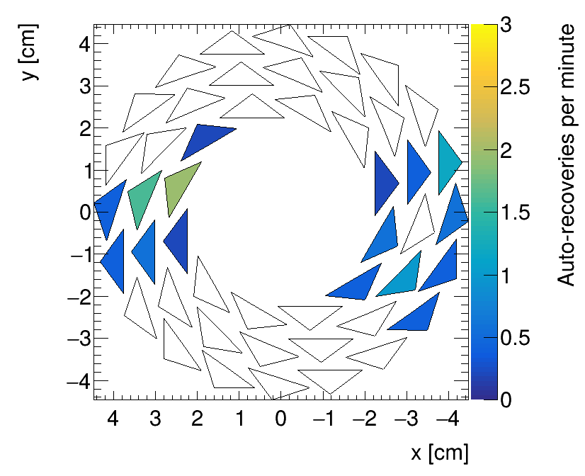
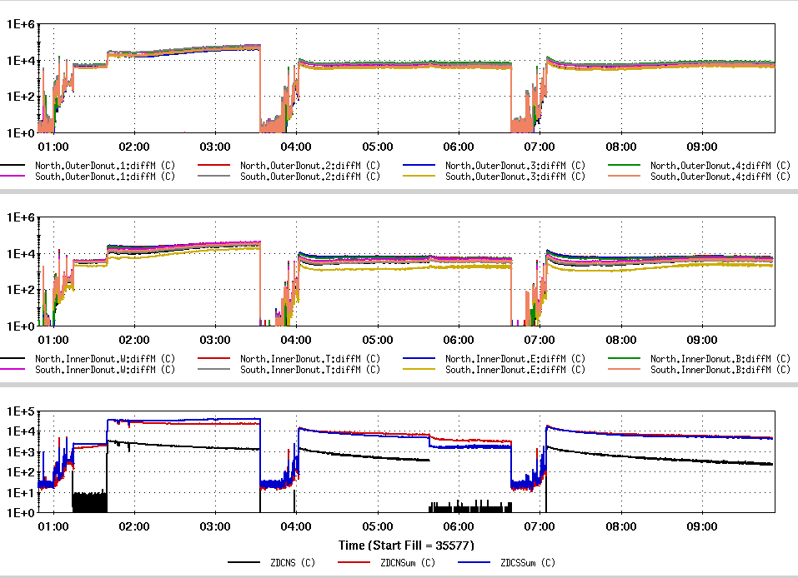
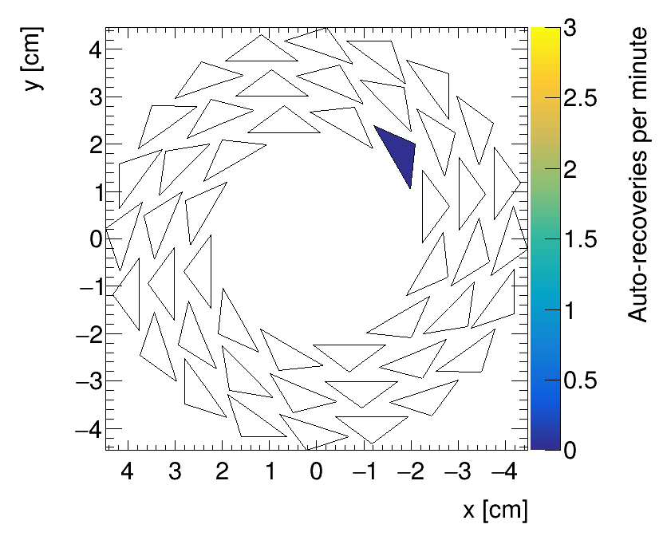
Collisions at sPHENIX (cont.)
MVTX background studies with C-AD have also started with input from the donuts and ZDC, in collisions and single yellow beam, running with streaming and triggered modes.
Streaming mode
Outer donuts
Triggered mode
Inner donuts
ZDC’s

Slide 4
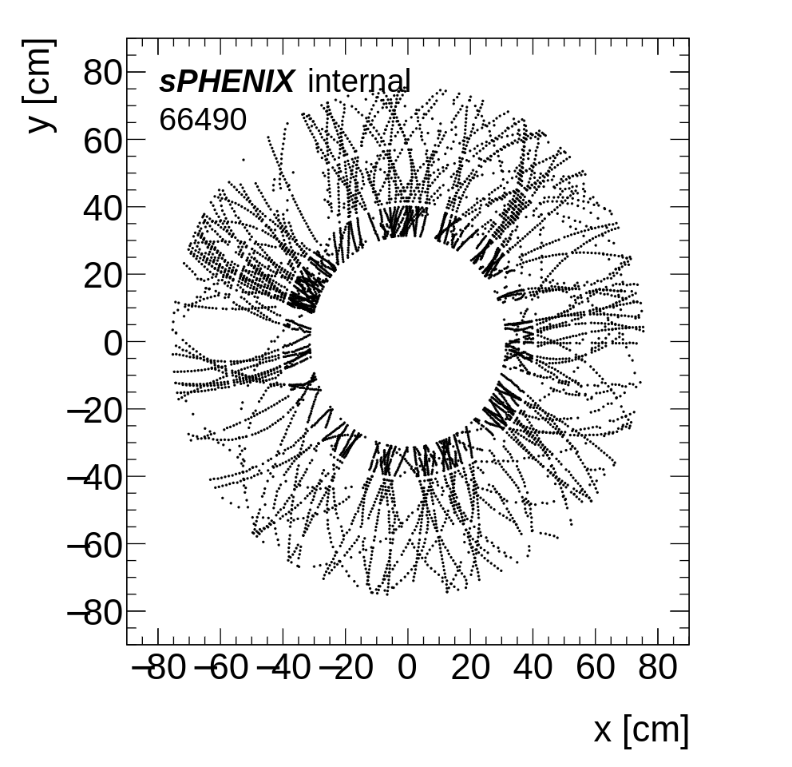
Collisions at sPHENIX (cont.)
First collision after TPC HV power supply system upgrade.

