Slide 1
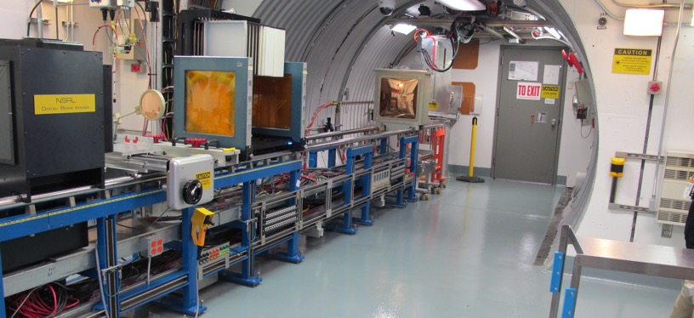
NSRL Time Meeting Report
10 June 2025
Michael Sivertz

Slide 2
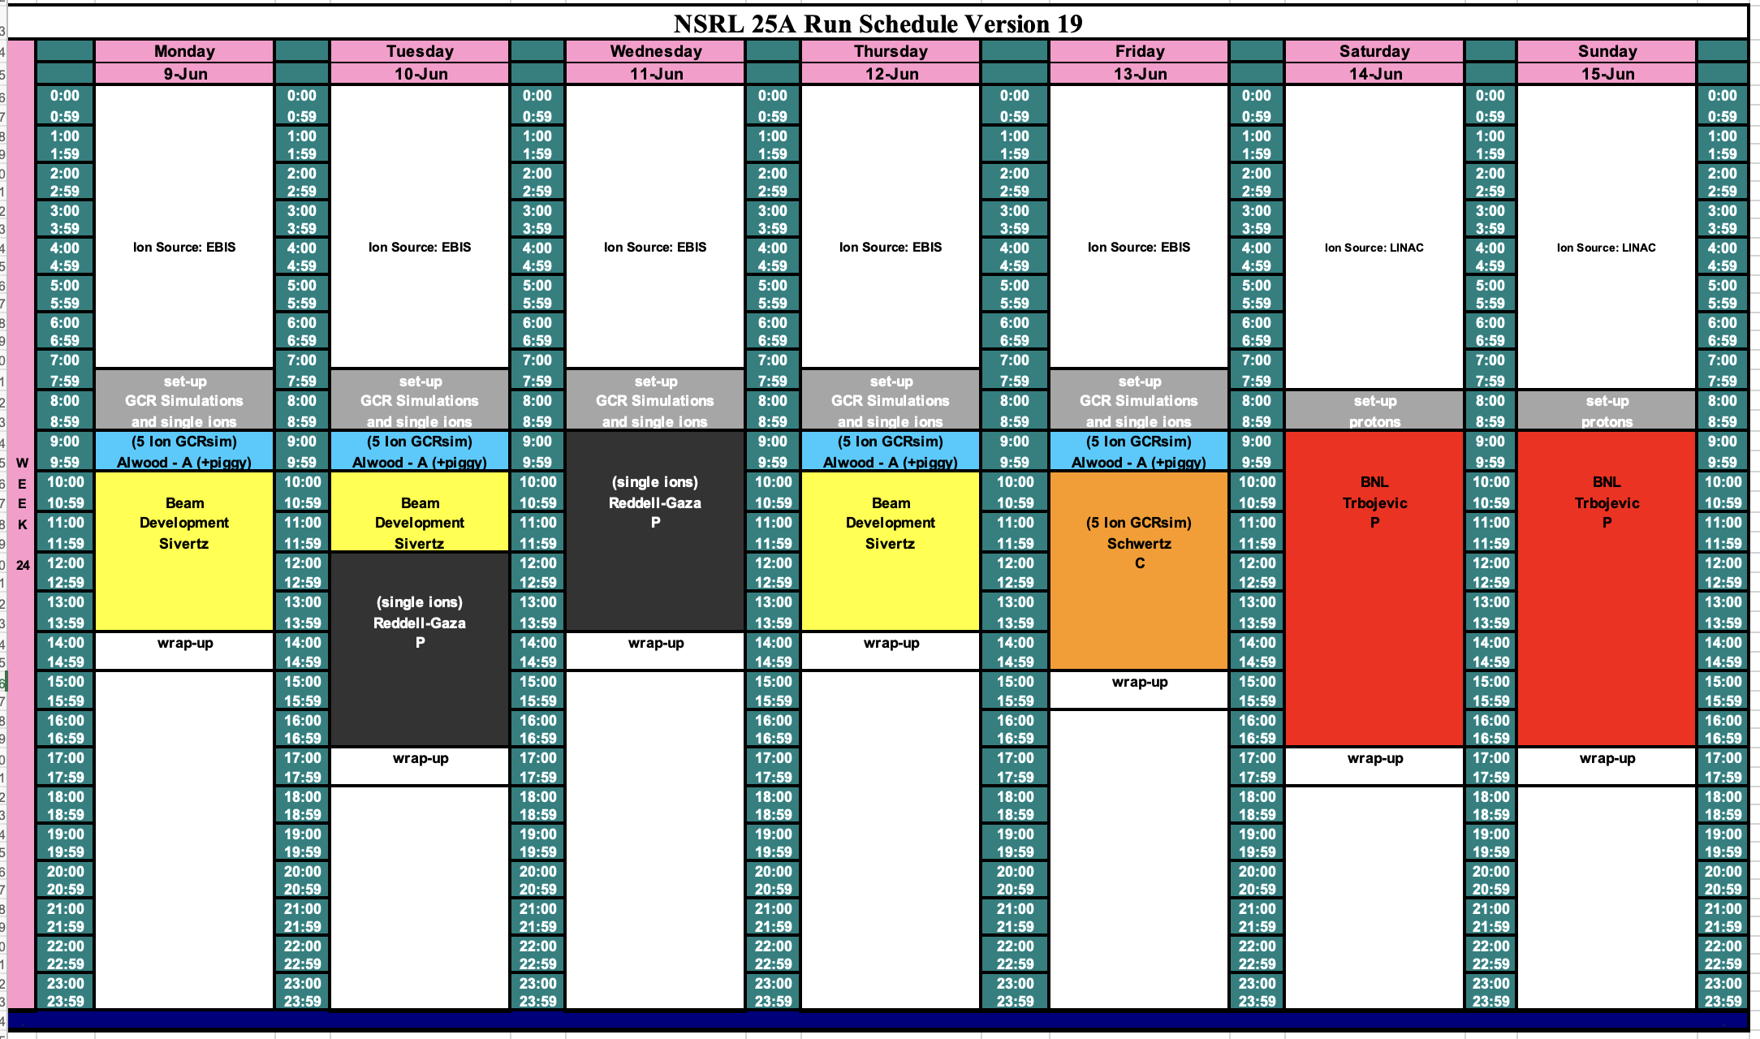
Schedule for this week

Slide 3
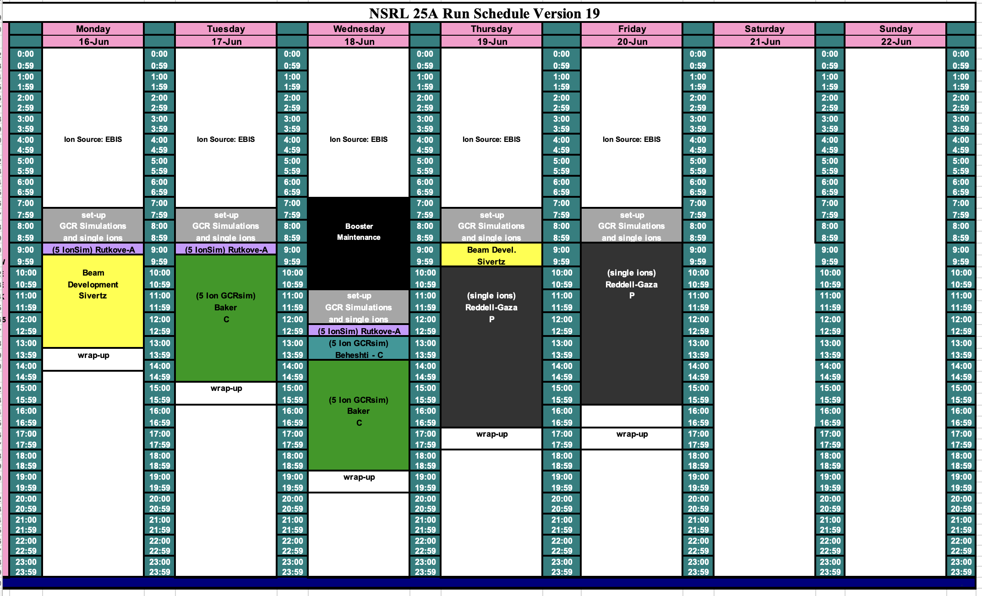
Schedule for next week

Slide 4
Future Schedule
EBIS still trying to understand tripping of the Collector Power Supply. The most recent trip took out several high current transistors. Waiting to replace these transistors delayed the animal program on Monday. We hope to recoup the Monday work by doubling up the exposures today. This may push the physics program late into the evening tonight. Hopefully the changes to the Collector PS trip circuit will lead to smoother running in the future.
Added two days of low energy proton beams for Dejan this weekend. There is still a lot of support work required to get this experiment ready. We may have to delay this weekend’s work until the following weekend.
NSRL is pushing to get final DOE approval to do a test using a uranium puck as a kick-starter for a reactor in space. It requires high energy protons, so it must be approved before the LINAC shuts off on 27 June.

