Slide 1
Data courtesy C. Naylor

Slide 2
Data courtesy C. Naylor

Slide 4
Data courtesy C. Naylor

Slide 5
Data courtesy C. Naylor

Slide 6
Data courtesy C. Naylor

Slide 7
Data courtesy C. Naylor

Slide 8
Data courtesy C. Naylor

Slide 9
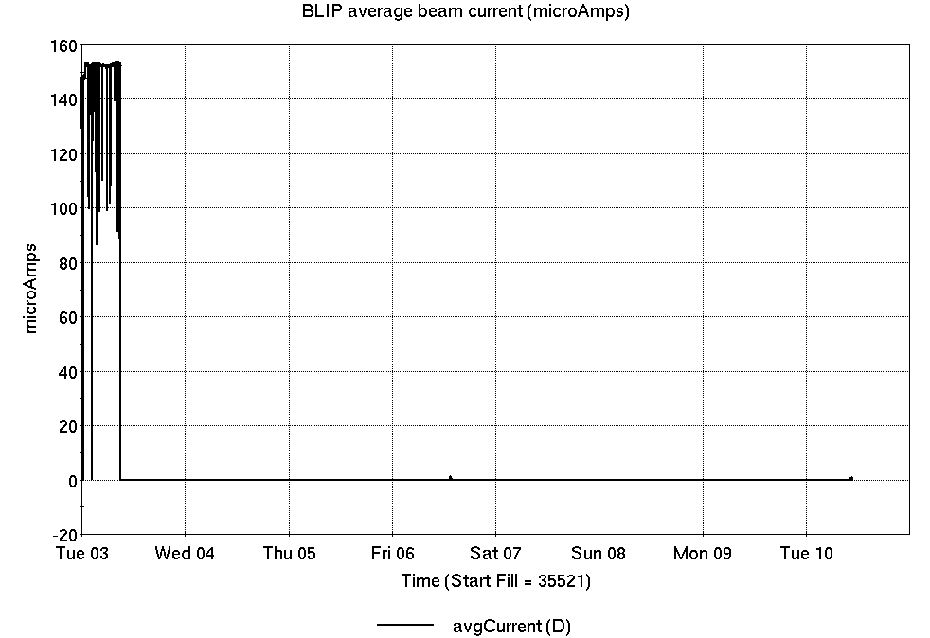
Operations for BLIP
6/3-10/2025:
200 MeV production concluded early Tuesday;
66 MeV setup on Friday.
1.02 hr production
0.32 hr setup
no failures
Availability: 100%
No BLIP
this past week
Notes:
BLIP plot from LogView /MCR/PerformanceStats/timeMeetingBLIP.lvdisp
Avail calc on nsrl time Excel sheet

Slide 10
NSRL activity past week: 6/3-10/2025 (as of 0800)
NSRL running continues. NASA biology in GCR mode, with some other user time and beam development for upcoming schedule.
No Tandem ions; Linac protons, 8 EBIS ions (He, O, Si, Fe, Nb, Ag, Ta, Bi) delivered to NSRL.
Running 25-A schedule since 3 February. Schedule posted, updates to 27 June for beams & users. 25-C schedule yet to be published for July-September.
Availability: 57.3%
Notes:
Graph and avail calc from nsrl time.xlsx

Slide 11
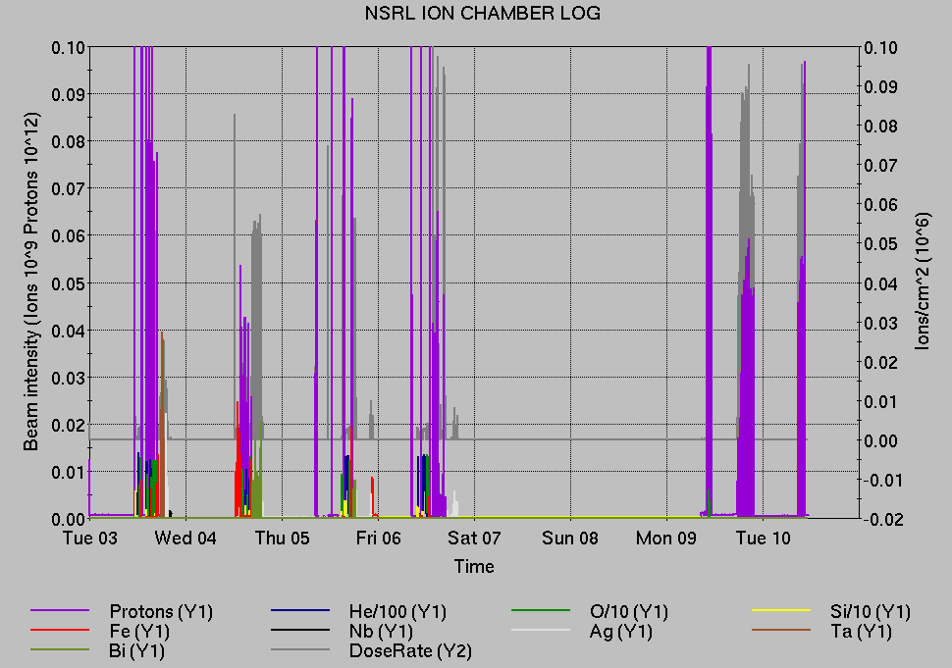
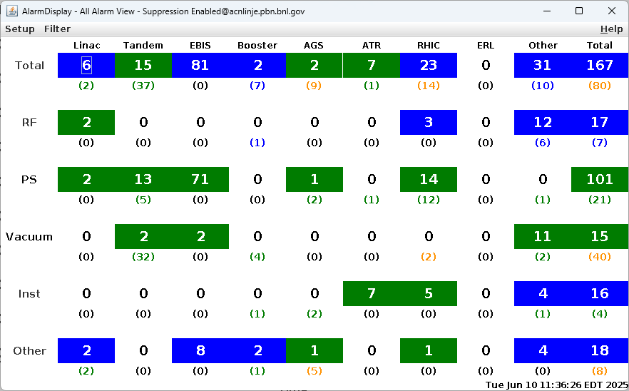
Notes from Operations
Notable failures (>1 hr)
EBIS Collector PS failures, ongoing
Booster C7 injection kicker PS failure, resistor
and regulator board replaced
NSRL vacuum valve failure, compressor air
restored
Booster MMPS trips (4x) ground fault indicators
Linac OPPIS source intensity low, grid reset
Additional PS work in Blue, Yellow after
initial setup/testing/hysteresis
Controls failure, cfe-4b-rtdl reset and recovery
Blue QLI at park (2x), Main Quad PS
regulator reset, dsp card replaced
yo5-qgt PS polarity failure, wiring repaired
YA1 RF failure, access to recover QEI
YA2 RF failure, cavity tuner issues
Yellow QLI; dmain PS failure at flattop, gate
drive board replaced
Yellow qtrim PS error, regulator card replaced
Other notes
Some corrector PS failures, access/repairs deferred
Various Tandem tuning, access, foil changes
Over 18 hours injector pp setup, other studies
(when injector systems are available)
Notes:
NSRL plot from LogView /MCR/PerformanceStats/timeMeetingNSRL.lvdisp, select Dose Rate and ion species in use
Screenshot of AlarmSummary

Slide 12
Reminder from Operations
MCR beam operations continue
  Operator/OC shifts continue for NSRL biology, 2 shifts/7 days this week.
    No ions from Tandem; Linac protons as required; Ion beams from EBIS pending repair.
  BLIP production continues 10-11 June; resumes 16 June.
  RHIC experiment setup with beam continues; additional system startups, beam tuning, luminosity ramp-up pending
    Tandem continues to provide Au31 for RHIC
  AGS Polarized proton setup, other studies continue behind stores
  MCR on duty 24/7.
Changes? Time to update is now. Expect calls at all hours.
  Alarm response instructions: Groups prompted for updates
  http://directory.pbn.bnl.gov/
    CHECK AND EDIT YOUR OWN CONTACT INFO
  https://www.cadops.bnl.gov/Operations/personnel/call_in_lists/
    CHECK YOUR CALLIN LIST: expect contact off-hours

Slide 13
Keytree notes
Remote keytree systems require a database lookup to validate and authorize distribution of keytokens. The Keytrak system’s database is available for lookup functionality, but can no longer be modified in any way to add or edit qualified personnel.
Personnel affected:
New employees, experimenters arriving after 12/1/2024 could not be enrolled in database
Existing employees & experimenters, not already enrolled, cannot be added or modified in database
Remote keytrees affected:
Iris scan @NSRL
BNLID scan @AGS South gate, North Conjunction Gate
Iris scan @RHIC STAR, sPHENIX, IP12, IP4
Keytrees NOT affected:
BNLID scan @Linac, Booster
BNLID scan @RHIC IP2
MCR keytrees

Slide 14
Keytree notes, continued
Mitigation:
Choose entrants that are currently enrolled to perform the work in the enclosure under Controlled Access (CA).
Obtain CA keys from MCR for remote gate watch
Arrange for local gate watch using other tokens for entrants.
Arrange for Restricted Access, and allow for delays incurred to sweep areas.
CAUTION
Follow procedures. Gate Watch staff will remain vigilant.
  No “piggy-backing” – one key/token per entrant.
  Access keys are not candy! Authenticated entrant retains possession.
Radiological Controls and the Access Controls System are not to be circumvented. This is (has been) enforced with disciplinary action (dismissal).

Slide 16
Notes:
Reliability comparisons to previous runs

Slide 17
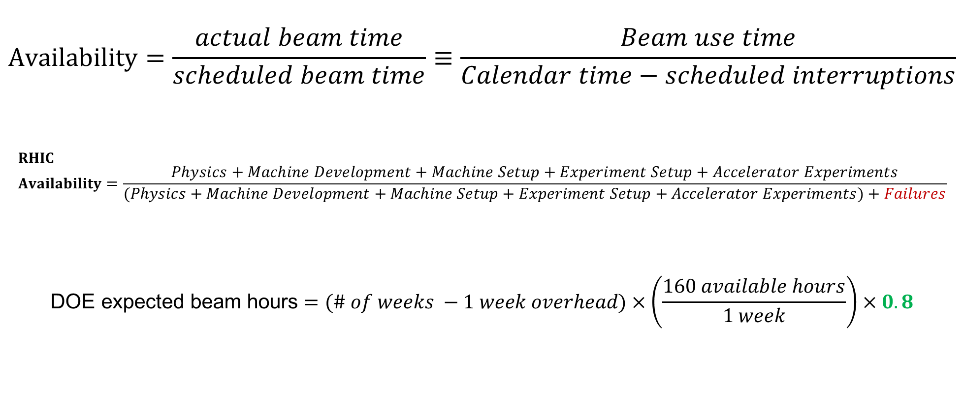
Availability, expected beam hours
$$Availability=\frac{actual beam time}{scheduled beam time}≡\frac{Beam use time}{Calendar time−scheduled interruptions}$$
$$RHIC \\ Availability=\frac{Physics+Machine Development+Machine Setup+Experiment Setup+Accelerator Experiments}{(Physics+Machine Development+Machine Setup+Experiment Setup+Accelerator Experiments)+Failures}$$
$$\text{DOE} \text{expected} \text{beam} \text{hours}=(\# of weeks −1 week overhead)×\left(\frac{160 available hours}{1 week}\right)×0.8$$
Notes:
Normally hidden. Explains how the 85% from DOE comes in to play, & general availability metrics

