Slide 1
Preinjector Status
D. Raparia
Time Meeting
June 17, 2025

Slide 2
Tandem
MP7 is currently providing ions for RHIC setup
MP6 providing ions for external users
Object foil for the MP7 was changed on Friday
Masahiro’s Li beam experiment conducted on 6/13
External users on 6/17 and 6/21

Slide 3
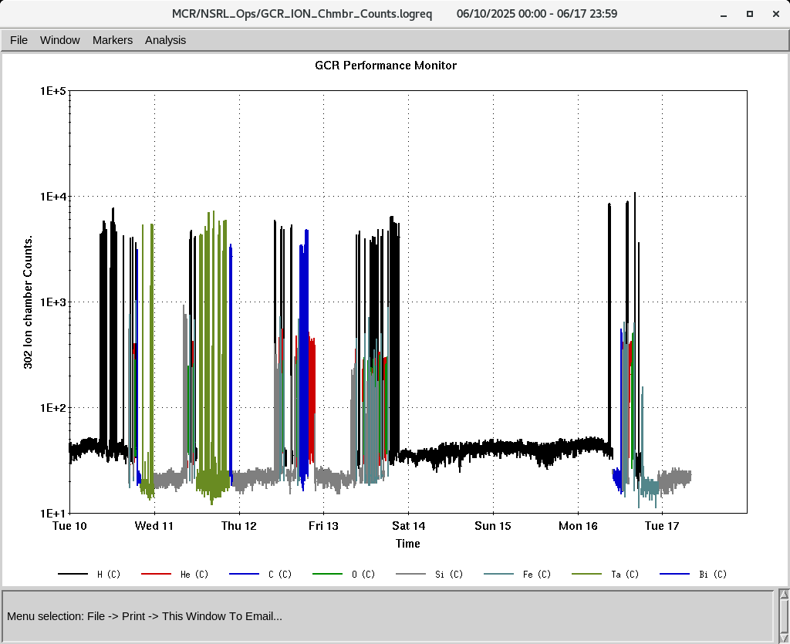
EBIS
All required beams for GCR is are being used
Required heavy ions were also used by NSRL
Collector Power Supply tripping frequency has been decreased last week.
DT 19 Trek was replaced yesterday
C ions were developed yesterday , will try develop Ne and Ar this week
IONS to NSRL
H, He⁺², C⁺⁵, O⁺⁷,Si⁺¹¹,Fe⁺²⁰, Ta⁺³⁸, Bi⁺⁴⁷

Slide 4
Linac, providing beam to NSRL, AGS, 200 MeV Polarimeter
BLIP 66 MeV Ti foil irradiation complied on 6/11
BLIP 200 MeV , 150 uA, Th irradiation started yesterday
6/16: tube 7835 was changed in Mod 3, delayed start of BLIP and NSRL (4 HRS)
OPPIS is successfully delivering beam to the 200 MeV line, Polarimeter Booster, and NSRL.
BLIP requesting two more irradiation on 27th
Ni-Au , 117 MeV, 100 uA, 60 sec
Thallium (Tl) , 66 MeV, 1 uA, 4 hours

