Slide 1
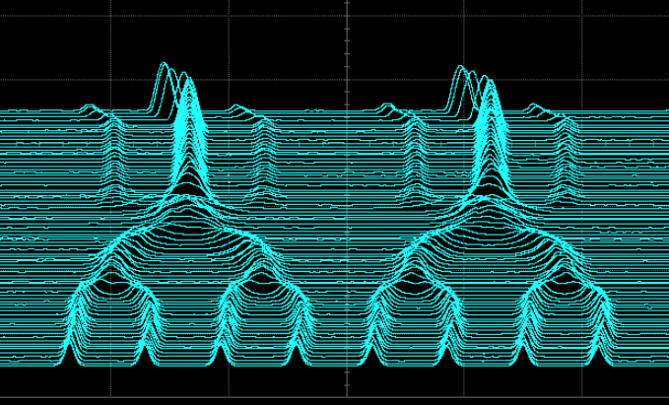
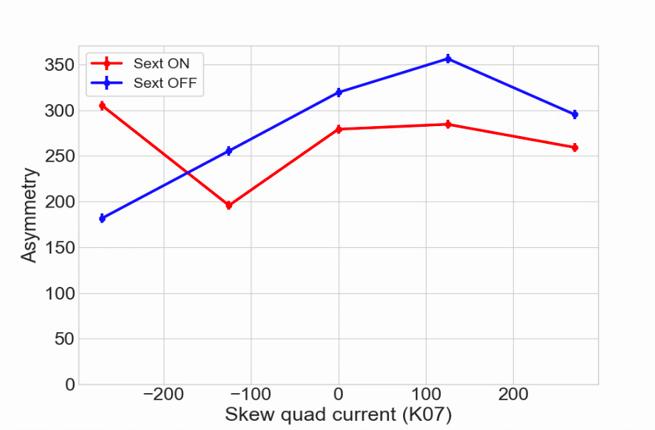
AGS Status: Time meeting 6/17/25
Additional merge added to the Au cycle
  Up to 3x10⁹ / bunch available for a full merge
  Currently mistuning the merge to leave ~20% outside the main bucket (‘baby bunches’).
  Plan to develop a scheme to optimize extraction emittance by adjusting both chopper and merge parameters
  Does require downstream adjustments in RHIC to handle longer bunches and filling time
This configuration provides more than is needed for per bunch intensity required for RHIC Run 25.
AGS Bunch Merges
Polarized Proton studies
Skew quad scan
Slower pace due to RHIC setup, some work interleaved as available
Some interest results showing chromm sextupoles strongly affect the correction
Discussing possibility of 1-2 wk extension for polarized proton beam beyond the Jun 27th nominal Linac shutdown date (to be decided by later in the week

